Slide 1
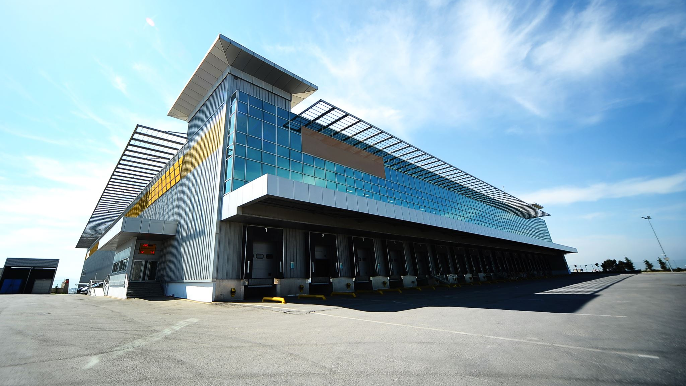
Super Smart Airport: iBeacon
Conceptual Deck

Slide 2

Agenda
What is iBeacon Technology?
Typical Applications & Use Cases
Passenger Users
Airport Staff Users
Architecture & Integration
Security & Access Control

Slide 3

What is iBeacon?
Proximity-based technology: receives a smartphone signal and sends a specific message back
Wireless devices send low-power Bluetooth (BLE) signals to nearby mobile devices
Device connects to a mobile app on a smartphone and triggers actions/events based on location & context

Slide 4
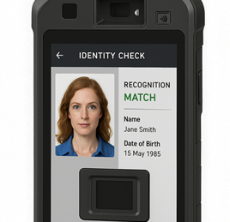
Introduction to Biometric Handheld Devices
Purpose: Mobile identity & document verification
Applications: Passenger screening, staff access, watchlist alerts
Thales-based multi-modal biometric tech

Slide 5
Device Technical Overview
IP65 rugged body, 5.5" screen, 10+ hrs battery
Facial recognition (IR+Liveness), Fingerprint, MRZ & RFID readers
AES-256, TPM 2.0, secure boot, SELinux/Android AOSP

Slide 6
Offline Operation & Secure Connectivity
No public internet/ISP dependency
Secure Wi-Fi (WPA3), mesh networking (LoRa/UWB)
MQTT/ZeroMQ for alerts & logging; LAN sync

Slide 7
Edge AI Processing
Snapdragon or NVIDIA Jetson for on-device inference
Local biometric match – no cloud delay
Private, real-time decision-making

Slide 8
Sample Use Case Workflow
Scan passport (MRZ/RFID)
Facial match verified locally
Log event via airport Wi-Fi
Trigger alert if on watchlist

Slide 9
Security & Compliance
Compliant with FIPS 140-2, GDPR, ICAO, FBI PIV
Zero Trust model, encrypted local data
OTA updates via airport LAN only

Slide 10
Integration Points
Passenger Manifest System
Border & Visa Databases (INTERPOL)
Airport Access Control
CCTV system for face tagging

Slide 11
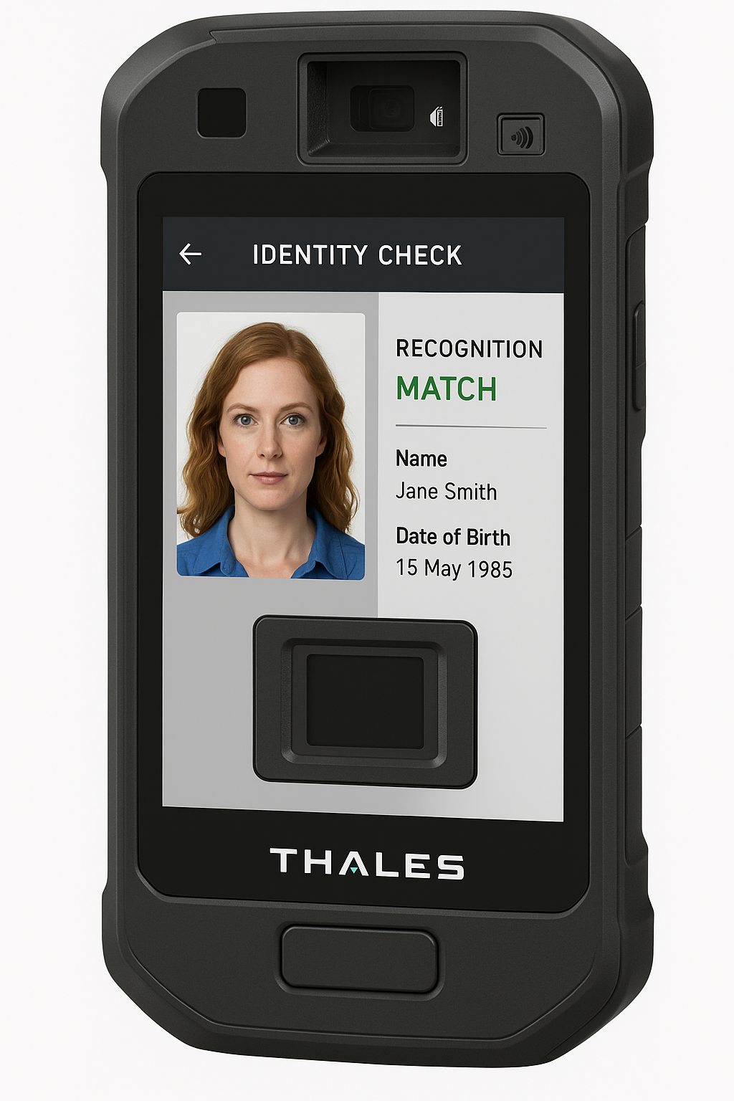
Introduction to Biometric Handheld Devices
Purpose: Mobile identity & document verification
Applications: Passenger screening, staff access, watchlist alerts
Thales-based multi-modal biometric tech

Slide 12
Device Technical Overview
IP65 rugged body, 5.5" screen, 10+ hrs battery
Facial recognition (IR+Liveness), Fingerprint, MRZ & RFID readers
AES-256, TPM 2.0, secure boot, SELinux/Android AOSP

Slide 13
Offline Operation & Secure Connectivity
No public internet/ISP dependency
Secure Wi-Fi (WPA3), mesh networking (LoRa/UWB)
MQTT/ZeroMQ for alerts & logging; LAN sync

Slide 14
Edge AI Processing
Snapdragon or NVIDIA Jetson for on-device inference
Local biometric match – no cloud delay
Private, real-time decision-making

Slide 15
Sample Use Case Workflow
Scan passport (MRZ/RFID)
Facial match verified locally
Log event via airport Wi-Fi
Trigger alert if on watchlist

Slide 16

Passenger Use Cases
Enhance Airport Passenger Experience (APAXX)
  Better indoor navigation via airport floor plan
  Provide meaningful real time & location sensitive information: flight timings, boarding gate, baggage claim
  Measure the distance to the gate
Enhance Non Aeronautical & Ancillary Revenue
  Accurately guide passenger to Duty Free, Food & Beverage, Lounges etc within the terminal
  Generate cross sell revenue with partners via campaigns & offers

Slide 17
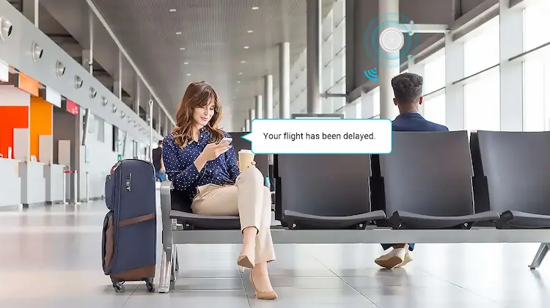
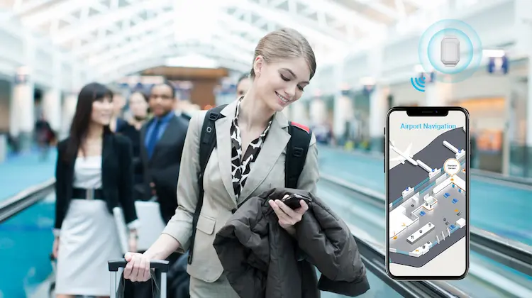
Passenger Use Cases
https://www.mokoblue.com/bluetooth-ibeacon-in-airport/

Slide 18
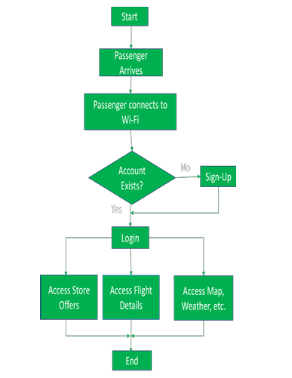
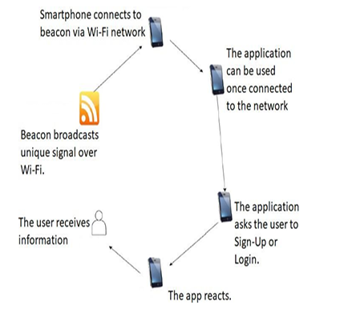
iBeacon logic

Slide 19
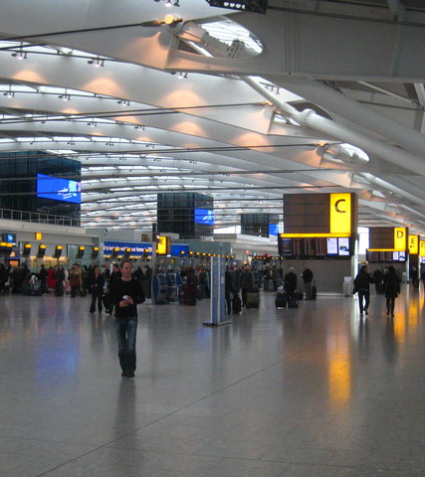
Passenger Use Cases – Case Study
      Use of iBeacons for Wayfinding & Engagement:
      Heathrow deployed iBeacons throughout Terminal 2 to provide turn-by-turn indoor navigation via their mobile app. Passengers receive real-time information about their flight, gate changes, and directions to nearby amenities like restaurants and duty-free. This led to:
        A 20% increase in mobile engagement
        An 8% uptick in non-aeronautical revenue from location-based retail promotions

Slide 20

Airport Staff Use Cases
Passenger biometric verification at gates and checkpoints-
Staff identity/authentication for airside access
Automated watchlist alerting
Offline ID validation with local sync to airport LAN
ID/passport authentication
Face recognition/matching
Weapon/explosive trace detection
Luggage tag and boarding pass verification
Real-time passenger screening or movement logging
iBeacon can pinpoint the exact location for better response eg suppose the airport staff needs backup/emergency response to deal with any situation

Slide 21
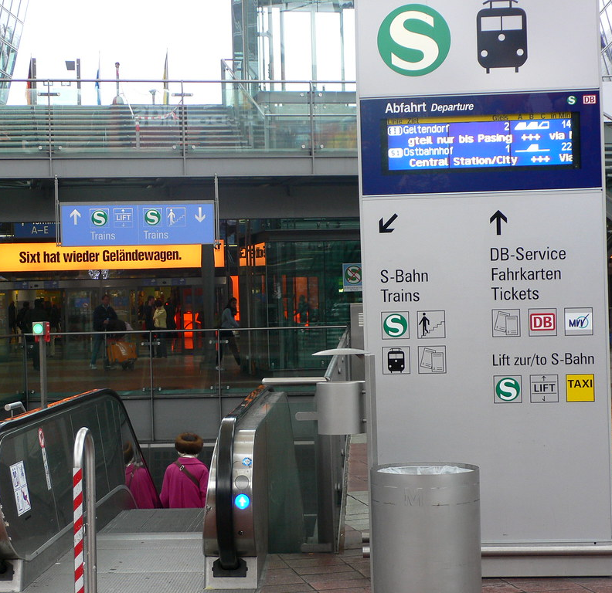
Munich Airport – Edge AI Handhelds + iBeacon Coordination
Objective: Non-disruptive mobile security checks with minimal infrastructure
40 biometric handhelds (Thales-based) with offline verification via airport WPA3 LAN
Paired with iBeacons for geo-fencing and behavioral triggers (e.g., mode switching)
On-device face match (Jetson Nano), encrypted geo-logging with timestamps
INTERPOL watchlist checks operational offline via LAN sync
This Photo by Unknown Author is licensed under CC BY

Slide 22
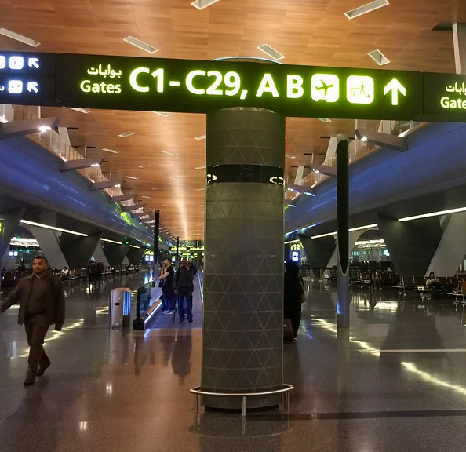
Hamad Intl. Airport – Covert Watchlist Alerting
Objective: Mobile checkpoint layer with no reliance on internet/telecom
Hardened Android AOSP devices with SELinux & TPM-secured boot
TensorFlow Lite facial recognition with occlusion handling (masks/glasses)
iBeacon triggers context-aware behavior; alerts via ZeroMQ broadcast
Watchlist alerts encrypted and synced only through physical LAN cradle
This Photo by Unknown Author is licensed under CC BY-NC-ND

Slide 23
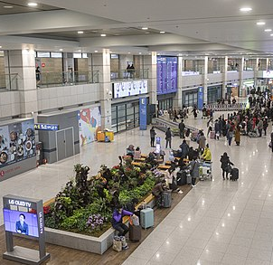
Incheon Intl. – Tiered Access with BLE + Biometrics
Objective: Dynamic access control for multi-role staff in secure zones
Combines BLE iBeacons, RFID badges, and biometric face verification
Local access matrix determines zone-based clearance in real-time
Unauthorized attempts trigger silent alert and badge lockout
Zero-trust logs ingested for forensic auditing; TLS + TPM-secured sessions
This Photo by Unknown Author is licensed under CC BY-SA

Slide 24
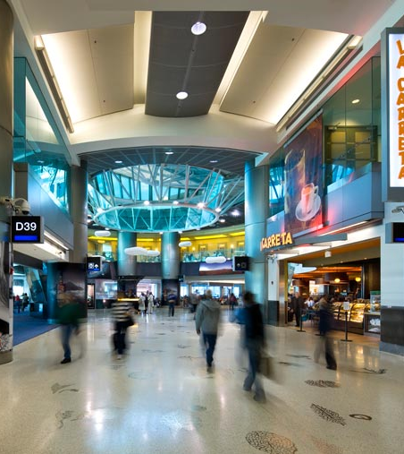
Miami International Airport, USA
  Operational Efficiency with iBeacons:
  Miami International implemented iBeacons for tracking airport staff in real time. This enabled:
    Faster response to emergencies by dispatching nearby personnel
    Improved security access monitoring for restricted zones
    Real-time updates on staff presence and task status
This Photo by Unknown Author is licensed under CC BY-NC-ND

Slide 25
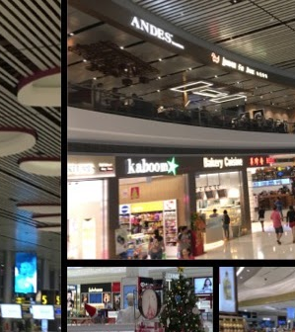
Changi Airport, Singapore
Integrated iBeacon Security Layer:
Changi uses BLE/iBeacon tech to complement biometric access and ID/passport verification. Staff devices sync securely over the local LAN (air-gapped from the passenger network). Features include:
Offline ID validation when disconnected from central servers
Geo-fenced alerts for unauthorized staff movement
iBeacons integrated with facial recognition and explosives trace detection for rapid threat assessment
Changi Airport pilot with 50 handheld units
Faster ID checks at gates & baggage areas
30% faster verification, enhanced zone flexibility
This Photo by Unknown Author is licensed under CC BY-NC-ND

Slide 26
Security & Compliance
Compliant with FIPS 140-2, GDPR, ICAO, FBI PIV
Zero Trust model, encrypted local data
OTA updates via airport LAN only

Slide 27
Integration Points
Passenger Manifest System
Border & Visa Databases (INTERPOL)
Airport Access Control
CCTV system for face tagging

Slide 28
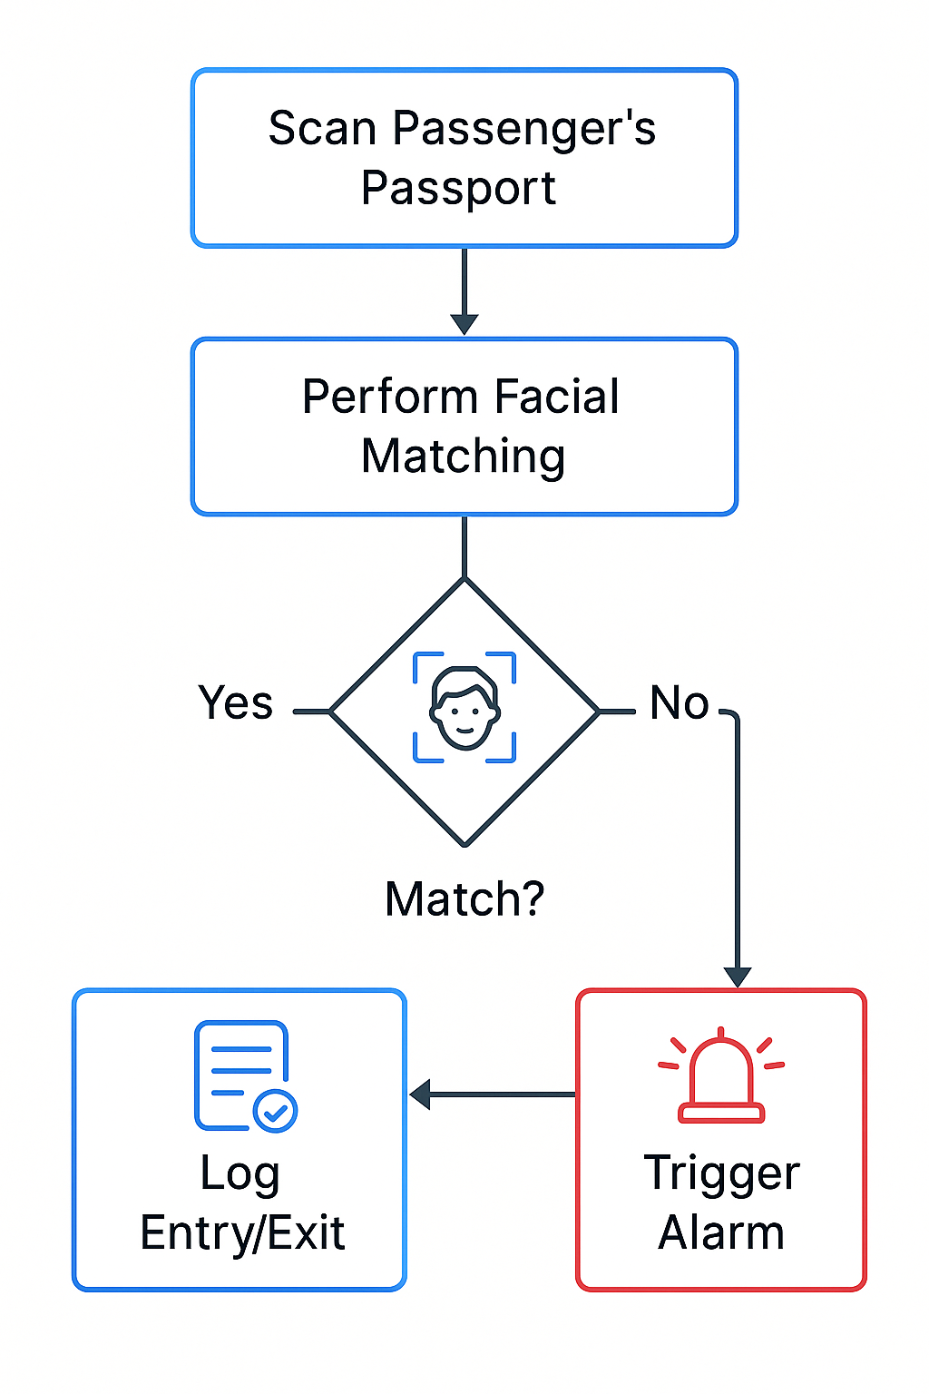
Case Study: Smart Mobile Screening (Concept)
Changi Airport pilot with 50 handheld units
Faster ID checks at gates & baggage areas
30% faster verification, enhanced zone flexibility

Slide 29
Security & Access control
Air gap between passenger app & airport staff app
Both apps leverage the location data from iBeacon but are otherwise separate

