Slide 1




Kenya Comprehensive Border Control & Technology Investment Initiative
A Focus on Deterrence
December 2025
Strategic Defense Proposal

Slide 2

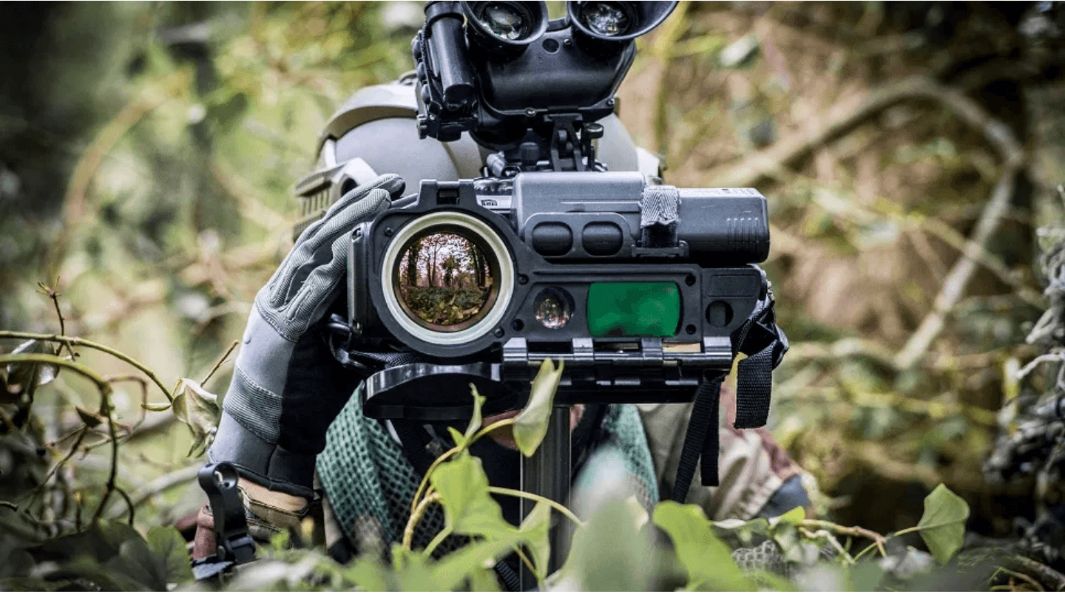
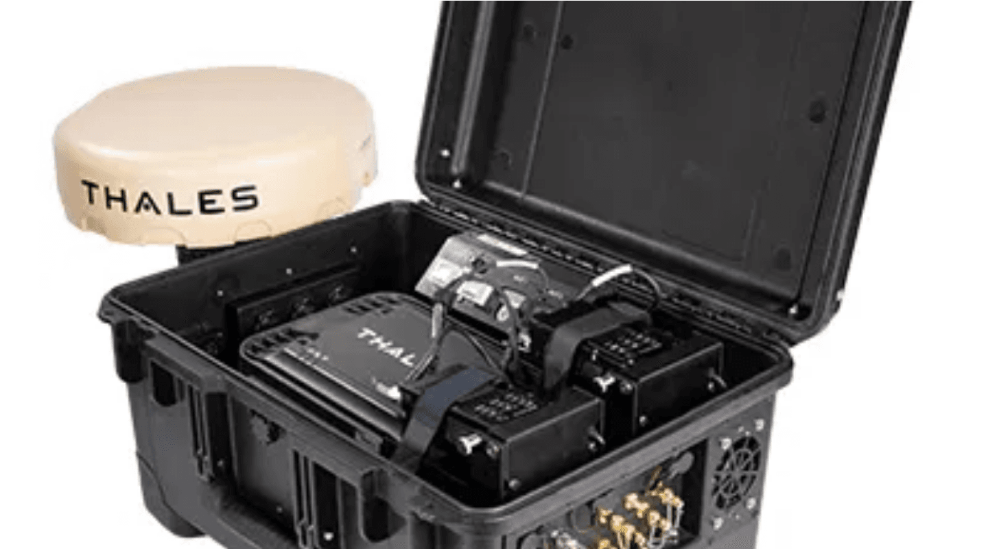

The Case for Modernization
Manual processes limit potential. Modernization establishes real-time command, deterrence, and revenue assurance.
Security & Deterrence
Travel & Technology
National Prosperity

Integrate advanced security systems for operational efficiency.

Drive investment through strategic technology partnerships.

Enable borders to become catalysts for trade and tourism.

Establish real-time command and control capabilities.

Implement automated systems for revenue assurance.

Unlock economic potential through secure environments.

Deploy visible deterrence assets to prevent threats.

Modernize infrastructure for seamless border processing.

Foster innovation and national growth.

Slide 3

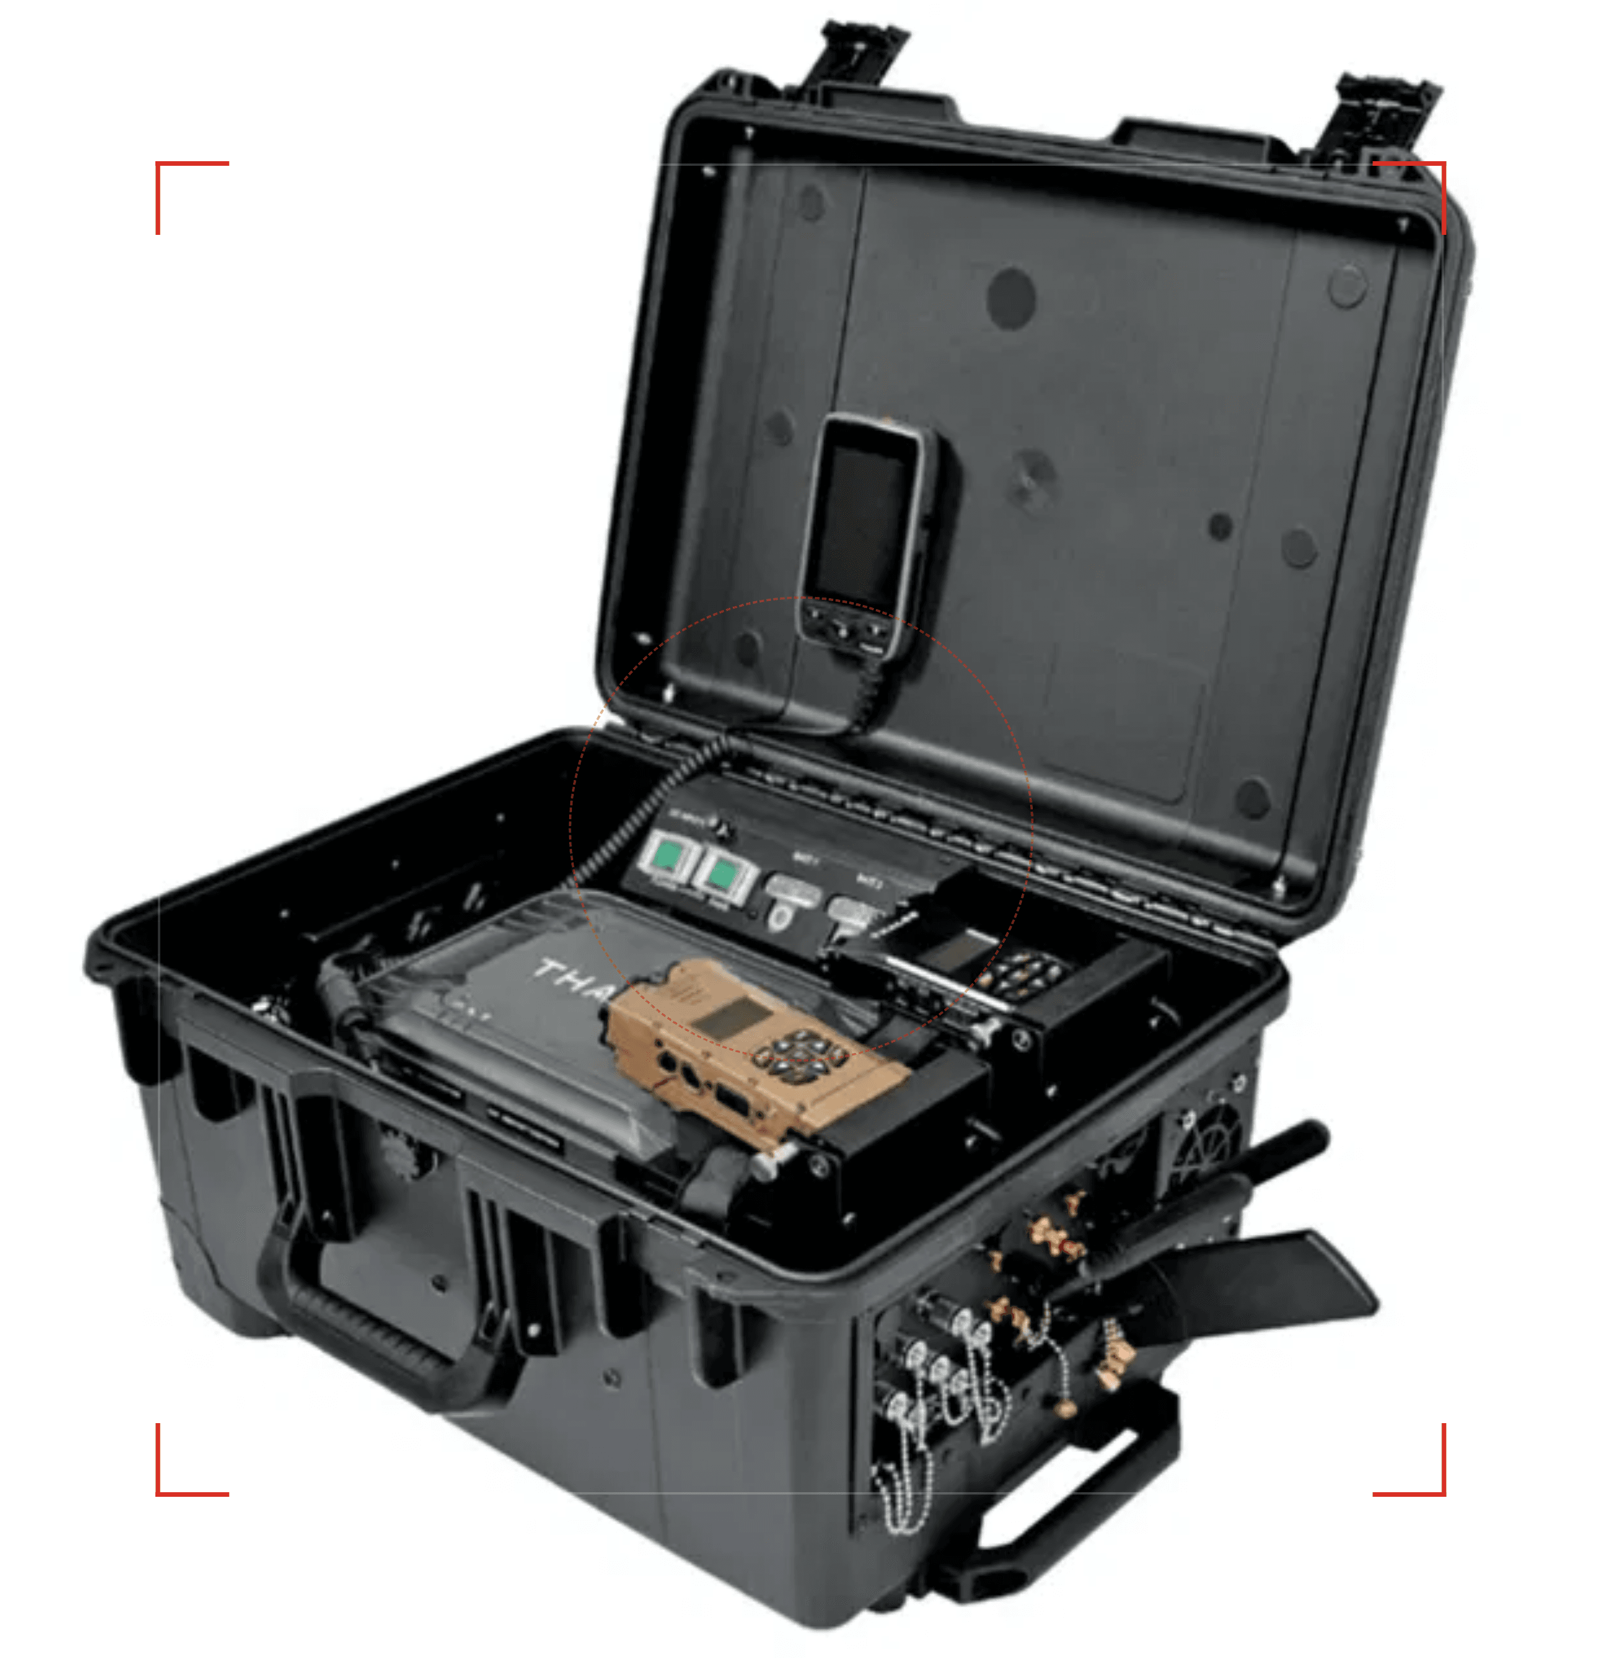



A Modern Shield
Deterrence & Response System
Proactive Surveillance
Advanced intelligence gathering to anticipate threats before they materialize.
Visible Presence
Robust physical and technological assets deployed to discourage illegal activity.
Rapid Response
Integrated command systems enabling immediate and effective reaction to incidents.

Slide 4

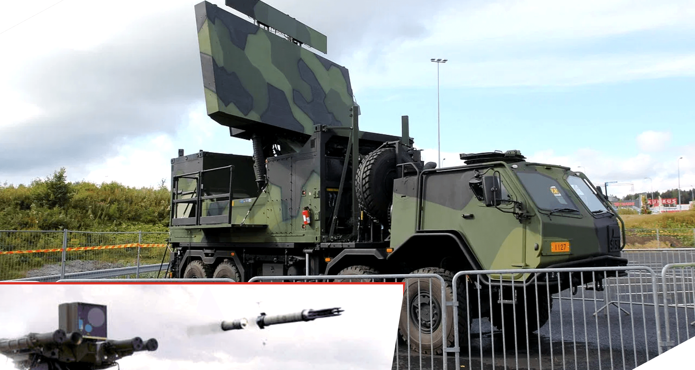


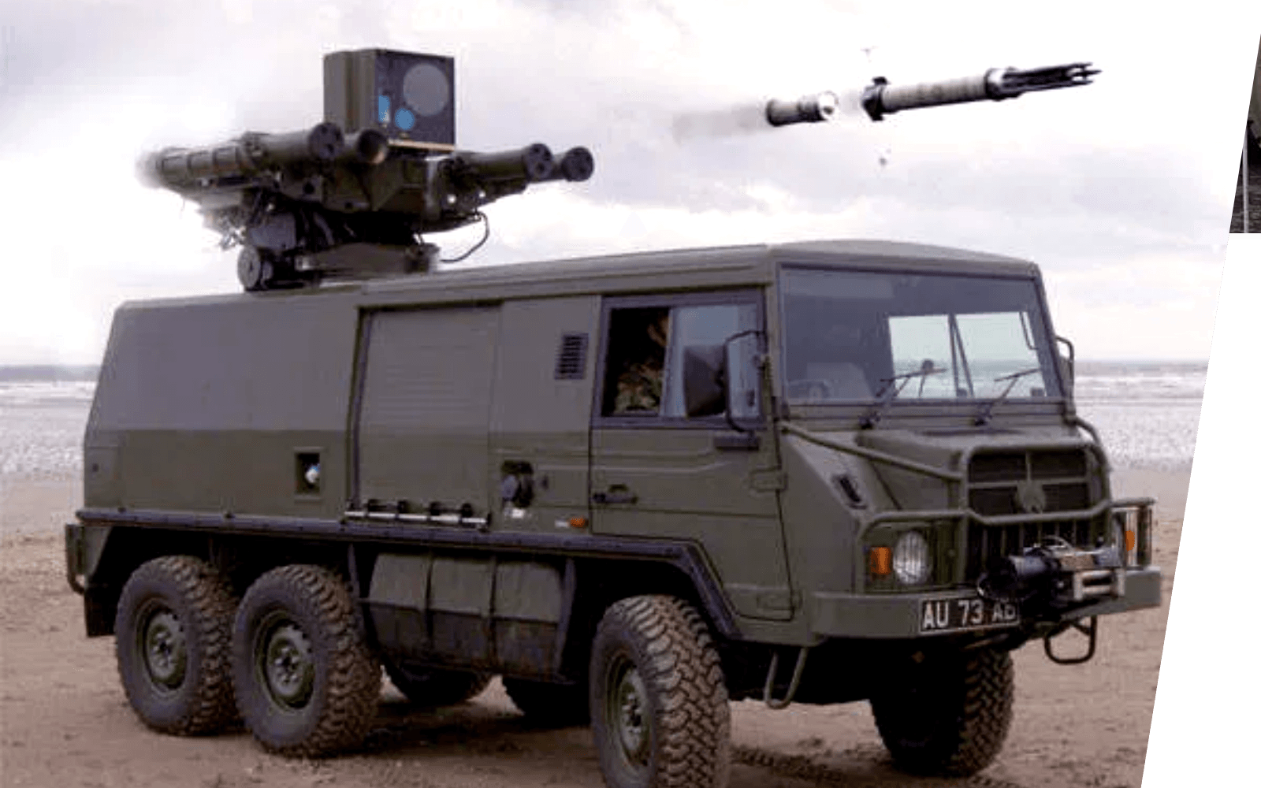

AIS: A Partner in Deterrence
Global Expertise. Local Security.
Global Defense Leader
Leveraging decades of experience in delivering mission-critical systems to armed forces worldwide.
Advanced Technology
From the Ground Master 400 Alpha radar to rapid response vehicles, providing cutting-edge deterrence capabilities.
Strategic Partnership
Committed to building a secure future for Kenya through technology transfer and long-term support.
80+
Countries Served

Slide 5

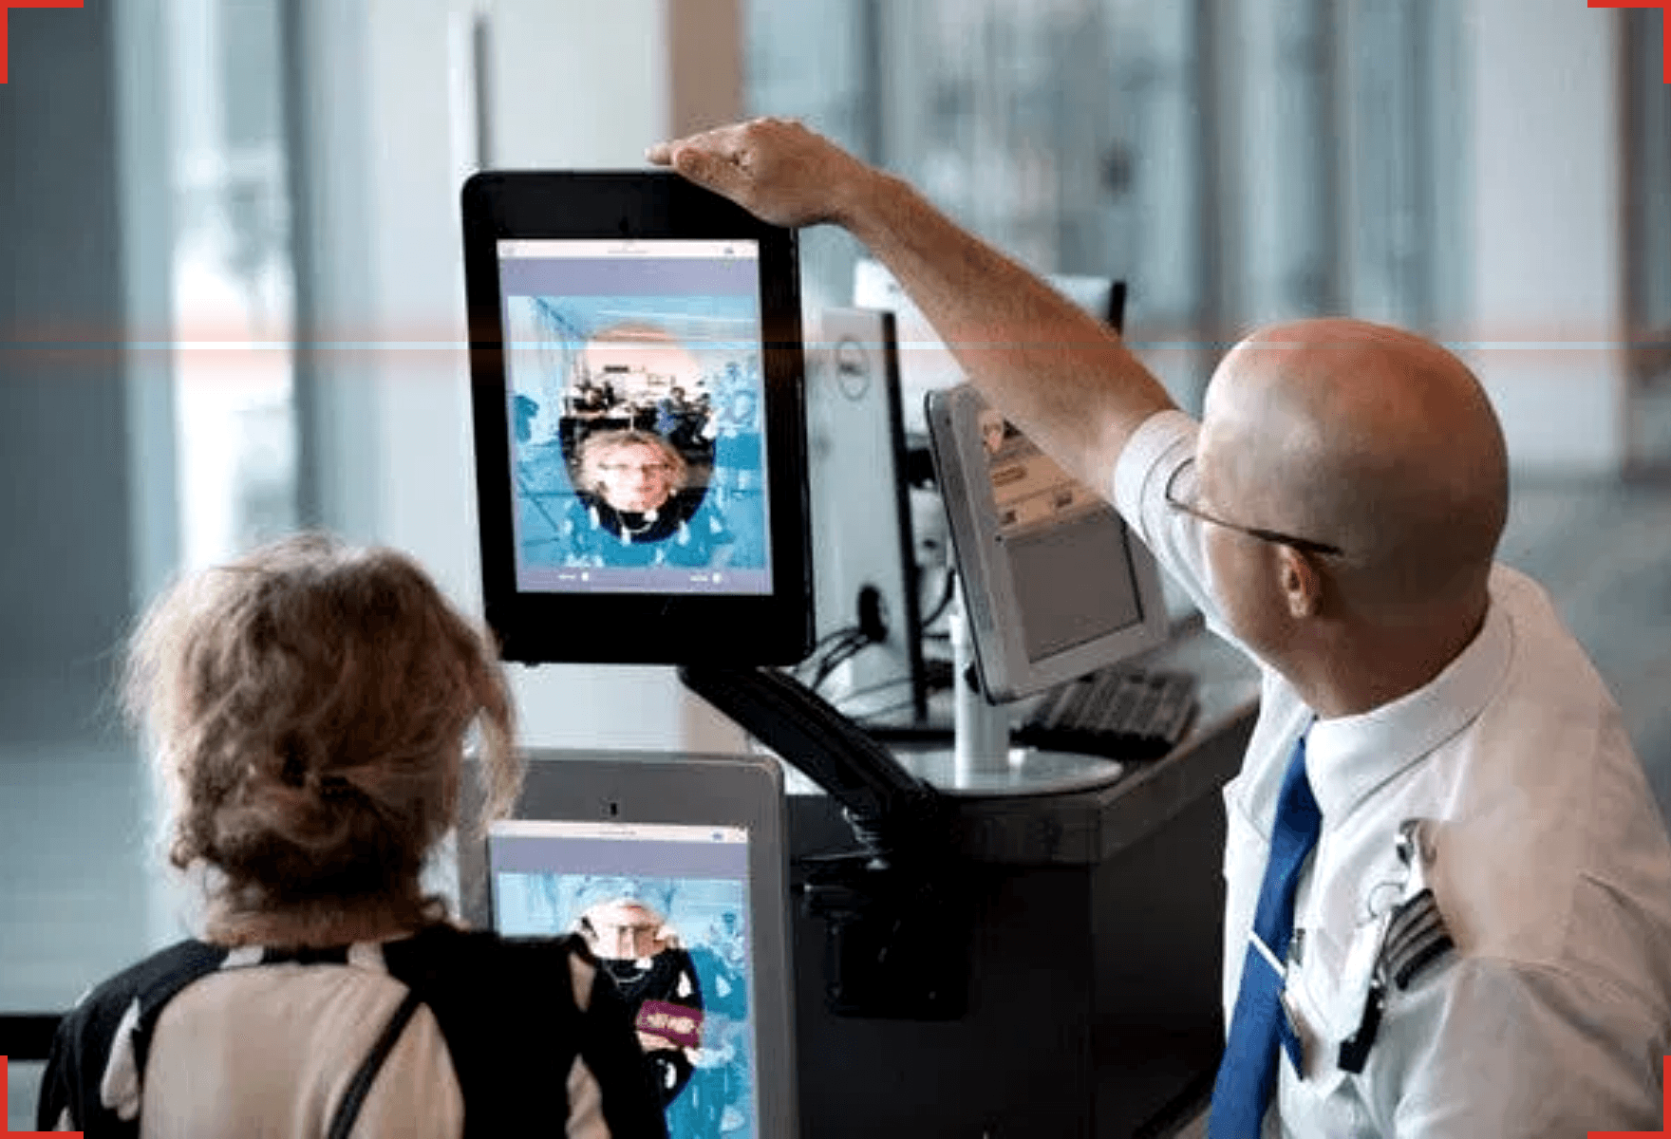
Best Practices in Border Deterrence
A Proactive Approach
01
Intelligence-led Operations
Leveraging advanced data analytics and biometrics to anticipate threats before they reach the border, shifting from reactive to proactive security.
02
Visible Presence
Strategically deploying robust physical and technological assets to create a psychological barrier that discourages illegal activity.
03
Community Engagement
Building trust and cooperation with border communities to enhance intelligence gathering and foster a shared security environment.
System Status: Active Monitoring

Slide 6

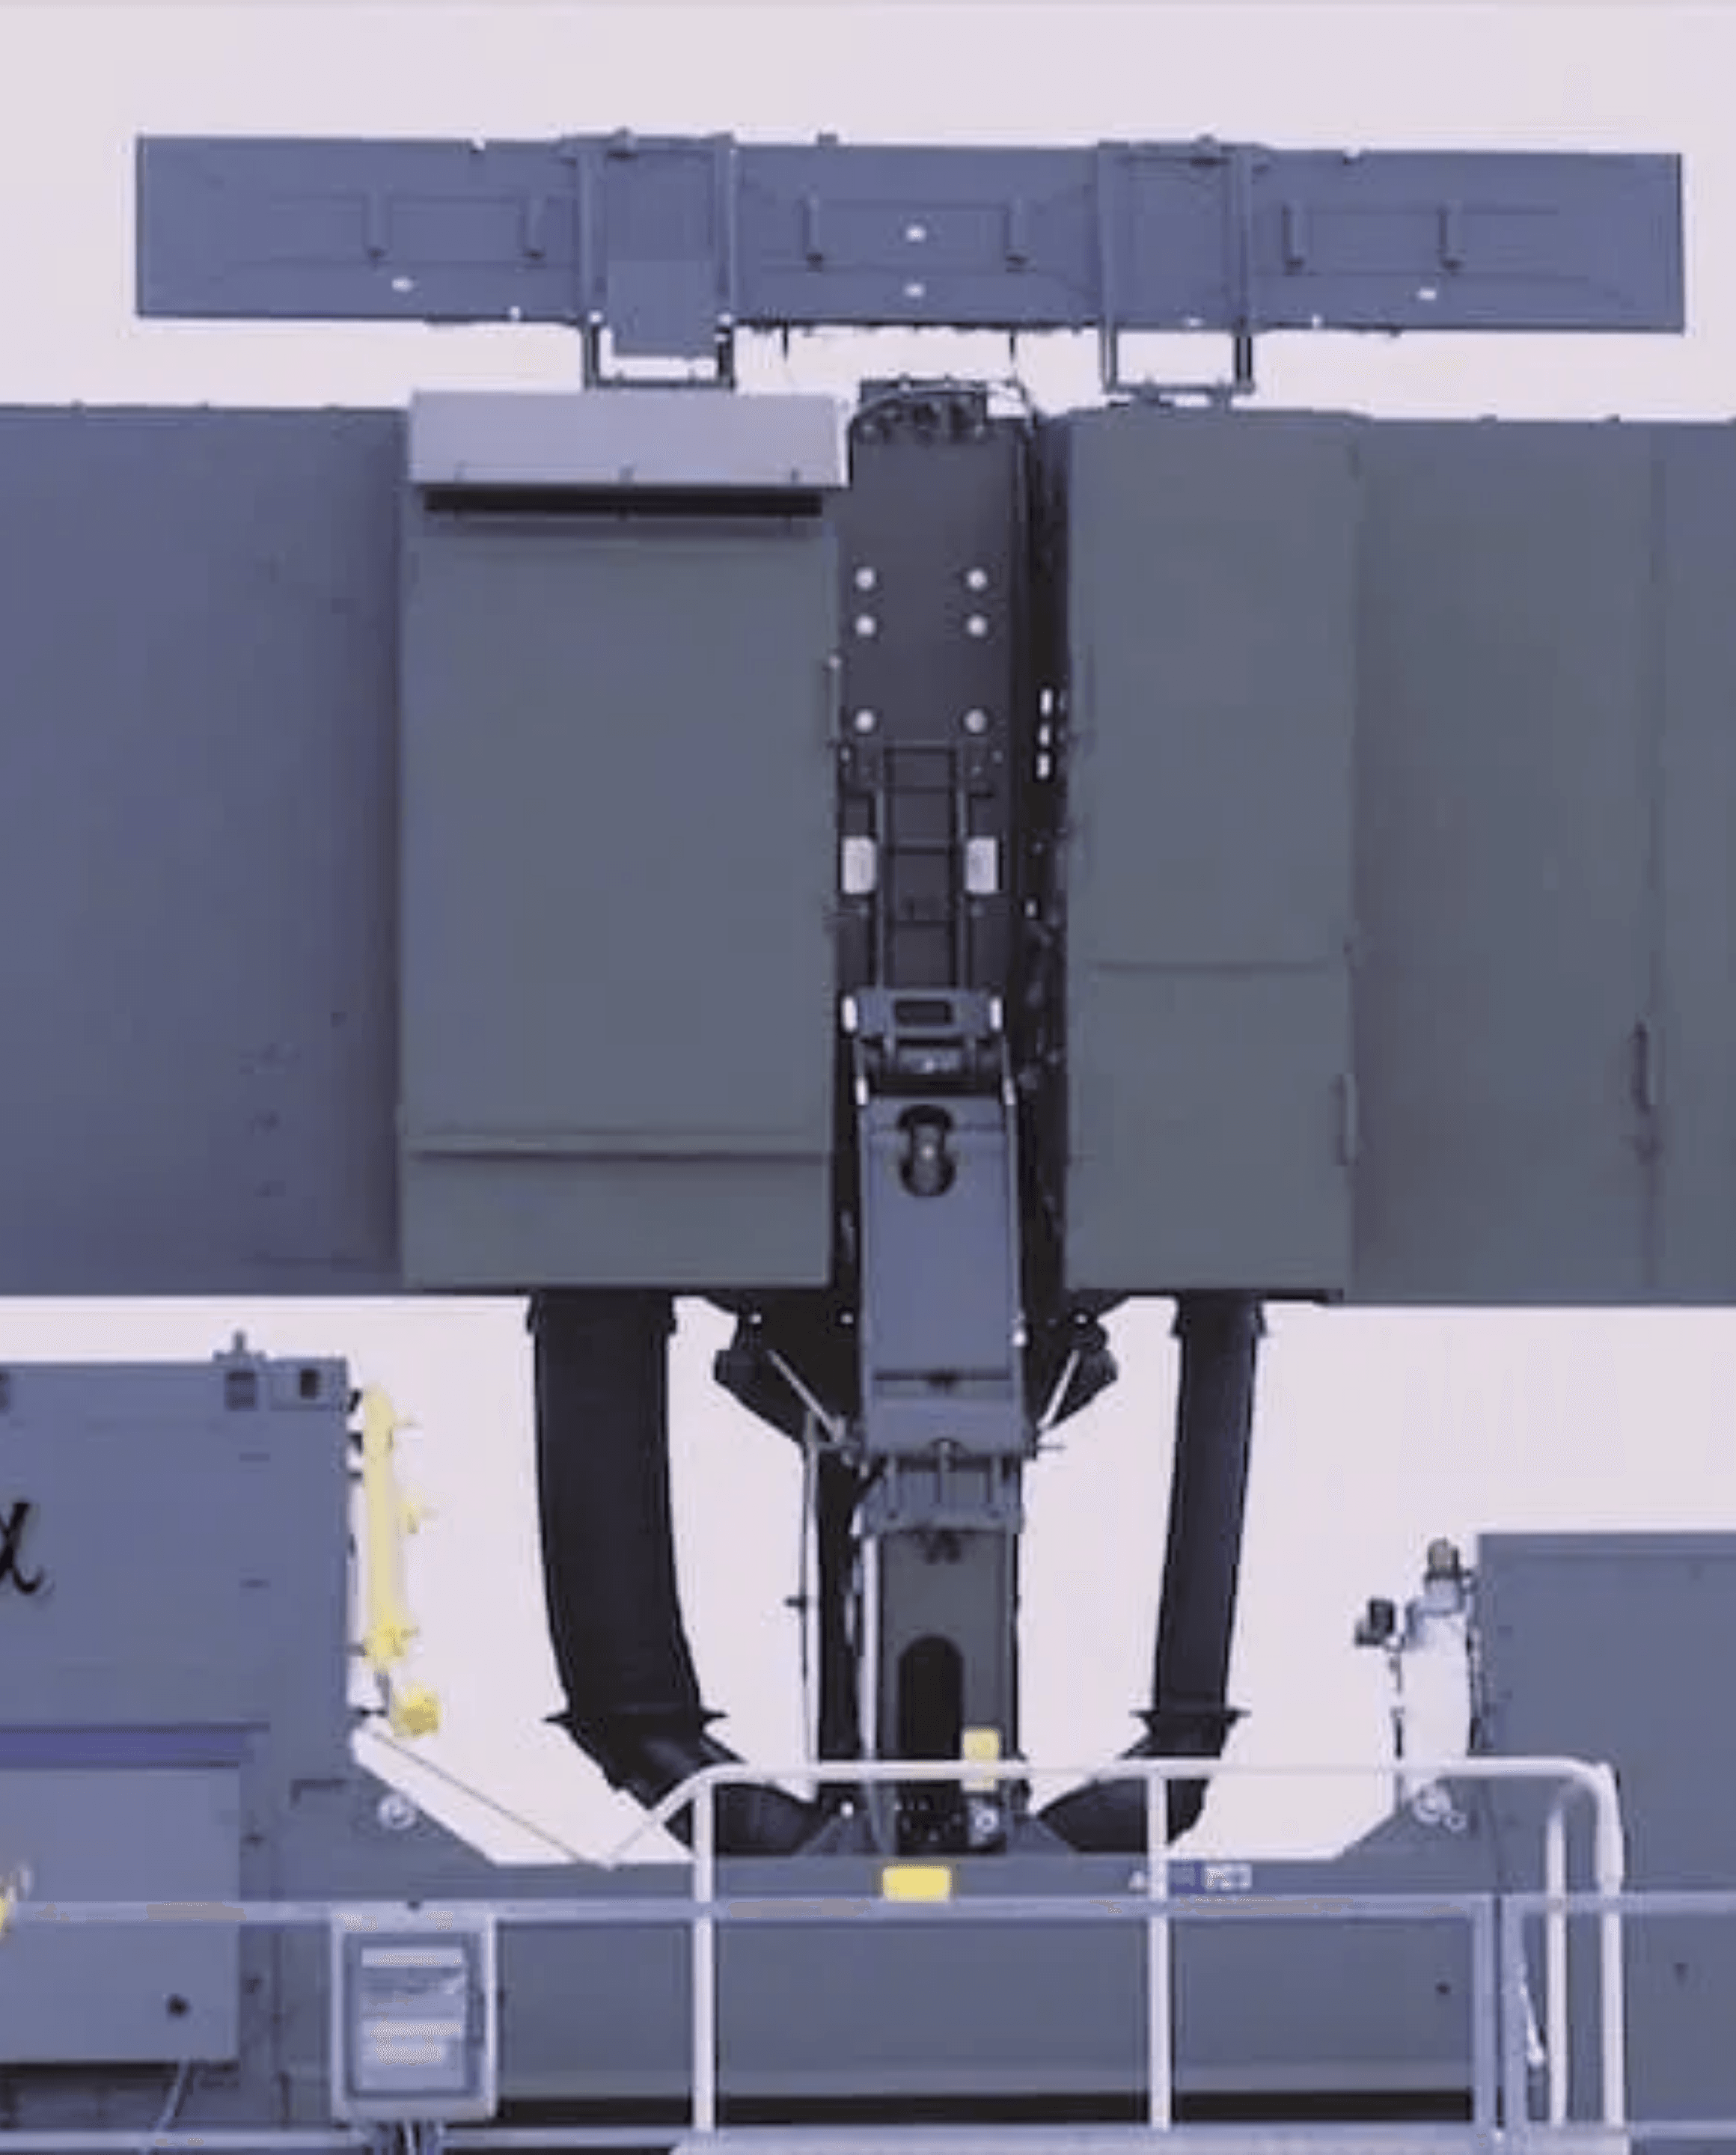



Core Technology
Surveillance &
Early Warning
Ground Master 400 Series
Long-range 3D air surveillance radars capable of detecting threats from very high to very low altitudes.
Coastal & Border Radars
Gap-filling coverage for surface and low-level threats, ensuring comprehensive perimeter security.
Satellite Surveillance
Strategic partnership with Telespazio for space-based monitoring and wide-area intelligence.
SYSTEM: GROUND MASTER 400 ALPHA
RANGE: 515KM
TYPE: 3D LONG-RANGE RADAR

Slide 7

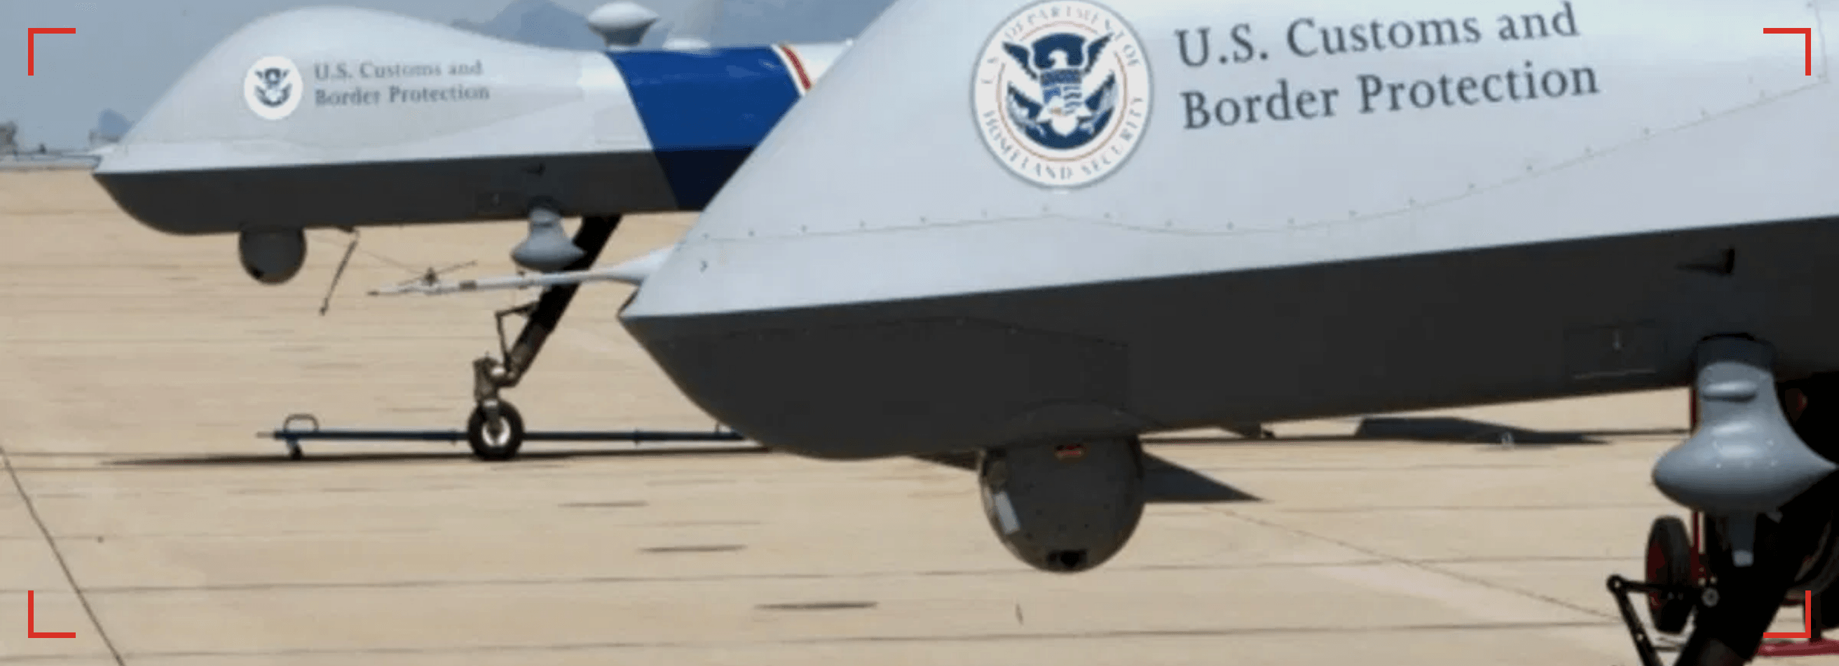


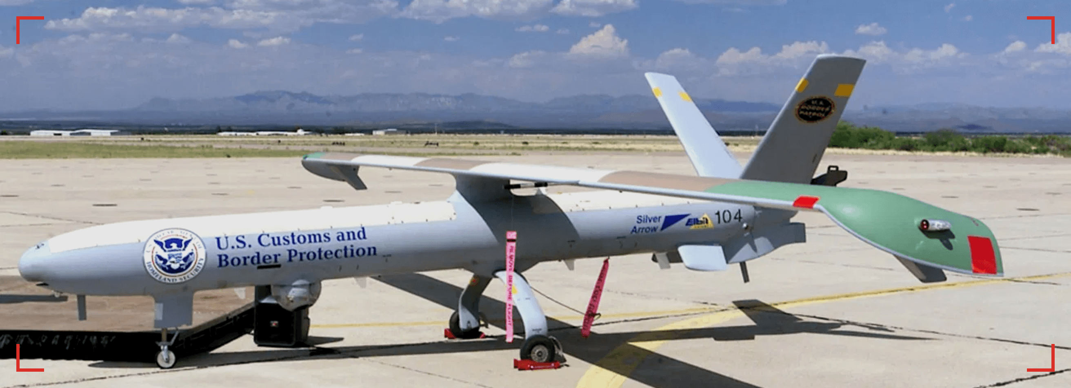

Core Technology: Unmanned Aerial Systems
Persistent Surveillance & Rapid Response
Persistent Surveillance
24/7 aerial monitoring of vast and inaccessible border regions, ensuring no blind spots in the security net.
Tactical Reconnaissance
High-resolution optical and thermal imaging for precise target acquisition and identification in all weather conditions.
Aerial Asset // Active
C4I Integration
Seamless real-time data transmission to Command & Control centers for immediate threat assessment and response.
Deployment Ready

Slide 8


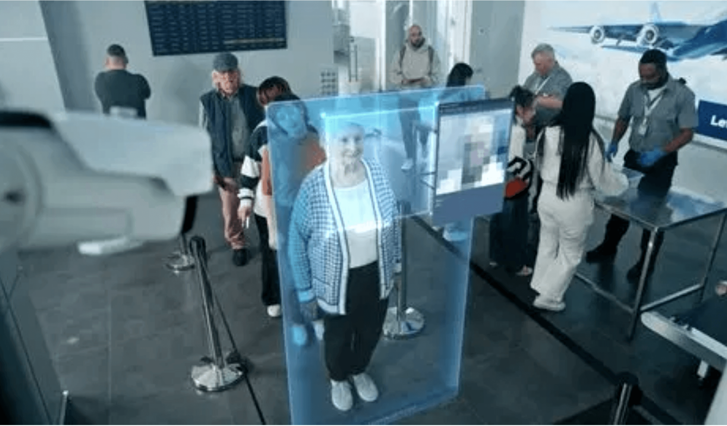


Core Technology: C4I Systems
Command, Control, Communications, Computers, & Intelligence
Integrated Command
SYSTEM STATUS: ONLINE
SECURE LINK ESTABLISHED
Centralized decision-making hubs connecting all border assets for unified operational control.
LIVE FEED: CHECKPOINT ALPHA
Secure Communications
Encrypted, resilient networks ensuring continuous data flow between field units and HQ.
DATA PACKET: 8944-X
LAT: 01.2921 S
LON: 36.8219 E
THREAT LEVEL: LOW
AI Intelligence
Advanced data fusion and analytics to identify patterns and predict potential threats.

Slide 9

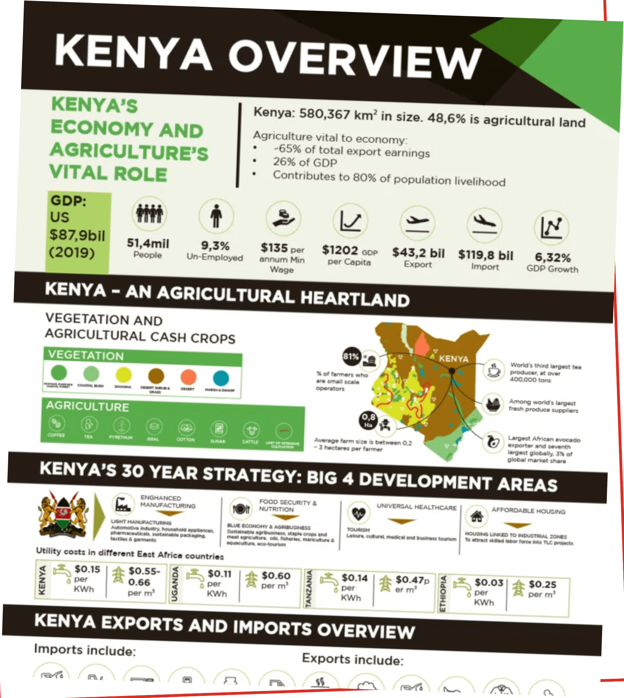



Integrated Border Management
A Holistic Approach
Smart Border Crossings
Implementing biometric identification and automated gates to streamline legitimate travel while securing entry points.
Mobile Patrol Units
Equipping patrol teams with real-time data access and secure communications for effective border enforcement.
Inter-agency Collaboration
Fostering information sharing and joint operations between customs, immigration, and security forces.
Strategic Context: Economic Impact

Slide 10




The Human Element: Training
Capacity Building & Operational Readiness
01
02
03
Operator Training
Maintenance Support
Operational Doctrine
Comprehensive certification programs for personnel on all new radar, UAS, and C4I systems to ensure maximum operational proficiency.
Establishing local technical capabilities and supply chains to guarantee long-term system sustainability and rapid repair.
Developing tailored Standard Operating Procedures (SOPs) and tactical frameworks to integrate new technology into border security missions.
Target: Full Autonomy
Timeline: Phase 1-3
Status: Planning

Slide 11





The Economic Benefits of Enhanced Deterrence
Security as a Catalyst for Growth
+15%
Trade Velocity
Projected GDP Impact
Secure borders reduce processing times and eliminate bottlenecks, facilitating the rapid movement of goods and lowering logistics costs.
Investor Confidence
A robust security environment signals stability, attracting Foreign Direct Investment (FDI) and fostering long-term economic partnerships.
ECONOMIC GROWTH
Revenue Assurance
Advanced monitoring eliminates smuggling and illicit trade, ensuring full customs revenue collection for national development.

Slide 12






Conclusion: A Secure and Prosperous Future
Vision for 2030 and Beyond
“
The Kenya Comprehensive Border Control & Technology Investment Initiative will create a secure environment that drives economic growth and national prosperity.
Uncompromised National Security
Accelerated Economic Development
Strategic Roadmap
Strategic Global Partnership
Atlas Systems
Confidential Proposal | December 2025

