Slide 1

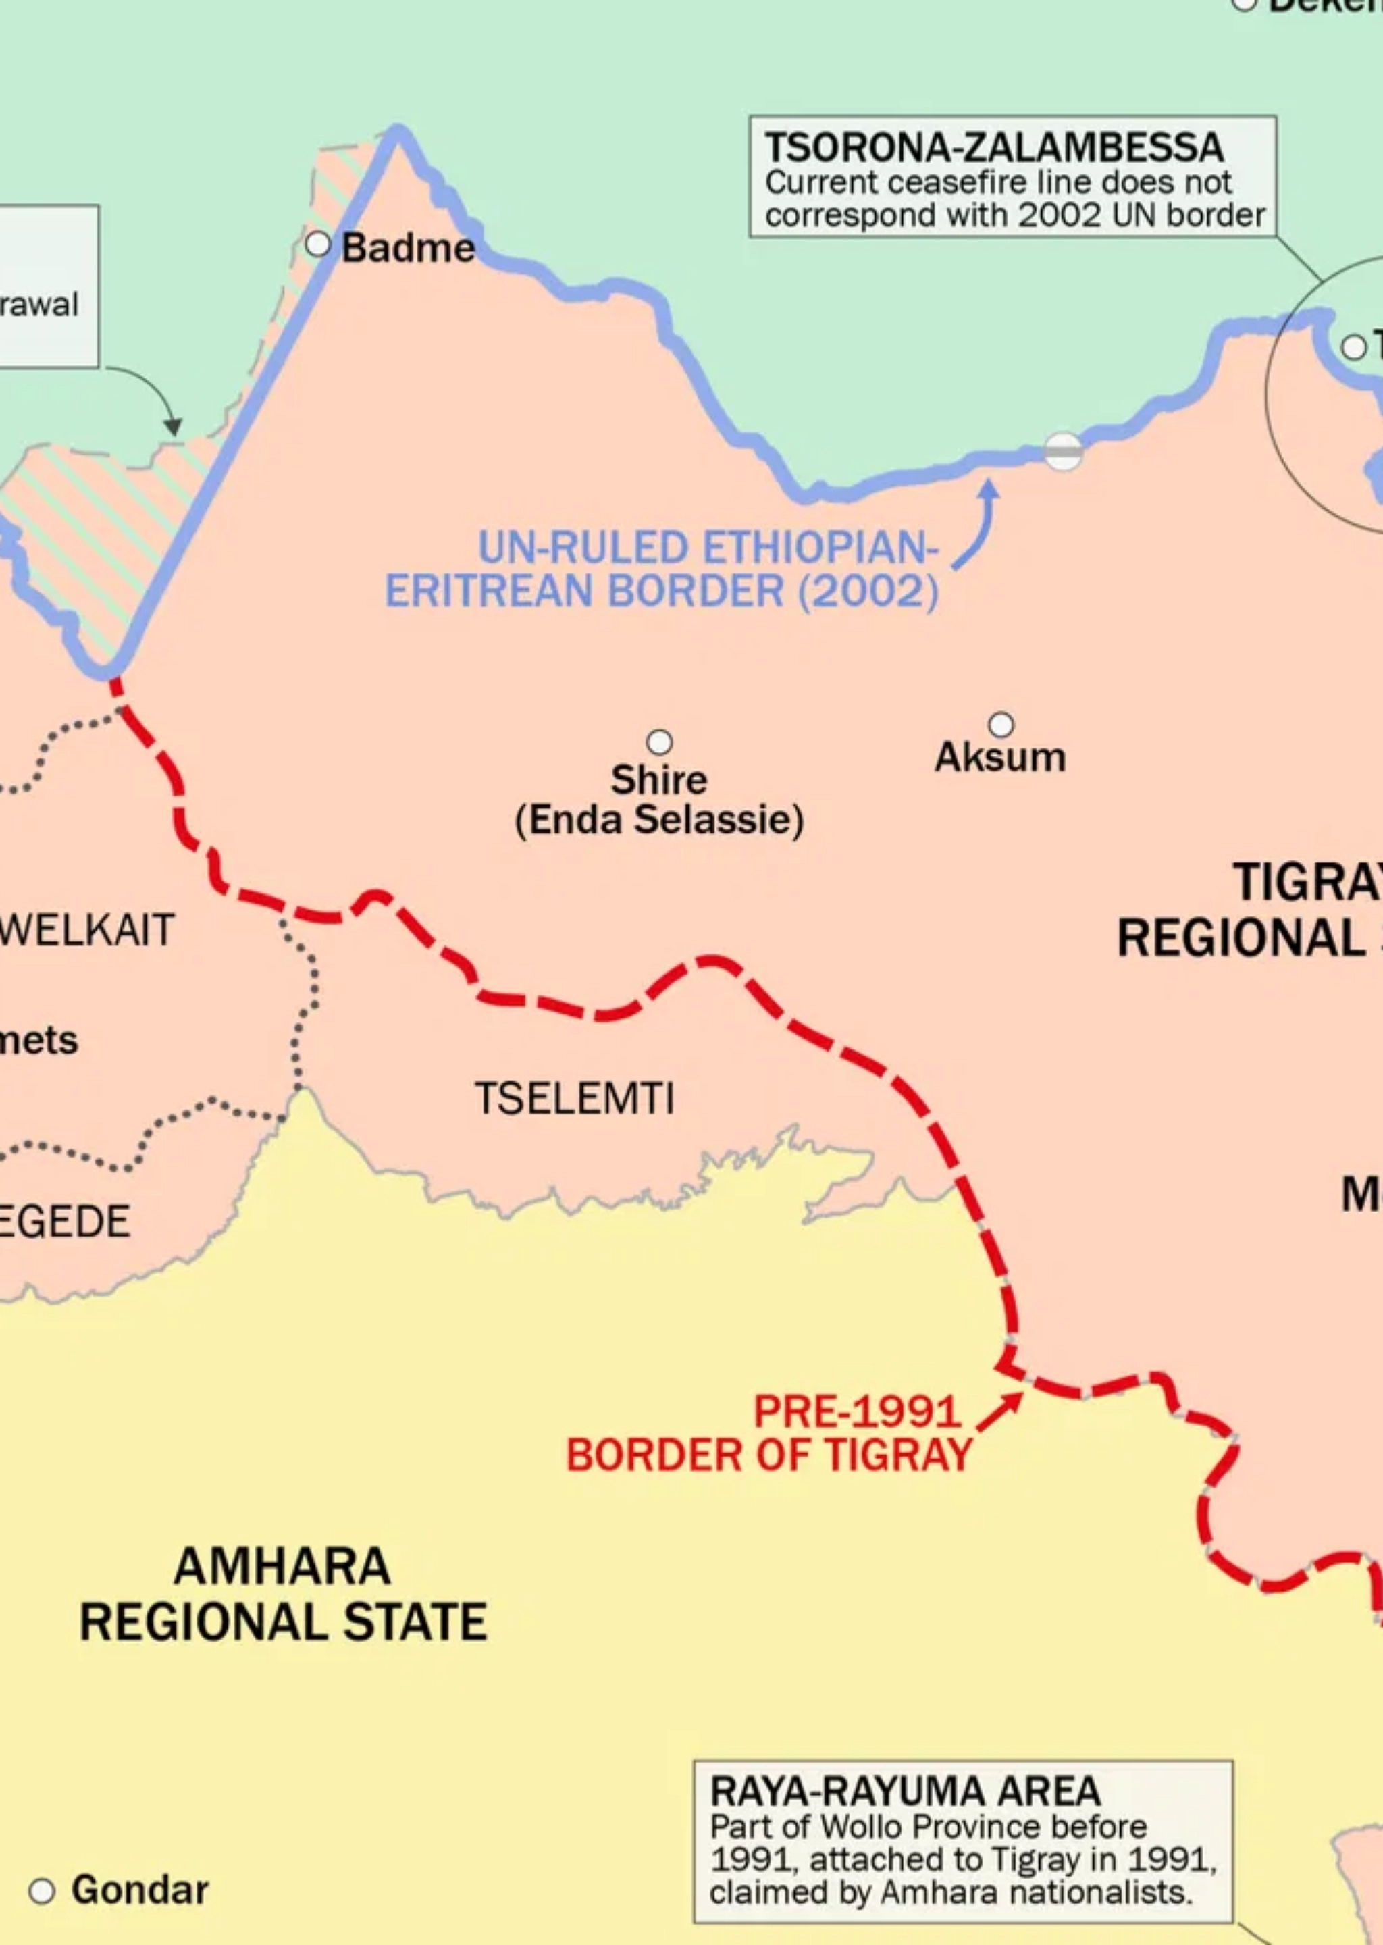
BORDER CONTROL
MANAGEMENT
FOR THE FEDERAL DEMOCRATIC REPUBLIC OF ETHIOPIA (FDRE)
A Strategic Imperative for National Development
Confidential | © 2025

Slide 2







Agenda
CORPORATE OVERVIEW
THE CONTEXT
BORDER CONTROL SOLUTION
WHY CHOOSE THIS SOLUTION
IMPLEMENTATION APPROACH
BENEFITS & OUTCOMES
BORDER CONTROL | Confidential | © 2025

Slide 3





CORPORATE OVERVIEW
Project Background
Key Stakeholders
A Public-Private Partnership (PPP) initiative to modernize Ethiopia's border control infrastructure and systems. This collaborative effort aims to transform borders into strategic national assets that enhance security while facilitating legitimate trade and travel.
This initiative brings together government agencies and private sector expertise to deliver a world-class border control system for Ethiopia.
National Intelligence and Security Service
Ethiopian Civil Aviation Authority
Comprehensive border management solution leveraging cutting-edge technology
Integration of physical and digital infrastructure for enhanced security
Ministry of Finance
Technology Partners
Revenue generation through improved customs and immigration processes
BORDER CONTROL | Confidential | © 2025

Slide 4
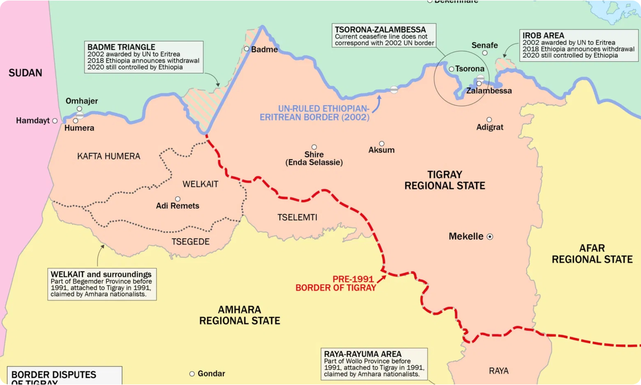

THE CONTEXT
Ethiopia's Border Landscape
Ethiopia shares borders with six countries: Eritrea, Djibouti, Somalia, Kenya, South Sudan, and Sudan. With over 5,300 km of land borders, Ethiopia faces unique challenges in border management.
Key Challenges:
Porous borders vulnerable to illegal crossings and smuggling
Limited technological infrastructure at border crossing points
Inefficient customs and immigration processes affecting trade
Regional security concerns requiring enhanced monitoring
BORDER CONTROL | Confidential | © 2025

Slide 5

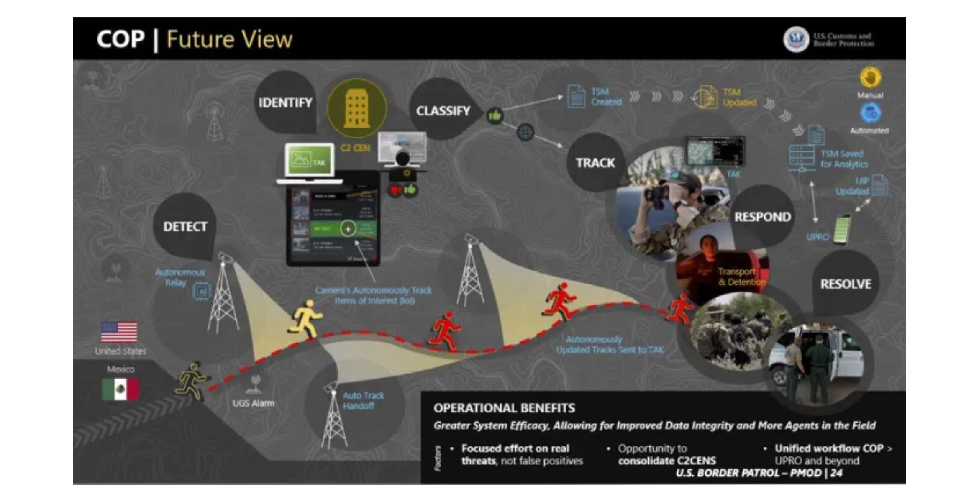






BORDER CONTROL SOLUTION
AI-Powered Risk Assessment
Intelligent system that analyzes traveler data before arrival, identifying potential security risks while facilitating legitimate travelers through expedited processing channels.
Smart Cargo Inspection
Non-intrusive inspection technologies combined with AI-based analytics to detect contraband, ensure regulatory compliance, and accelerate legitimate trade flows.
Integrated Border Management System
A comprehensive platform that connects all border control points and agencies, providing real-time information sharing and coordinated response capabilities across land, air, and sea borders.
Secure Communications Infrastructure
Resilient and encrypted network connecting all border posts with central command, ensuring continuous operations even in remote locations with challenging environments.
Advanced Traveler Verification
Multi-modal biometric identification system (facial, fingerprint, iris) integrated with international watchlists and Ethiopia's national databases for enhanced security and faster processing.
Revenue Enhancement Module
Digital customs and fee collection system that increases transparency, reduces leakage, and optimizes revenue generation from border operations.
BORDER CONTROL | Confidential | © 2025

Slide 6

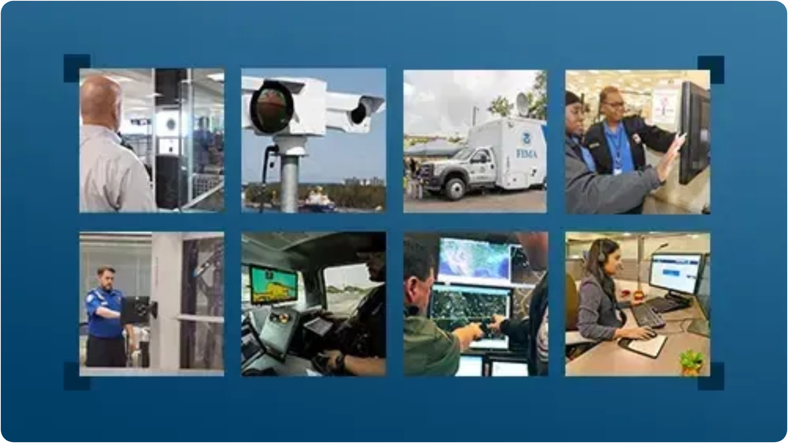




WHY CHOOSE THIS SOLUTION
Revenue Generation
Efficient border operations lead to increased customs revenue collection and reduced smuggling, creating new revenue streams for the government.
Economic Growth
Streamlined border processes facilitate legitimate trade and travel, boosting Ethiopia's economic development and regional integration.
Improved Traveler Experience
Faster processing times and reduced congestion create a positive experience for travelers and traders crossing Ethiopia's borders.
Enhanced Security
Advanced AI-powered threat detection and biometric verification systems provide superior security capabilities compared to traditional methods.
Public-Private Partnership
Leveraging private sector expertise and investment while maintaining government oversight ensures optimal outcomes.
Scalable & Future-Proof
Modular architecture allows for easy expansion and integration of new technologies as they become available.
BORDER CONTROL | Confidential | © 2025

Slide 7

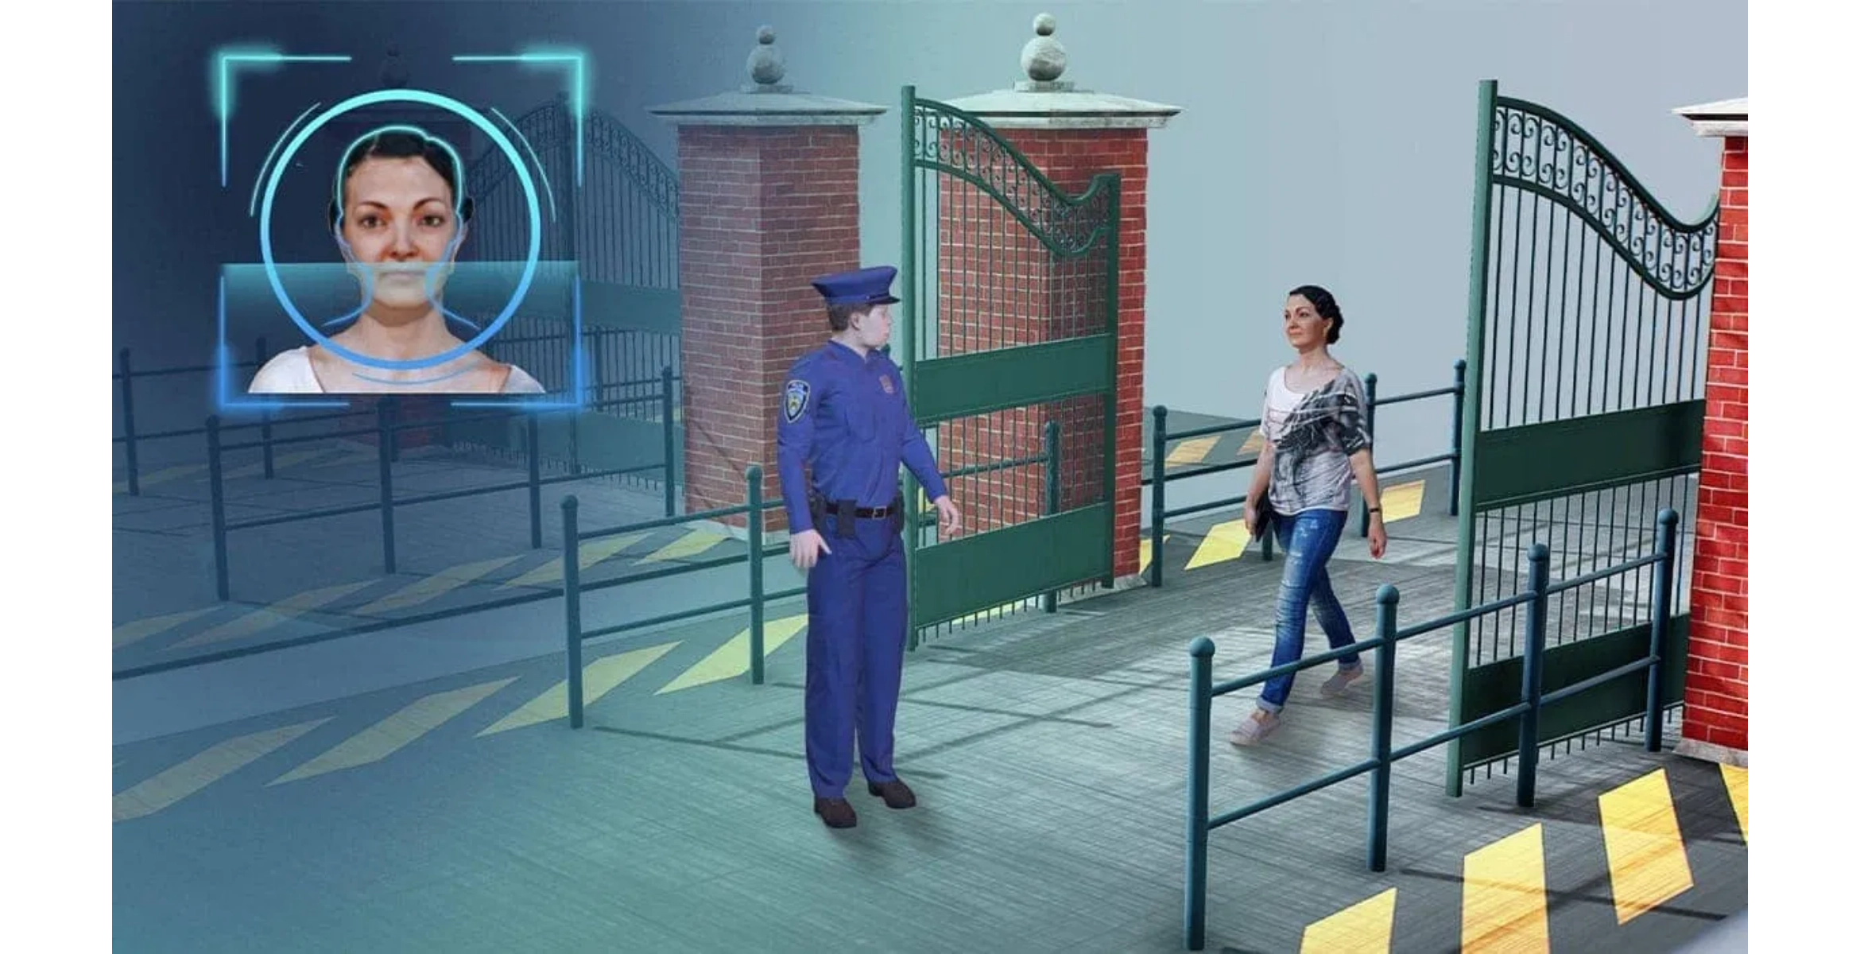








IMPLEMENTATION APPROACH
Priority Implementation Sites
Air Borders:
Addis Ababa Bole International Airport and regional
airports
Land Borders:
Major crossing points with Djibouti, Kenya, Sudan,
and Somalia
Sea Access:
Port facilities in partnership with Djibouti
Command Centers:
National coordination center in Addis Ababa
with regional hubs
Implementation Phases
Implementation Timeline
Phase 1:
Assessment and Planning (3 months)
Months 1-3
Phase 2:
Infrastructure Development (6-8 months)
Assessment, planning, and stakeholder alignment
Phase 3:
System Integration and Testing (4 months)
Months 4-12
Infrastructure development and initial system deployment
Phase 4:
Training and Capacity Building (3 months)
Months 13-18
Phase 5:
Deployment and Go-Live (2 months)
System integration, testing, and training
Months 19-24
Phased deployment and operational transition
BORDER CONTROL | Confidential | © 2025

Slide 8








BENEFITS & OUTCOMES
Security Benefits
Economic Benefits
Enhanced national security through improved identification of threats and risks
Increased revenue generation through improved customs collection
Reduced illegal border crossings and smuggling activities
Facilitated legitimate trade with faster processing times
Improved intelligence gathering and information sharing
Enhanced regional economic integration and cooperation
BORDER CONTROL | Confidential | © 2025

Slide 9





NEXT STEPS
Immediate (1-2 months)
Project Initiation
Stakeholder Engagement
Form joint steering committee, finalize requirements, and secure initial funding commitments.
Schedule executive briefings with key government agencies to secure buy-in and align strategic priorities. Establish regular coordination meetings with all stakeholders.
Short-term (3-6 months)
Detailed Planning
Complete site assessments, develop technical specifications, and establish implementation roadmap.
Agreement Finalization
Complete and sign formal agreements including technical specifications, financial terms, implementation timeline, and performance metrics.
Medium-term (6-12 months)
Pilot Implementation
Deploy initial systems at priority locations, test integration, and refine operational procedures.
Project Team Formation
Establish joint implementation team with representatives from government agencies and technical partners. Define roles, responsibilities, and reporting structures.
Long-term (12-24 months)
Full-Scale Deployment
Roll out complete solution across all designated border points and establish ongoing support framework.
Initial Assessment
Conduct comprehensive assessment of priority border sites to establish baseline conditions and identify specific infrastructure and technology requirements.
BORDER CONTROL | Confidential | © 2025

Slide 10
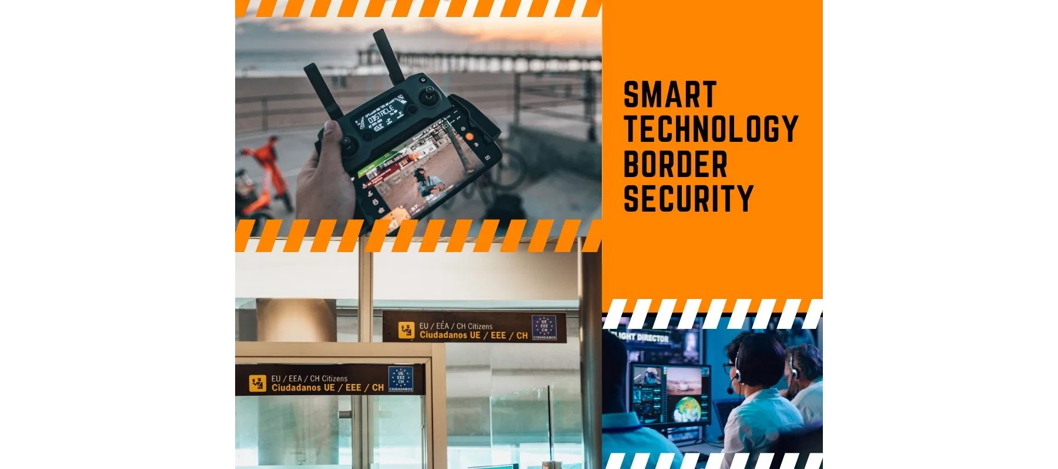
SOCIAL AND ENVIRONMENTAL IMPACT
Social Benefits
Environmental Considerations
Enhanced community safety in border regions through reduced criminal activities
Paperless processing significantly reduces environmental impact
Advanced identification systems to combat human trafficking
Energy-efficient infrastructure with renewable energy sources where feasible
Improved public health through enhanced screening capabilities
Environmental impact assessments for all new border infrastructure
Direct and indirect job creation in border management and related sectors
Enhanced capabilities to combat illegal wildlife trafficking
Strengthened cross-border community relations and cultural ties
Reduced vehicle congestion and emissions at border crossing points
BORDER CONTROL | Confidential | © 2025

Slide 11





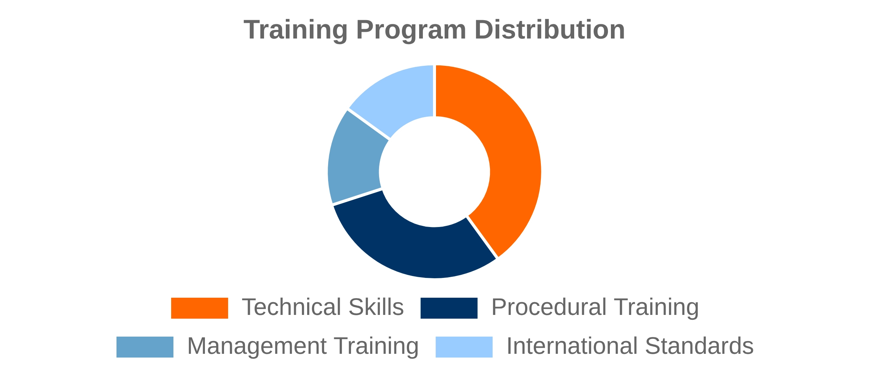


CAPACITY BUILDING AND TRAINING
Comprehensive Training Program
Knowledge Transfer Strategy
Technical Skills Development
Train-the-Trainer Approach
Training on biometric verification and document authentication
Ethiopian officials become certified instructors
International Exchange Programs
Procedural Training
Knowledge exchange through study visits and joint exercises
Standardized procedures aligned with international best practices
Training Infrastructure
National Training Center with regional training hubs
BORDER CONTROL | Confidential | © 2025

Slide 12






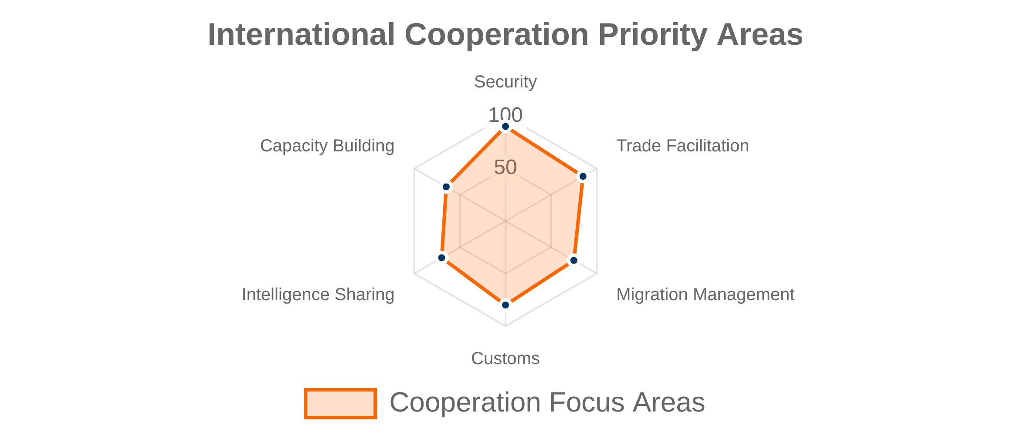
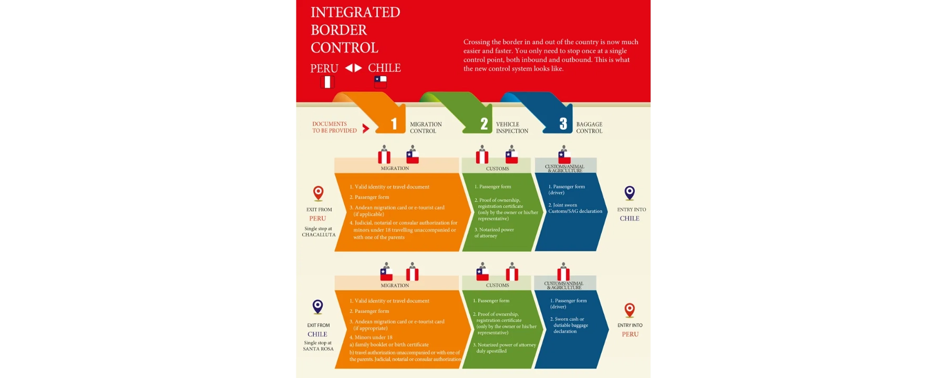
INTERNATIONAL COOPERATION
Regional Partnerships
Global Partnerships
Bilateral Agreements
International Organizations
Formalized cooperation frameworks with neighboring countries
Collaboration with WCO, IOM, INTERPOL, and UNODC
Technical Assistance Programs
Regional Economic Communities
Support from development partners and bilateral donors
Active participation in IGAD and COMESA border initiatives
Information Sharing Networks
Integration with global security databases and early warning systems
Joint Border Committees
Local-level coordination at key border crossings
BORDER CONTROL | Confidential | © 2025

Slide 13






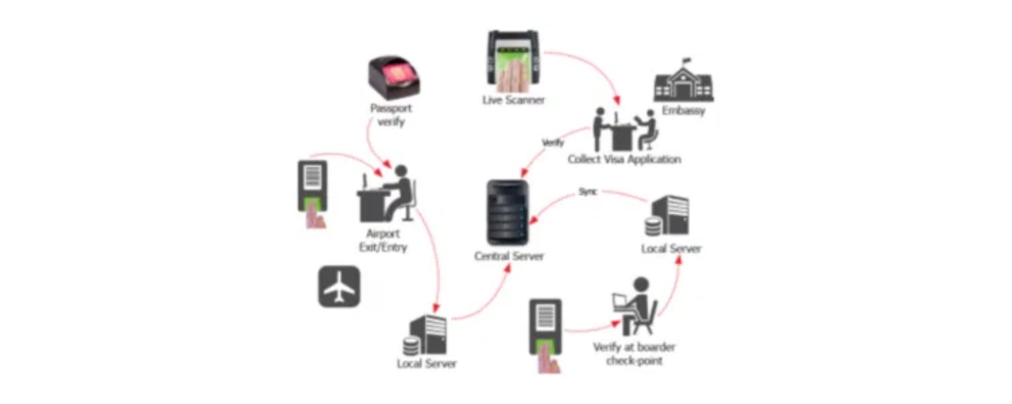
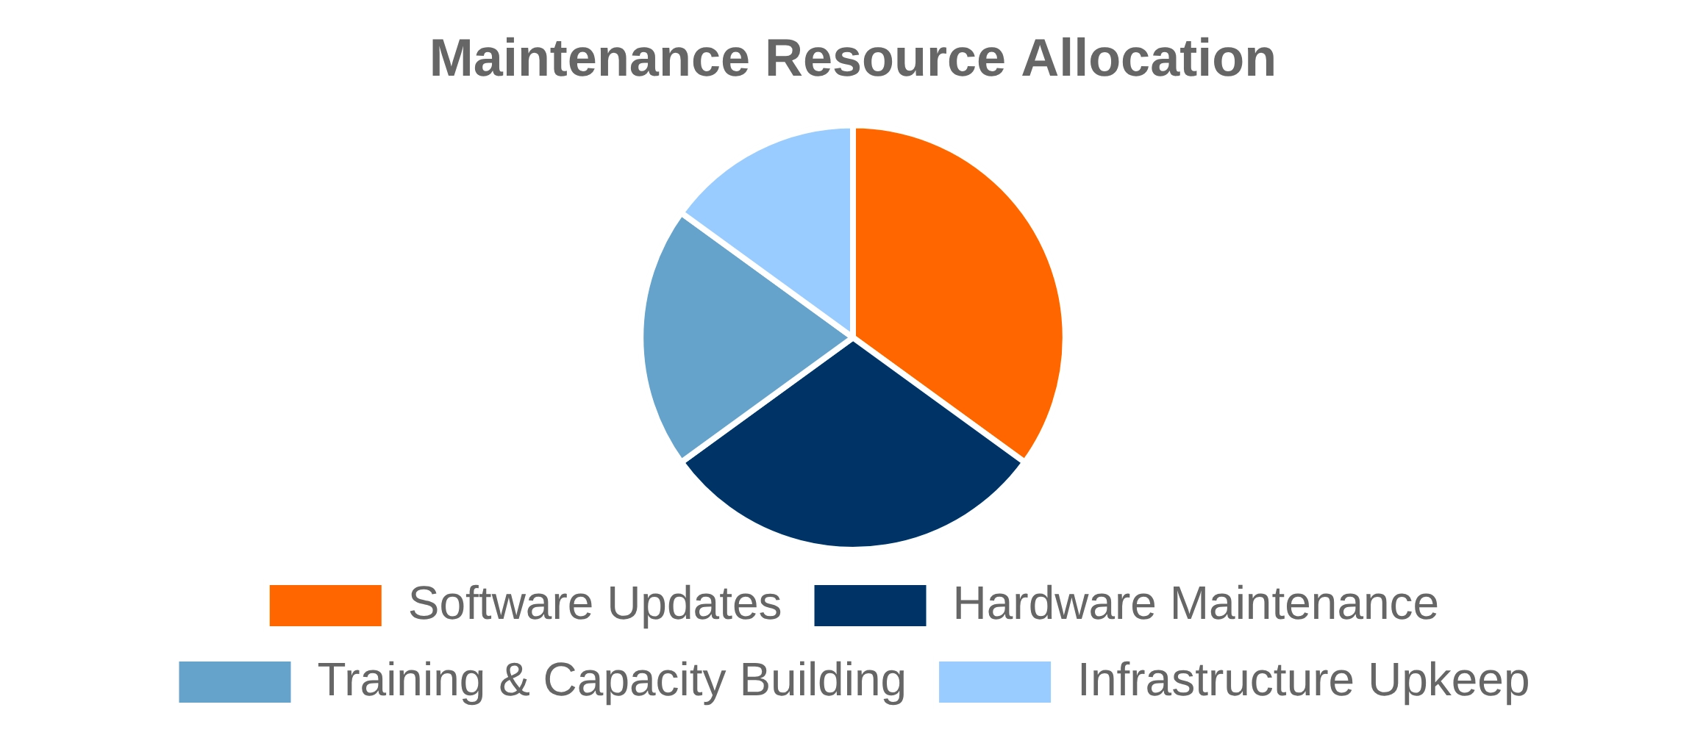
SUSTAINABILITY AND MAINTENANCE
Financial & Technical Sustainability
Operational Continuity
Revenue Reinvestment Model
Redundant Systems
Percentage of increased customs revenue dedicated to system maintenance
Built-in redundancy and failover capabilities for critical infrastructure
Public-Private Partnership
Standard Operating Procedures
Performance-based maintenance contracts with technology providers
Comprehensive documentation ensures consistent operations
Modular Architecture
Continuous Improvement
Interchangeable components for targeted upgrades without system disruption
Regular performance reviews drive iterative enhancements
BORDER CONTROL | Confidential | © 2025

Slide 14





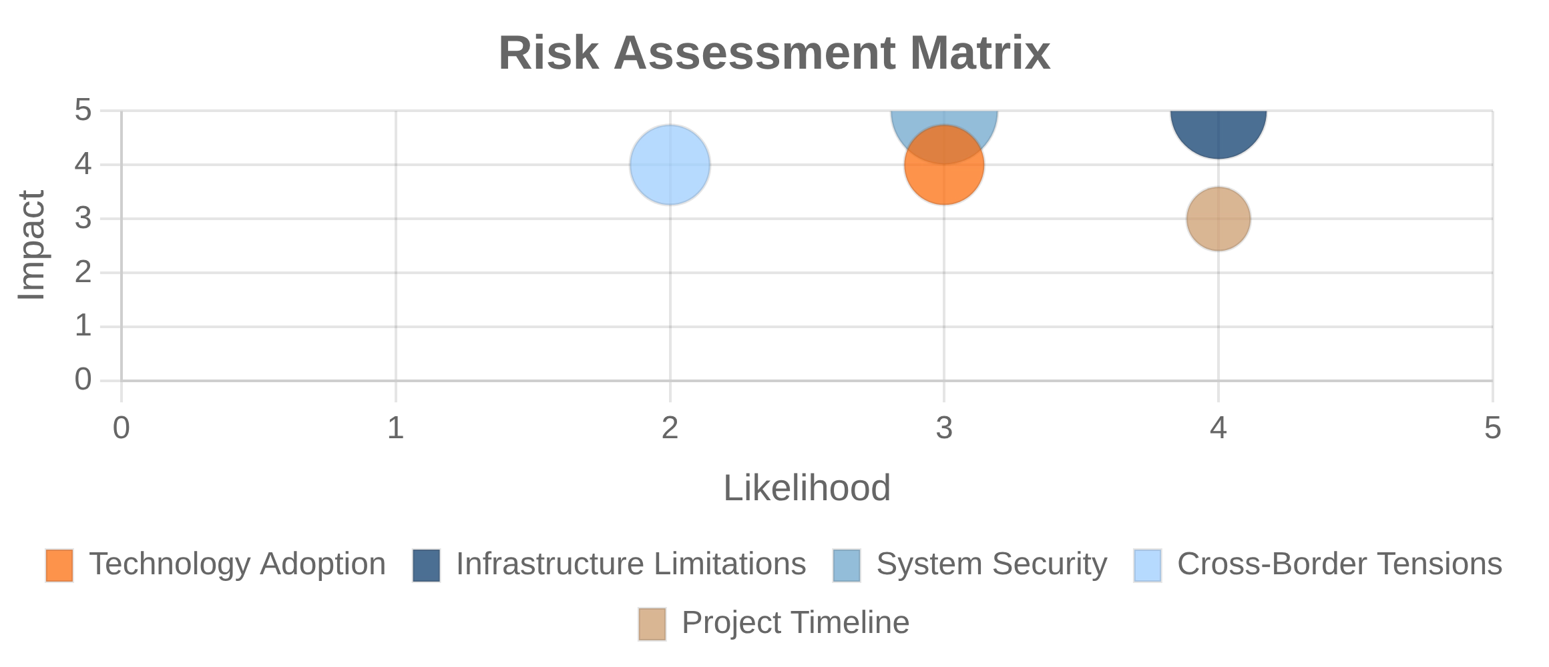

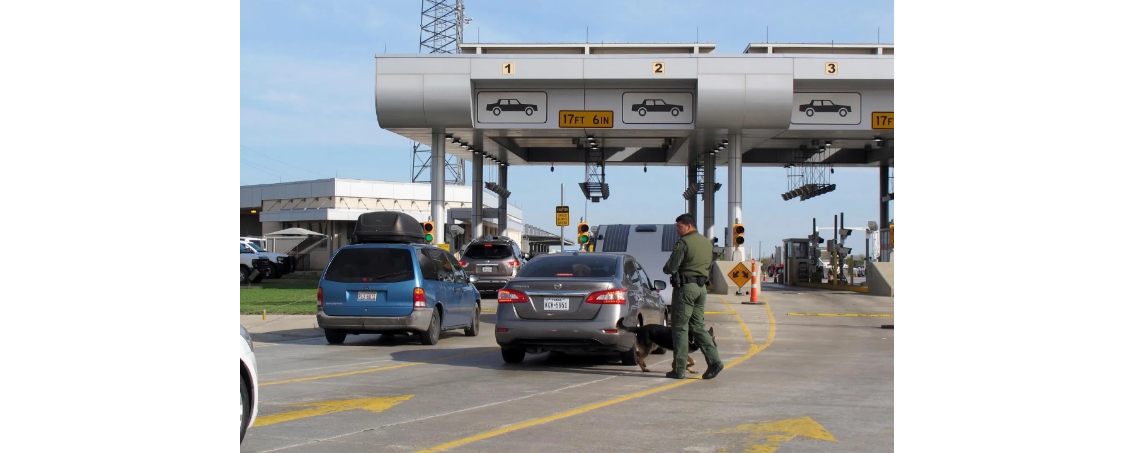
RISK MANAGEMENT AND MITIGATION
Implementation Risks
Operational Risks
Technology Adoption
System Security
Risk:
Risk:
Resistance to new technologies by border personnel
Cyber threats targeting border information systems
Mitigation:
Mitigation:
Comprehensive change management program with early user involvement
Multi-layered security architecture with continuous monitoring
Cross-Border Tensions
Infrastructure Limitations
Risk:
Risk:
Political issues affecting border operations
Inadequate power and connectivity at remote locations
Mitigation:
Mitigation:
Diplomatic engagement and flexible operational protocols
Self-sufficient power solutions and satellite communication links
Project Timeline Delays
Risk:
Implementation delays due to procurement processes
Mitigation:
Realistic scheduling with built-in contingencies
BORDER CONTROL | Confidential | © 2025

Slide 15



CONTACT INFORMATION
For More Information
info@bordermanagement.gov.et
+251 11 551 7700
National Border Management Office
Addis Ababa, Ethiopia
Thank you for your interest in Ethiopia's
Border Control Management Initiative
BORDER CONTROL | Confidential | © 2025

