Slide 1

BORDER MANAGEMENT
FOR THE FEDERAL DEMOCRATIC REPUBLIC OF ETHIOPIA (FDRE)
Atlas Innovative Systems

Slide 2
Agenda
CORPORATE OVERVIEW
THE CONTEXT
AIS's PROPOSITION : BORDER CONTROL SOLUTION
WHY AIS
Notes:
The presentation includes a lot of facts and figures about AIS; how we work with our customers and the air transport community; and the solutions we provide to our customers. It also includes AIS's evolution in recent years and our strategic direction. At the end we look at some of the recent performance of AIS.
So let’s start with why AIS is so closely involved with the air transport community, and give you a some key facts and figures about us.
Note to presenters
You can walk through the presentation in its current order.
OR:
You can click on a section on this contents page, present that section, then click back at the end of the section to return to this table of contents. You’ll see a button (called CONTENTS) on a slide at the end of each section

Slide 3
CORPORATE OVERVIEW

Slide 4

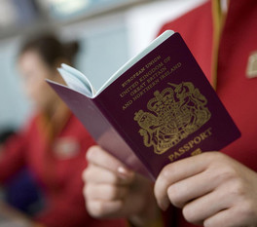

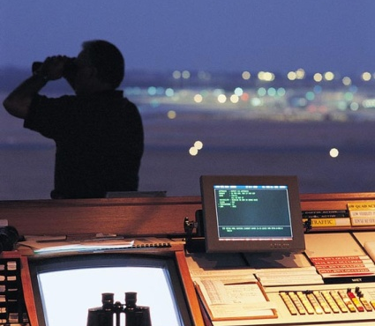
CORPORATE OVERVIEW
Notes:
This slide sums up our approach … we’re specialists in air transport communications and IT solutions.
And as its specialists we have a commitment to meeting and exceeding the demands of the air transport industry … every day.
We have the broadest portfolio of services for the air transport industry – broader than any other provider.
They range from Cloud computing and common-use platforms …
To intelligent airports, mobility, border control …
And they include advanced aircraft communications, next generation passenger management, and more ...
We’ll come back to portfolio.
You can see here our customer proposition – to focus on helping our customers perform. We place a major emphasis on delivery. Later you’ll see some slides that showcase our successes and highlight some of our latest developments.

Slide 5

GLOBAL SITES / LOCATIONS
WE ARE EVERYWHERE 4 U
Notes:
FOR BEST EFFECT USE IN PLAY MODE: In play mode, click each number on the right to activate the animation.
Script: If we’re going to meet industry requirements we do of course have to be where the industry is ...
That’s why we like to say we’re local everywhere ... As I said the most international organization on earth.
We provide services to over 200 countries and territories, and we serve over 1000 airports.
We have 350 sites in 140 countries ... We have 4 service desks (Montreal, Delhi, Frankfurt and Oman) providing first line support to customers .... We have 4 next generation data centres – two in Atlanta, one in London and one in Singapore ....
We have 2 state of the art Command Centers – these enable proactive monitoring and management of AIS's communication and IT solutions used by hundreds of airlines and airports around the world. With real-time visibility and advanced technology, it means AIS can identify issues and take pre-emptive action before any impact takes place on airline and airport customer services. We have over 100 service centers around the world. ** And global software development capability from over 15 centers (13 AIS software development centers plus 4 offshore through our partnerships with companies like NIIT and Mindtree.)
Background if required
AIS Software development capability:
Atlanta, US (Passenger: fares, reservations, ticketing, check-in etc); Bohemia, US (airports / ecommerce); Boston, US; Godalming, UK (government, security, biometrics); Letterkenny, Ireland (government, security, biometrics); London, UK (flight operations); Sydney, Australia (government, security, biometrics); Vancouver, Canada (fares). Other software development with Solutions Lines takes place in Copenhagen, Dayton, Miami, Montreal and Nice.
Offshore Software development capability: Brazil – CINQ; Rumania – Luxsoft; India – NIIT; India – Mindtree.
**Background if required - Service Desks / Service Centers
Service Desks: First point of contact for all customers. They provide consistent incident management for all AIS services.
AIS's integrated global Service Desk is designed to provide customers with much more than fast resolution of incidents
and problems. Serving as the single point of contact for all operational requirements it means: Simpler, streamlined service management based on a consistent set of tools, processes and procedures; around the world and around the clock; dedicated support staff with a global view of your networks and applications; Proactive response and escalation of performance problems; better tracking, monitoring and accountability; for proactive notification of technical issues detected by our network monitoring systems and teams of global experts, to minimize operational impact.
Service Center: Provide technical Field Service at AIS and Orange customers premises in their locale. Services include: Break/Fix maintenance and Installations, Moves, Additions & Changes (IMAC) for all AIS and Orange products. They manage and maintain the Network Operations Center(s) in their locale on behalf of both AIS & Orange. In this role they provide all technical and administrative support for the network center, including management of the centre facilities (air con, power & generator backup, security etc), maintenance of vendor relationships, particularly with the local Telco's and a range administrative duties in support of AIS / Orange in that country.

Slide 6
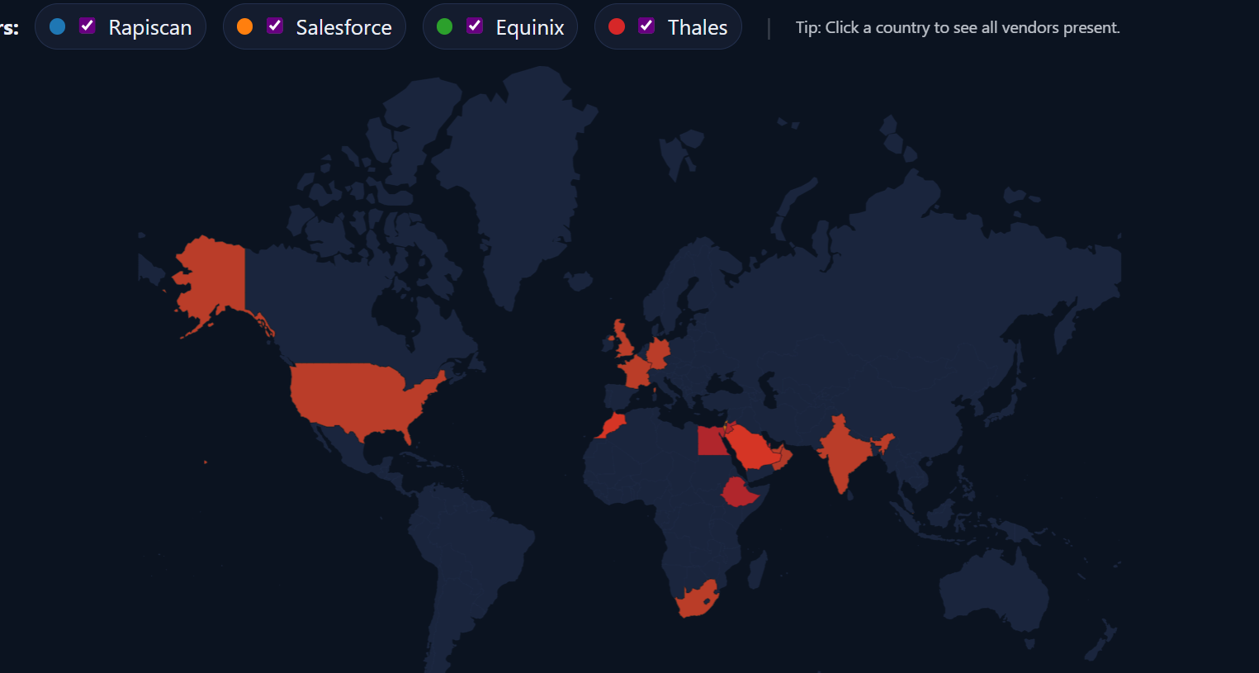
Country | ISO3 | Region | Total | Rapiscan_Office | Salesforce_Entity | Equinix_DC_Present | Thales_CountryPage
United Kingdom | GBR | Europe | 4 | 1 | 1 | 1 | 1
Germany | DEU | Europe | 4 | 1 | 1 | 1 | 1
United States | USA | Americas | 4 | 1 | 1 | 1 | 1
India | IND | APAC | 4 | 1 | 1 | 1 | 1
Singapore | SGP | APAC | 4 | 1 | 1 | 1 | 1
United Arab Emirates | ARE | GCC | 3 | 0 | 1 | 1 | 1
South Africa | ZAF | Africa | 3 | 0 | 1 | 1 | 1
France | FRA | Europe | 3 | 0 | 1 | 1 | 1
Saudi Arabia | SAU | GCC | 2 | 0 | 1 | 0 | 1
Oman | OMN | GCC | 2 | 0 | 0 | 1 | 1
Morocco | MAR | Africa | 2 | 0 | 1 | 0 | 1
Qatar | QAT | GCC | 1 | 0 | 0 | 0 | 1
Egypt | EGY | Africa | 1 | 0 | 0 | 0 | 1
Ethiopia | ETH | Africa | 1 | 0 | 0 | 0 | 1
Jordan | JOR | MENA | 1 | 0 | 0 | 0 | 1
Israel | ISR | MENA | 1 | 0 | 1 | 0 | 0
Bahrain | BHR | GCC | 0 | 0 | 0 | 0 | 0
Kuwait | KWT | GCC | 0 | 0 | 0 | 0 | 0
Sudan | SDN | Africa | 0 | 0 | 0 | 0 | 0

Slide 7
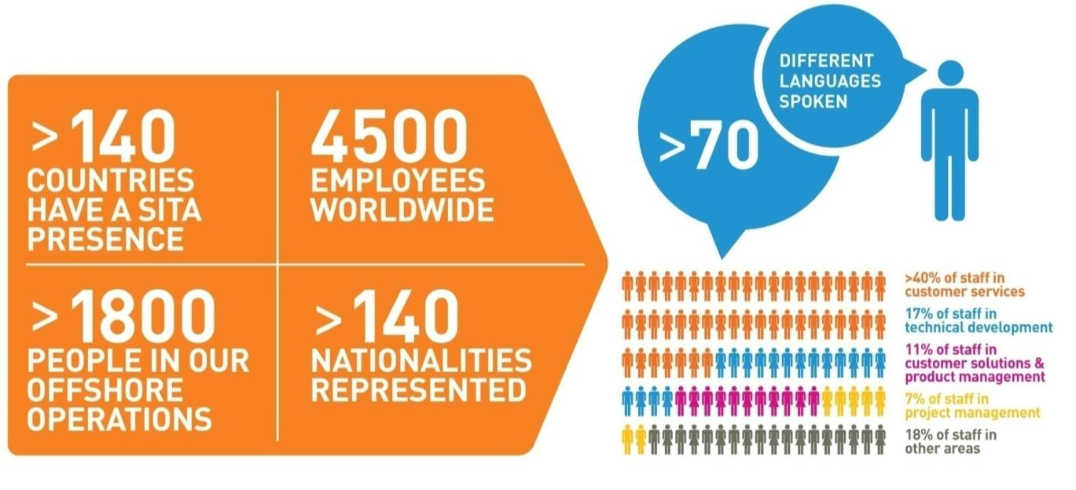
OUR PEOPLE ARE YOUR PEOPLE
A TRULY GLOBAL ORGANIZATION
| BORDER Border Management | Confidential | © AIS 2018
Notes:
FOR BEST EFFECT USE IN PLAY MODE: In play mode, click each number on the right to activate the animation.
Script: If we’re going to meet industry requirements we do of course have to be where the industry is ...
That’s why we like to say we’re local everywhere ... As I said the most international organization on earth.
We provide services to over 200 countries and territories, and we serve over 1000 airports.
We have 350 sites in 140 countries ... We have 4 service desks (Montreal, Delhi, Frankfurt and Oman) providing first line support to customers .... We have 4 next generation data centres – two in Atlanta, one in London and one in Singapore ....
We have 2 state of the art Command Centers – these enable proactive monitoring and management of AIS's communication and IT solutions used by hundreds of airlines and airports around the world. With real-time visibility and advanced technology, it means AIS can identify issues and take pre-emptive action before any impact takes place on airline and airport customer services. We have over 100 service centers around the world. ** And global software development capability from over 15 centers (13 AIS software development centers plus 4 offshore through our partnerships with companies like NIIT and Mindtree.)
Background if required
AIS Software development capability:
Atlanta, US (Passenger: fares, reservations, ticketing, check-in etc); Bohemia, US (airports / ecommerce); Boston, US; Godalming, UK (government, security, biometrics); Letterkenny, Ireland (government, security, biometrics); London, UK (flight operations); Sydney, Australia (government, security, biometrics); Vancouver, Canada (fares). Other software development with Solutions Lines takes place in Copenhagen, Dayton, Miami, Montreal and Nice.
Offshore Software development capability: Brazil – CINQ; Rumania – Luxsoft; India – NIIT; India – Mindtree.
**Background if required - Service Desks / Service Centers
Service Desks: First point of contact for all customers. They provide consistent incident management for all AIS services.
AIS's integrated global Service Desk is designed to provide customers with much more than fast resolution of incidents
and problems. Serving as the single point of contact for all operational requirements it means: Simpler, streamlined service management based on a consistent set of tools, processes and procedures; around the world and around the clock; dedicated support staff with a global view of your networks and applications; Proactive response and escalation of performance problems; better tracking, monitoring and accountability; for proactive notification of technical issues detected by our network monitoring systems and teams of global experts, to minimize operational impact.
Service Center: Provide technical Field Service at AIS and Orange customers premises in their locale. Services include: Break/Fix maintenance and Installations, Moves, Additions & Changes (IMAC) for all AIS and Orange products. They manage and maintain the Network Operations Center(s) in their locale on behalf of both AIS & Orange. In this role they provide all technical and administrative support for the network center, including management of the centre facilities (air con, power & generator backup, security etc), maintenance of vendor relationships, particularly with the local Telco's and a range administrative duties in support of AIS / Orange in that country.

Slide 8
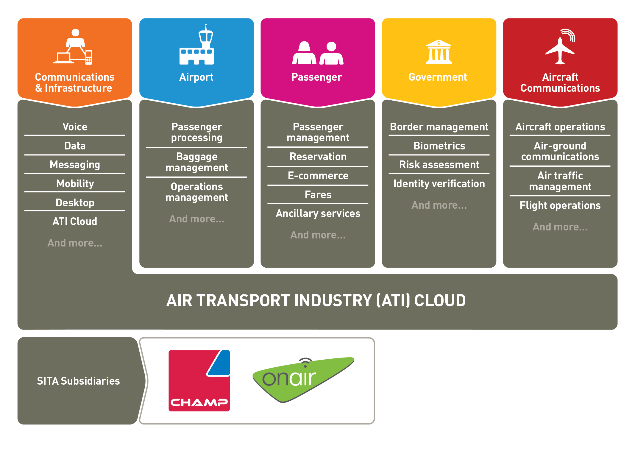
PRODUCTS & SOLUTIONS
A broad portfolio for the transport and government sector
Notes:
As I said, our portfolio offers the broadest range of IT and communications solutions for the air transport industry.
It includes managed global communications and infrastructure, in which we’re seeing some of the latest developments in mobility and cloud.
And it includes solutions for:
Airports, such as Airport management and operations, business intelligence and baggage operations ...
Passengers and airlines, such as fares and reservations – which, for example, includes investing significantly in next generation passenger management.
It includes solutions for governments and border management, as well as aircraft communications (for instance: aircraft operations, air-ground communications, flight operations).
AIS has two main subsidiaries: OnAir, which is the leading provider of in-flight connectivity, and CHAMP Cargosystems, the world's only IT company dedicated solely to air cargo. AIS also operates two joint ventures providing services to the air transport community: Aviareto for aircraft asset management and CertiPath for secure electronic identity management.
We’ve been making big investments in the portfolio and again as we work with the industry – including the AIS Board and Council – it’s evolving rapidly.
We’ll see more about our evolution soon ...

Slide 9
UNIQUE AIS POSITION
AIS, through its activity and history, is at the heart of the air transport industry IT system.
We work with all players of the air transport industry : governments, airline companies, airports.
AIS has a unique experience in the provision of passengers data transmission systems built over the past two decades.
Notes:
As I said, our portfolio offers the broadest range of IT and communications solutions for the air transport industry.
It includes managed global communications and infrastructure, in which we’re seeing some of the latest developments in mobility and cloud.
And it includes solutions for:
Airports, such as Airport management and operations, business intelligence and baggage operations ...
Passengers and airlines, such as fares and reservations – which, for example, includes investing significantly in next generation passenger management.
It includes solutions for governments and border management, as well as aircraft communications (for instance: aircraft operations, air-ground communications, flight operations).
AIS has two main subsidiaries: OnAir, which is the leading provider of in-flight connectivity, and CHAMP Cargosystems, the world's only IT company dedicated solely to air cargo. AIS also operates two joint ventures providing services to the air transport community: Aviareto for aircraft asset management and CertiPath for secure electronic identity management.
We’ve been making big investments in the portfolio and again as we work with the industry – including the AIS Board and Council – it’s evolving rapidly.
We’ll see more about our evolution soon ...

Slide 10

THE CONTEXT

Slide 11
ETHIOPIA CHALLENGES
Budget

Slide 12

AIS’S PROPOSITION

Slide 13
Security Council
Security Council
Extract : Résolution 2178 (2014)
“9.Calls upon Member States to require that airlines operating in their territories provide advance passenger information to the appropriate national authorities in order to detect the departure from their territories, or attempted entry into or transit through their territories, by means of civil aircraft, of individuals designated by the Committee established pursuant to resolutions 1267 (1999)and 1989 (2011)(“the Committee”), and further calls upon Member States to report any such departure from their territories, or such attempted entry into or transit through their territories, of such individuals to the Committee, as well as sharing this information with the State of residence or nationality, as appropriate and in accordance with domestic law and international obligations;”

Slide 14
ICAO WCO IATA
Management Summary on Passenger-related Information
“A growing number of States require airlines to provide information on passengers that intend to travel to their territory. The information usually exists in the Carrier’s reservation system and departure control system operated by the Carrier. Some states also require passenger related information from other modes of transport.
Taking into account the increasing number of air passengers, the increase in security related measures, the environmental and efficiency-driven innovations which result in bigger airplanes, together with the need for more efficient passenger flows at airports, it is necessary to develop more intelligent and efficient methods to check passengers and their baggage. This means that decisions to check passengers will have to be made more on the basis of pre-flight risk analysis instead of generally increasing level of checks at immigration or cross border desks and baggage claim areas.”
*Extract from « Management Summary on Passenger-related Information
» _ OACI /OMD/IATA

Slide 15
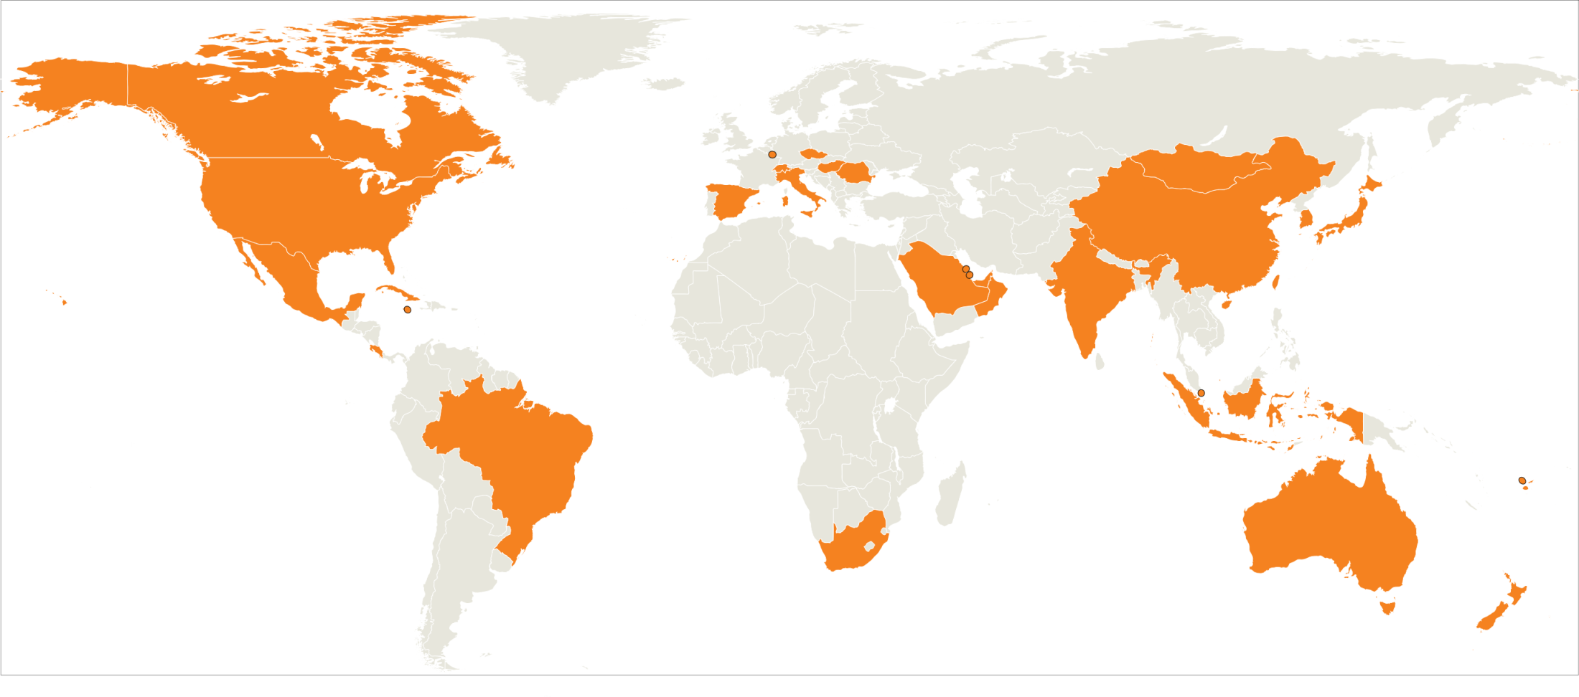
OUR EXPERIENCE
20+
Major Solutions
Delivered
20 Years
200M+
Passengers
Every year
150+
Certified
Airlines
15
Notes:
After 20 years of bridging the gap between airlines and governments, AIS has delivered more than 20 major border management solutions. Our border management solutions process more than 200M passengers every year, with over 150 connected airlines.
Our customers include most of the world’s leading governments that set the standard when it comes to best practices in border management, and we have been at the leading edge helping these governments improve border security and facilitation.
This unparalleled experience has allowed us to articulate a comprehensive end-to-end vision of the future of border security, which we have brought to life in our intelligence-led, integrated portfolio of products and services to help governments create their “Border of the Future” today – we call it BORDER CONTROL .

Slide 16





























Creating Success with AIS BORDER CONTROL
2015
2014
2013
Thailand APP
Spain APIS Program
UK miSense Project
US enabling services
Mongolia APIS
Italy APIS/PNR/Risk
2012
2011
Sri Lanka APP/ PNR
Myanmar APP/PNR
2010
2009
2008
Brasil PNR
USA Biometrics
Airlines PNR Push/Filter
Kuwait APP
Indonesia Primary Line
2007
UAE APP/PNR/Risk
Oman VIS/APP
2006
UK Semaphore Pilot
Japan APIS Comms
2005
Mexico PNR
Saudi Arabia APP/PNR/Risk
Airline Korea iAPP service
Biometric RTP
between US & EU
2004
Bahrain APP, eVisa, Hotels
UK Customs PNR
New Zealand APP
Indonesia Biometrics
US SecureFlight airlines
Qatar APP/PNR/Risk
2003
2002
South Africa APP
Canada APIS+PNR
1999
Singapore APP/PNR
Airline AQQ service for US
Airline APIS service for India
Australia Customs PNR Push
Argentina APIS
Australia APP
Australia DIAC
ETAS Solution
1995
Notes:
AIS is the global leader in border management solutions that combine risk assessment of passenger data and sophisticated tools for processing passengers at the border and for managing the nations border operation.
Our history goes back to the 1990s with the work we did with the Australian government to improve border security and facilitation in advance of the Sydney Olympics.
Following 9/11 we led the industry with the earliest solutions that allowed governments to perform risk assessment of traveler data, beginning in 2002 with the Canadian Border Security Agency where we provided ManifestData and BookingData and subsequently with many other governments that called upon our expertise to implement similar programs.
As the sophistication of our customers developed, so did the sophistication of our BORDER CONTROL portfolio; with the deployment of large scale biometric identity management systems that married risk assessment with a biometric verification, not only ensuring the risk level of each passenger but also ensuring that they are who they claim to be.
Along the way we have helped the industry define more standard ways to risk assess traveler data and at the same time we have extended the set of tools we can provide to governments to be the most powerful available from a single supplier.

Slide 17




AIS BORDER CONTROL PORTFOLIO
BORDER CONTROL ® – a complete set of capabilities to transform border security and facilitate the travel experience through information, intelligence, optimised interactions with travelers and comprehensive insights to enhance every aspect of border operations.
BORDER CONTROL
Information
BORDER CONTROL
Intelligence
BORDER CONTROL
Interaction
BORDER CONTROL
Insight
17
Notes:
Designed to enhance every aspect of border operations, BORDER CONTROL has four core capabilities: Information, Intelligence, Interaction and Insight.
BORDER CONTROL Information ensures that government agencies always have the right information at the right time at in the right place to make effective decisions. BORDER CONTROL Information acquires, collates and transforms vast amounts of disparate traveler data from airline and other travel industry systems with other existing operational data sources, such as passport and visa databases, into a comprehensive set of information that allows border control agencies to identify risks and speed up the processing of legitimate travelers and goods.
BORDER CONTROL Intelligence allows border management agencies to turn this comprehensive information into actionable intelligence. By assuring traveler identities, performing sophisticated risk assessment and analyzing watch lists, BORDER CONTROL Intelligence supports fast and accurate identification of high-risk travelers, allowing for informed decision making to secure the border and protect legitimate travel, tourism and trade.
BORDER CONTROL Interaction provides secure and rapid facilitation of travelers at border crossings using our advanced solution for the manual primary line, BORDER CONTROL EntryExit. BORDER CONTROL Interaction goes further by extending the border to the point of departure and beyond through pre-travel authorization and e-Visas (BORDER CONTROL TravelAuthorization), while our BORDER CONTROL BorderAutomation gates and kiosks provide expedited self-service border crossing for low-risk travelers.
Border management agencies need to make timely well-informed decisions, ensure systems are available and resources deployed where and when they are needed. This is where the final piece, BORDER CONTROL Insight, comes into play - providing comprehensive insight into the performance of the entire border across the country and the tools to manage the border operation. BORDER CONTROL Insight powers collaborative decision-making and the targeting of resources based upon risk and demand.

Slide 18
BORDER CONTROL INFORMATION
BORDER CONTROL Information ensures government agencies always have the right information in the right place at the right time.
BORDER CONTROL
TravelerData
Rapidly and securely delivers high quality traveler data for a modern, effective border.
BORDER CONTROL
GovernmentLink
Increases the value of government systems with comprehensive real-time integration and matching of sensitive data for risk-based border security.
18
Notes:
BORDER CONTROL Information ensures government agencies always have the right information in the right place at the tight time. Two products are included.
BORDER CONTROL TravelerData provides various forms of traveler data, including:
BookingData – this is essentially the data captured by airlines and other carriers when a traveler makes a reservation and later checks in. In travel industry jargon this is known as PNR (Passenger Name Record) and DCS (Depart Control System) data. It is a very rich source of data useful for risk assessment. BookingData can be provided at various times after a reservation is made up to the point of departure.
ManifestData is essentially the complete manifest of all passengers and crew including flight details and travel document data. In industry jargon it is known as Advanced Passenger Information or API data. It is normally provided after flight departure.
InteractiveData provides similar data as ManifestData but it is sent one passenger at a time as passengers check in. Governments can respond in real time authorizing or denying boarding of the traveler based on risk assessment. From the government’s perspective this is a very powerful capability, since it effectively exports the border by allowing governments to prevent inadmissible persons from ever arriving at the border. InteractiveData is known in the industry by several names: Advance Passenger Processing (APP), API Quick Query (AQQ), and interactive Advance Passenger Information (iAPI).
All data is validated, standardized, filtered according to business rules, correlated and stored in a database for later viewing and use in the risk assessment process.
BORDER CONTROL GovernmentLink adds value to BORDER CONTROL TravelerData by supporting integration with existing government systems and databases such as watch lists, passports and visa databases. Almost all BORDER CONTROL implementations involve extensive integration, some with as many as 20 external systems. BORDER CONTROL GovernmentLink supports both access to BORDER CONTROL data by external systems and access to external systems from BORDER CONTROL , all via a secure and standardized integration layer.

Slide 19
IN MORE DETAIL
BORDER CONTROL TravelerData
Make booking
Check-In
Departure
In-Country
72 hrs
24 hrs
2 hrs
0hrs
Hotels, Car Rental etc.
1st customer – Royal Oman Police
UAE:90M booking records per annum
11 governments
200M+ transactions /annum
99.8% take < 2.5 seconds
132 airline users
Saudi 7.5M transactions/month
Spain: 130 airlines (110 live in 3 months) ,16M passengers/ annum
BookingData
InteractiveData
ManifestData
InCountryData
Board /
No-Board
Response
Boarding
Request
BORDER CONTROL TravelerData
Data Validation, Normalization, Correlation, Storage & Viewing

Slide 20

CASE STUDY
BORDER CONTROL GovernmentLink
Watch Lists
BORDER CONTROL GovernmentLink
TBD
Case
Mgmt
BORDER CONTROL
GovernmentLink
Increases the value of government systems with comprehensive real-time integration and matching of sensitive data for risk-based border security.
Passports,
Permits,
Visas etc.
Taxes
More than 20 different external systems integrated for Australia

Slide 21

GOVERNMENT LINK: EXAMPLE
Interface with Interpol Stolen and Lost Travel Documents database
Interpol releases image of two men who used stolen documents to take flight MH370 (The Guardian)
BORDER CONTROL | Confidential | © AIS 2025

Slide 22
BORDER CONTROL INTELLIGENCE
BORDER CONTROL Intelligence transforms data into actionable intelligence; powering risk assessment, targeting and identity assurance for fast, accurate decisions to secure the border.
BORDER CONTROL
RiskManagement
Transforms traveler information into actionable intelligence to manage risk with confidence.
BORDER CONTROL
IdentityAssurance
Delivers certainty that travelers are who they say they are – and identifies those who aren’t.
22
Notes:
BORDER CONTROL Intelligence transforms data into actionable intelligence; powering risk assessment, targeting and identity assurance for fast, accurate decisions to secure the border. It includes two products.
BORDER CONTROL RiskManagement provides the tools to do sophisticated risk assessment of traveler data including:
Matching against internal and external watch lists to identify known persons of interest
Matching of traveler data against configurable risk profiles to identify potentially high-risk individuals
Social network analysis to identify potential networks of individuals involved in illegal activities. For example multiple persons whose reservations were made by the same travel agent but who are traveling on different flights, one of whom used a credit card previously associated with a terrorist organization.
BORDER CONTROL RiskManagement includes the ability to manage and action alerts that are generated from the risk assessment process.
BORDER CONTROL IdentityAssurance ensures that travelers are who they say they are by checking their biographic and live biometric data against their travel document and the BORDER CONTROL person-centric identity database. All biographic and biometric data is associated to the person to which it belongs, so that the system can detect identity fraud – for example, someone claiming an identity which does not match their live biometric data.
The two work together by ensuring both the identity and the risk level of each traveler.

Slide 23
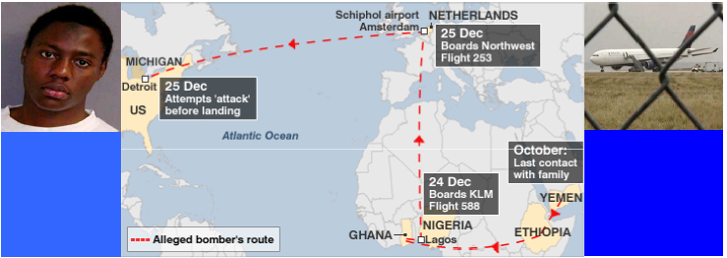
INTELLIGENCE EXAMPLE
Traveler Data Profiling
INTELLIGENCE EXAMPLE
Traveler Data Profiling
Umar Farouk Abdulmutallab
Cash payment
Ticket purchased from airport
One-way ticket
No hold luggage
Suspicious route
Identified on a US Watch list
BORDER CONTROL | Confidential | © AIS 2025
Notes:
Here is an example of a real case that BORDER CONTROL could have prevented.
Any of the bullets mentioned above would be considered worthy of creating a travel profile. If that were the case, Umar would have been highlighted as a potential risk. On closer inspection, the other factors would have been grounds for taking action.

Slide 24

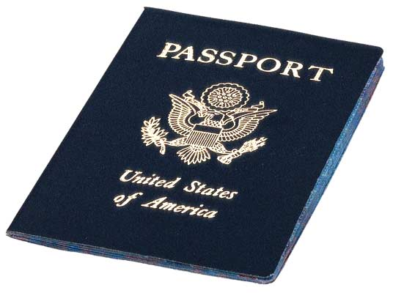
South Africa 2010 World Cup
The Headlines
South Africa 2010 World Cup
The Times 
Special Issue
AIS helps secure South Africa’s borders during and after World Cup
more than 350 alerts kept “undesirables” out of the country
Johannesburg, September 2010
South Africa’s Department of Home Affairs, today celebrated the success of Advance Passenger Processing (APP), the border management solution from air
“We selected AIS's APP solution because it has been successfully used in other parts of the world … it has exceeded our expectations, ensuring the smooth arrival of the hundreds of thousands of visitors to South Africa for the FIFA World Cup.
“Because only those who were authorized to enter South Africa boarded the planes we were saved the expense of processing unauthorized visitors. It also allowed us to concentrate our efforts on those suspects, hooligans and others, which posed a real risk to the country, speeding up the entry process for the majority of passengers upon arrival.”
Home Affairs Director General,
Mkuseli Apleni
transport IT specialist AIS, during the recent 2010 FIFA World Cup. The system, implemented in just nine months, successfully kept “undesirables” from entering the country during the tournament.
24

Slide 25
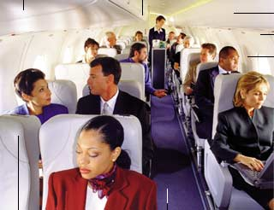

Link Detection
Seemingly Unassociated Travelers
Using API, PNR & Historical Data
Advance Risk Assessment
25
BORDER CONTROL | Confidential | © AIS 2025

Slide 26
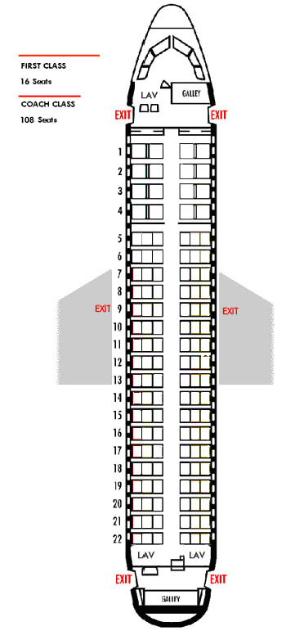
Example
Person alerted by Watchlist
Possible Links or Association
Same Booking/PNR
Booking at same date/time with same agency but different PNR
Same Credit Card used for booking
Staying at the same hotel
Similar itinerary and travel dates
Associated in past arrival/departure
26

Slide 27
Example
Person alerted by Watchlist
Possible Links or Association
Same Booking/PNR
Booking at same date/time with same agency but different PNR
Same Credit Card used for booking
Staying at the same hotel
Similar itinerary and travel dates
Associated in past arrival/departure
27

Slide 28
Example
Person alerted by Watchlist
Possible Links or Association
Same Booking/PNR
Booking at same date/time with same agency but different PNR
Same Credit Card used for booking
Staying at the same hotel
Similar itinerary and travel dates
Associated in past arrival/departure
28

Slide 29
Example
Person alerted by Watchlist
Possible Links or Association
Same Booking/PNR
Booking at same date/time with same agency but different PNR
Same Credit Card used for booking
Staying at the same hotel
Similar itinerary and travel dates
Associated in past arrival/departure
29

Slide 30
Example
Person alerted by Watchlist
Possible Links or Association
Same Booking/PNR
Booking at same date/time with same agency but different PNR
Same Credit Card used for booking
Staying at the same hotel
Similar itinerary and travel dates
Associated in past arrival/departure
30

Slide 31
Example
Person alerted by Watchlist
Possible Links or Association
Same Booking/PNR
Booking at same date/time with same agency but different PNR
Same Credit Card used for booking
Staying at the same hotel
Similar itinerary and travel dates
Associated in past arrival/departure
31

Slide 32
Example
Person alerted by Watchlist
Possible Links or Association
Same Booking/PNR
Booking at same date/time with same agency but different PNR
Same Credit Card used for booking
Staying at the same hotel
Similar itinerary and travel dates
Associated in past arrival/departure
32

Slide 33
Example
Person alerted by Watchlist
Possible Links or Association
Same Booking/PNR
Booking at same date/time with same agency but different PNR
Same Credit Card used for booking
Staying at the same hotel
Similar itinerary and travel dates
Associated in past arrival/departure
High Probability of Association
Further validation through face-to-face questioning
33

Slide 34
BORDER CONTROL INTERACTION
BORDER CONTROL Interaction optimizes and simplifies the traveler experience while delivering governments far greater control of who crosses the border from pre-departure to in-country arrivals.
BORDER CONTROL
TravelAuthorization
Exports the border, enabling early risk-based decisions about who can travel.
BORDER CONTROL
EntryExit
Rapid processing of low-risk travelers and accurate interception of high-risk travelers.
BORDER CONTROL
BorderAutomation
Fast and secure self-service border systems for an enhanced traveler experience.
34
Notes:
BORDER CONTROL Interaction optimizes and simplifies the traveler experience while delivering governments far greater control of who crosses the border from pre-departure to in-country arrivals. Three products are included:
BORDER CONTROL TravelAuthorization is a complete solution for effective pre-departure travel authorization. It includes a full e-visa issuance and management system, as well as the ability to issue electronic travel authorizations that offer a traveler-friendly visa substitute for visitors from visa waiver countries. Real-time denial of boarding functionality ensures that all last-minute checks are in order prior to authorizing the airline to board the passenger.
BORDER CONTROL EntryExit provides governments with a comprehensive border clearance system for the manual immigration lanes to process arriving and departing travelers efficiently and securely. Biometric and biographic data is captured and checked against government watch lists to ensure detection and timely interception of high-risk travelers.
BORDER CONTROL BorderAutomation self-service kiosks and gates automate the border control process for low-risk travelers, freeing up border control resources to focus on higher-risk travelers. High standards of security are ensured by combining biometric identity verification with checks against watch lists and risk assessment data.

Slide 35

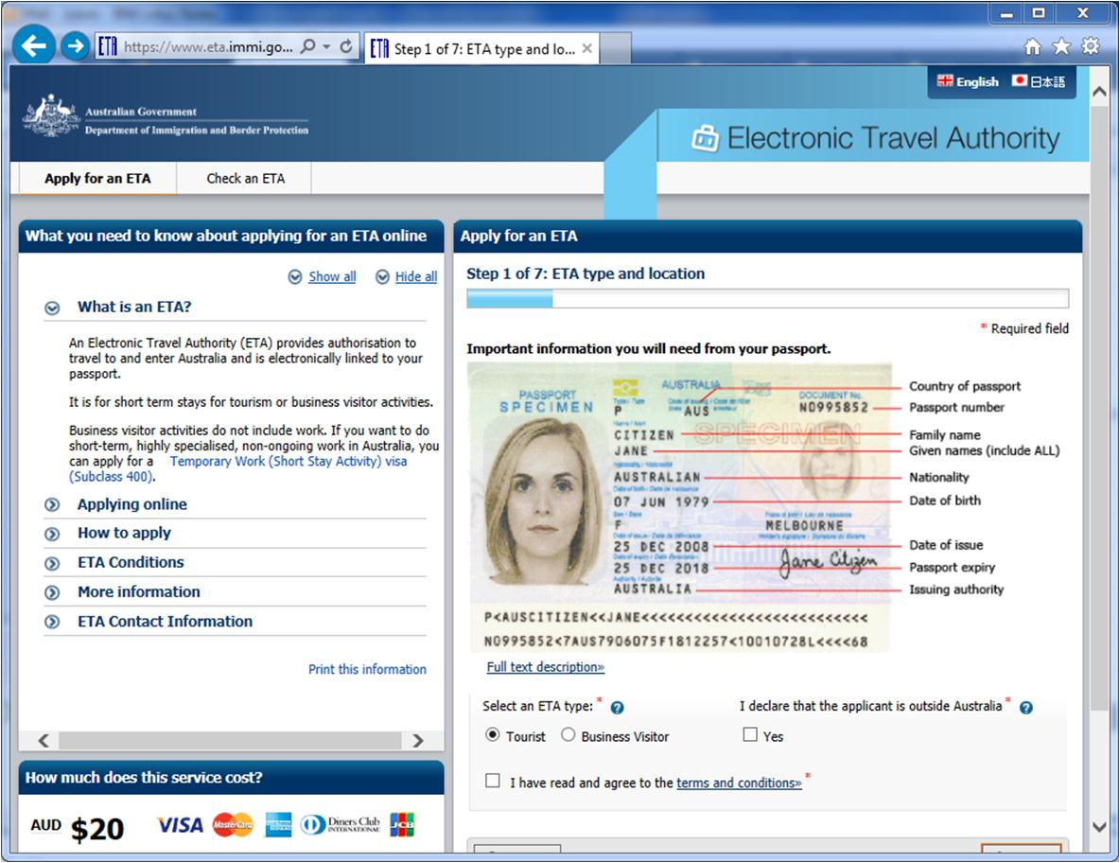
USE CASE - AUSTRALIA
BORDER CONTROL
TravelAuthorization
2.5M electronic travel authorizations per year
3M enquiries on ETAs status
35
Notes:
The Australian Government has been using BORDER CONTROL since the late 1990s, when it deployed Electronic Travel Authorizations (ETAs) in readiness for the Sydney 2000 Olympics. Today more than 2.5M ETAs are issued to nationals of 34 nations annually.
BORDER CONTROL TravelAuthorization allows ETAs to be issued by a travel agent or airline on behalf of the traveler, or the traveler can apply themselves through an Internet portal. Both tourism and visitor ETAs are supported. In most cases the traveler receives an immediate response indicating that their ETA is approved. Airlines have the ability to check travelers’ ETA status at the airport of departure. More than 3M ETA enquiries are performed each year, helping airlines avoid fines for non-compliance with border regulations.
Subsequently Australia deployed other BORDER CONTROL components, including denial of boarding functionality, that allows the Australian government to authorize or deny boarding of each passenger at the time of check-in in real time based on the latest risk assessment. The system works anywhere that a passenger is checking in for a flight to Australia, with 99.98% of transactions taking less than 2.5 seconds. More than 20 different government systems and databases have been integrated with BORDER CONTROL , ensuring a rapid response based on the latest available risk data.
Deploying BORDER CONTROL TravelAuthorization helped Australia cope with the security and facilitation demands of the Sydney Olympics and it remains a cornerstone of Australia’s border management strategy today.

Slide 36
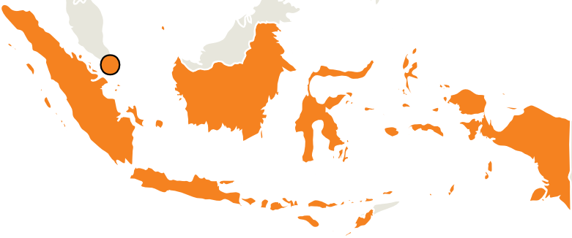
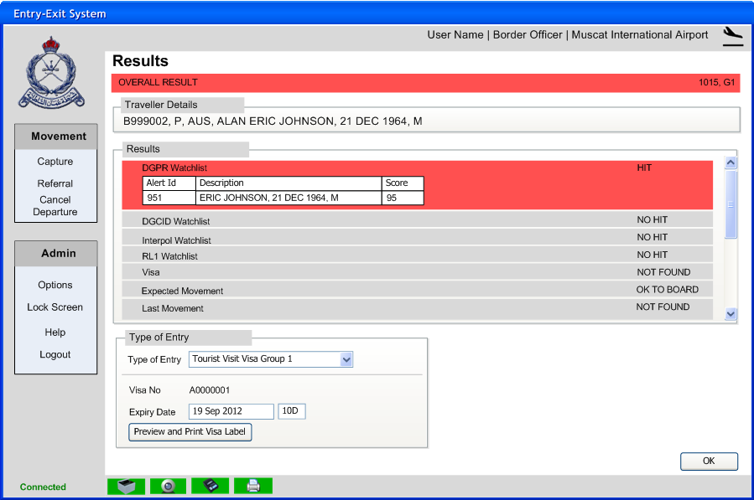
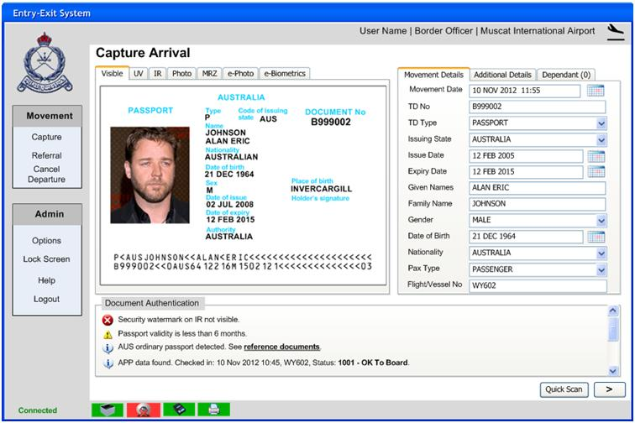
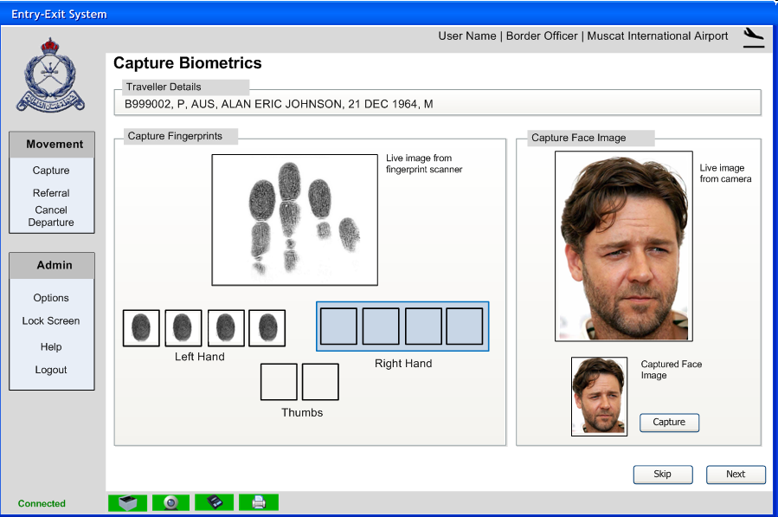

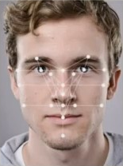
USE CASE - INDONESIA
BORDER CONTROL
EntryExit
Travel document verification, biometric capture, watch list checks, distributed watch lists
33 ports, 400+ workstations, 27M passengers p.a.
BORDER CONTROL
IdentityAssurance
Person-centric database: 15M identities
Biometric watch list with over 15k records.
36
Notes:
For Imigrasi, the Immigration Authority in Indonesia, AIS has provided an extensive deployment of BORDER CONTROL EntryExit and BORDER CONTROL IdentityAssurance.
BORDER CONTROL EntryExit is used at the manual immigration primary line counters to process arriving travelers, including capturing biometric data from visitors. The system is deployed at 33 ports across the nation, including airports and seaports, and is used on more than 400 workstations / immigration lanes. 27M passengers per annum are processed using the system.
BORDER CONTROL EntryExit provides a 3 step process. In the first step travel document data is captured. In the second step biometrics are captured and in the third step results are displayed to the officer, including watch list checks (biometric and biographic) as well as visa and passport checks and prior travel history. Additional functionality is provided for Visa on Arrival processing and for additional investigations on the secondary line.
BORDER CONTROL IdentityAssurance is used to centrally manage all biometric identity data across the border management operation. Biometric data is captured from the primary line, for the passports and visas issuance systems, from illegal detention centers and the prison system as well as other sources. Currently the system stores over 15M identities in the person centric database. The system effectively prevents identity fraud by checking each traveler against the most reliable source of data previously provided by that individual as well as against their travel document.

Slide 37
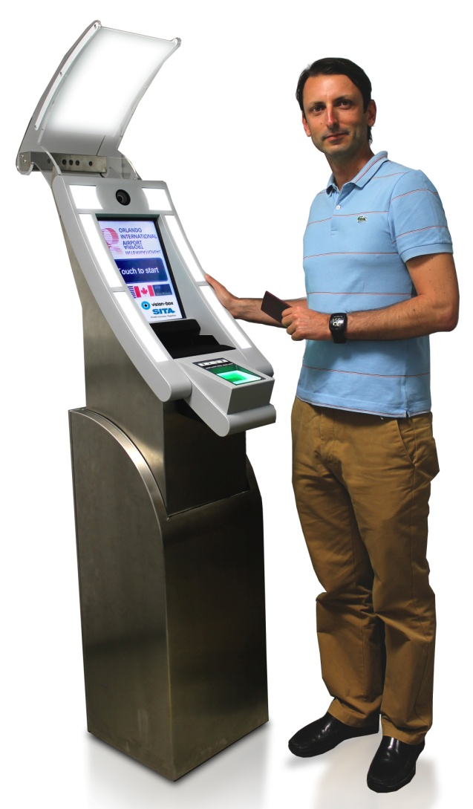
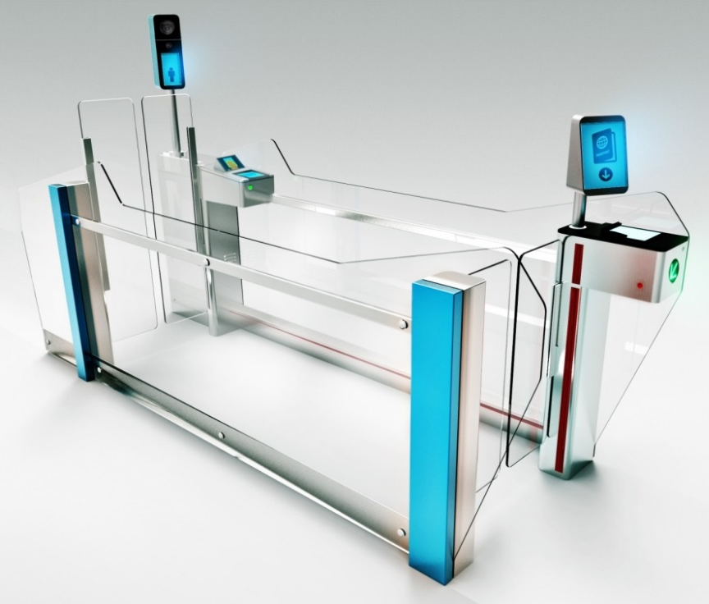
USE CASE – BORDER CONTROL INTERACTION
BORDER CONTROL
BorderAutomation
Automated Border Control Gates (DUB, FCO).
Biometric clearance of low-risk travelers
Designed for maximum flow
Increased security
Automated Passport Control (US CBP).
Secure biometrics and document capture
Integrated with standard border clearance process
37
Notes:
AIS has deployed our BORDER CONTROL BorderAutomation gates at Dublin and Rome airports. The gates are capable of processing each passenger in less than 10 seconds and are designed to be very easy to use. Both face and fingerprint are supported with the biometric matching for face against the e-Passport typically taking less than 2 seconds.
In Miami and Orlando we have deployed BORDER CONTROL BorderAutomation kiosks which are used to capture travel document, biometric data and the customs declaration in advance of the traveler presenting to the immigration officer at the primary line. By speeding up the immigration process at the counters, the kiosks have improved overall throughput by 400%, resulting a significant reduction in wait times which were running as high as 3-4 hours at peak times.
AIS kiosks are distinguished by their ease of use and the high quality and ergonomic biometric capture, which uses a moving camera system and advanced lighting to capture a direct-on face image that is appropriately lit regardless of variable lighting conditions at the airport.

Slide 38
BORDER CONTROL INSIGHT
BORDER CONTROL Insight ensures governments have a comprehensive view of border operations; powering collaborative decision-making and risk-based targeting of resources to keep the border secure and the country open for business.
BorderOperations
Delivers a complete picture of border operations in real-time across the entire country.
BorderPerformance
Delivers optimum performance for the efficient management of a secure border.
38
Notes:
BORDER CONTROL Insight ensures governments have a comprehensive view of border operations; powering collaborative decision-making and risk-based targeting of resources to keep the border secure and the country open for business. Two products are included:
BORDER CONTROL BorderOperations allows governments to centrally manage the border operation across the entire nation. It includes the tools to manage risks, action alerts and allocate resources based on emerging threats. AIS can deploy complete operations center solutions for customers including all the tools needed to manage the border operation as well as on-the-ground operations staff and infrastructure. Our most sophisticated customers have deployed state-of-the-art command and control center facilities that include a video wall showing aircraft movements and emerging threats in real time. Aircraft are tracked on a map. If a threat emerges the aircraft is shown in red. Operators at workstations can click on the flight to view details of the threat (e.g. watch list hit) and use the BORDER CONTROL BorderOperations tools to initiate an appropriate action in response to the threat.
BORDER CONTROL BorderPerformance allows governments to monitor the performance of the border. This is the newest area of the BORDER CONTROL portfolio, with capabilities such as a performance dashboard expected to be launched in 2014.

Slide 39
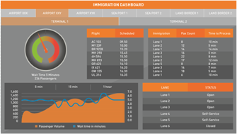
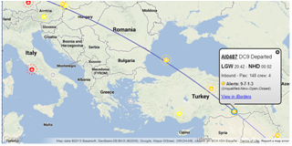
BORDER CONTROL INSIGHT SNAPSHOT
BORDER CONTROL Insight delivers complete real-time situational awareness of border operations and performance. Our solution provides a centralized view, statistics, metrics and powerful predictive tools to dynamically match resources against demand and priorities.
KEY BENEFITS
  Enhanced ability to predict and react to changing threat environments
  Multiple government agencies are able to make timely and collaborative decisions
  Advanced reporting and analysis tools drive efficient risk-based resource allocation and reliable performance reporting
  Full integration with BORDER CONTROL broader portfolio
BORDER CONTROL Insight Portals and Dashboards
FEATURE / FUNCTION
Features
  Operations portal
  Operations reporting
Options
  ContactManager
  RiskTracker
Notes:
BORDER CONTROL provides border agencies with a complete situational awareness capability. This is achieved by combining all available information from multiple sources to deliver real-time insight on border operations. Reporting and analysis tools are then added to support fast and effective decision-making to optimize the utilization of all available resources where and when they are most needed.
KEY BENEFITS
Enhanced ability to predict and react to changing threat environments.
Insight provides up to date visibility of all travelers' status as they journey to and from the country. This coupled with the risk view of each traveler allows the government to plan action in advance and to react to changing circumstances.
Through the provision of historical statistical and trend data regarding the threat environment, government users can make predictions based on time of year, special events, the impact of changing carrier routes, etc.
Multiple government agencies able to securely access high quality information driving timely analysis and collaborative decision making
Secure, controlled access is provided to the stakeholders identified by the customer to provide the opportunity for collaboration where this is of benefit.
The data feeding BORDER CONTROL products goes through a rigorous certification process before being put into live operations and is validated and corrected during submission and at reception to ensure it is high quality and dependable.
Advanced reporting and analysis tools provide statistically based views of current, past and predicted future trends to help drive efficient risk based resource allocation and reliable performance reporting.
Best in class analysis and reporting products are incorporated with BORDER CONTROL Insight, and this selection is continuously reviewed. The detailed and long-developed domain knowledge of our BORDER CONTROL development team ensures that the BORDER CONTROL data structures are appropriately structured and contextualized to ensure insights the customer desires are made possible.
Full integration with BORDER CONTROL Interaction, Intelligence and Information products
All BORDER CONTROL products can be combined into a solution in almost any combination to answer the customer’s specific needs. This modularity also allows for BORDER CONTROL products to quickly and easily be combined with existing customer systems or recommended 3rd party software to build a customized solution.
FEATURE / FUNCTION
Features
Operations portal: Gives complete oversight of the operating condition of the BORDER CONTROL solution, provides customizable triggers for threshold based proactive notification of emerging issues and logs status for further analysis. [Built-in to all BORDER CONTROL solutions]
Operations Reporting: Contains standard reports, developed over many successful BORDER CONTROL deployments to highlight historical trends, provide statistical information, build stakeholder compliance evidence, quantify the value achieved from the BORDER CONTROL solution and inform the customer’s own business reporting. [Built-in to all BORDER CONTROL solutions]
Options
RiskTracker: Provides a graphical display of live flights overlaid on a map, with a clear indication of the current risk associated with each flight, based on risk assessment of associated traveler data.
ContactManager: Provides the tools and workflow to manage interactions with external stakeholders, such as airlines requesting support when a traveler is denied boarding based on a risk assessment result, or vetting a visa application.

Slide 40
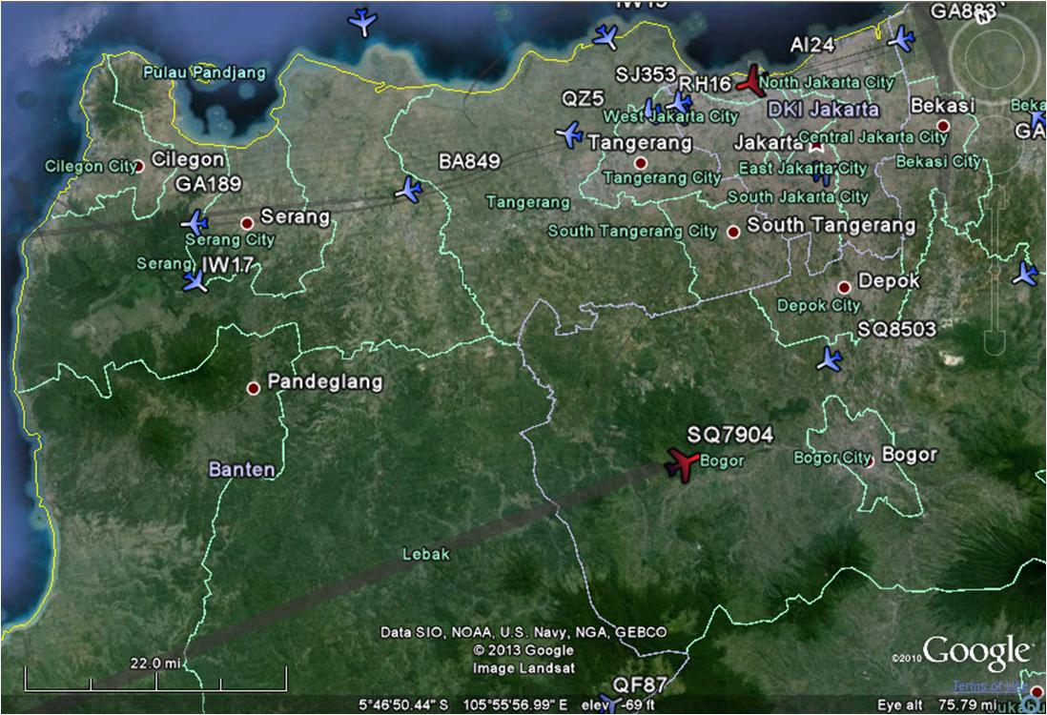
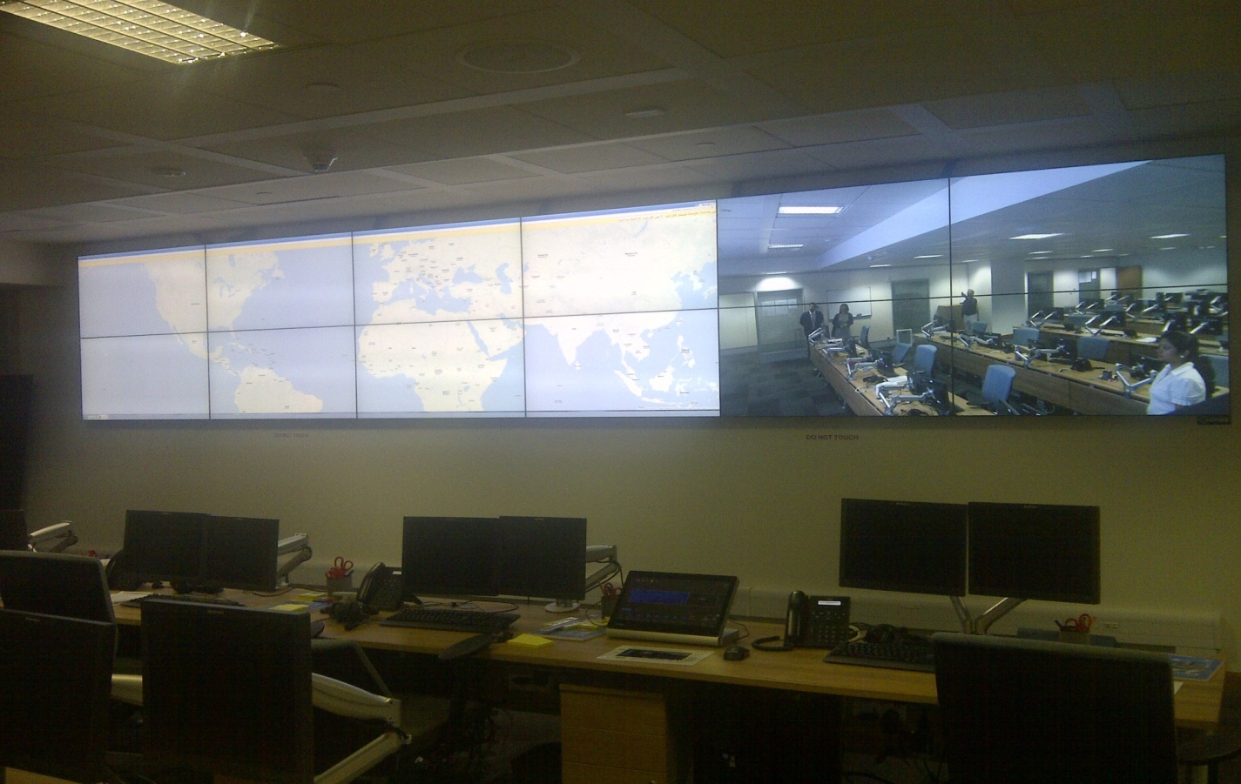
IN MORE DETAIL
BORDER CONTROL BorderOperations
BORDER CONTROL BorderOperations
Delivers a complete picture of border operations in real-time across the entire country.

Slide 41
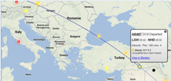




HOW DOES IT WORK?
BORDER CONTROL BorderOperations – RiskTracker
BorderOperations
RiskTracker
See location of flights
See risks inbound
For risk management officers and resource managers
Prioritise workflow
Effectively deploy port resources
Live risk updates
Carriers (air, sea, land)
BORDER CONTROL
RiskManagement
Notes:
BORDER CONTROL BorderOperations RiskTracker
A geographical display of all known inbound vehicles, and their risk status
Used by risk management officers and resource managers
Allows prioritisation of risk assessment workflow and resource deployment at ports
Integrates with multiple sources of data to provide multiple levels of real-time flight updates. If available, local radar, ADS-B or Air Traffic Control feeds provide maximum accuracy.
All indicated flights are illustrated based on their overall risk status, and risk summary details provided as a configurable pop-up. Direct access to a particular traveler or flight in RiskManager is just one click away.
Easily filtered to match an individual’s priorities, workload can be managed based any mixture of the most urgent or the most important risks & flights.

Slide 42
WHY AIS
42
BORDER CONTROL | Confidential | © AIS 2025

Slide 43
WHAT MAKES BORDER CONTROL UNIQUE?
The most comprehensive border management portfolio available, with the largest and most prestigious customer base
The only commercially available, integrated traveler data acquisition and risk assessment available today
The only commercially available, interactive system that supports real-time denial of boarding based on risk assessment
Our unique position at the center of the air travel industry facilitates the technical and business relationship with the airlines, making implementation much easier
We are the global leader in providing mission-critical solutions, backed by our always-on global network, support and operations solutions
43
Notes:
BORDER CONTROL is unique as it is the most comprehensive portfolio available in the market today: from the provision of traveler information (e.g. BORDER CONTROL TravelerData) to analyzing complex data sets for risk assessment (e.g. BORDER CONTROL RiskManagement) to providing complete situational awareness of every aspect of border operations (e.g BORDER CONTROL BorderOperations), BORDER CONTROL enables governments to transform border security and ensure the country stays open for legitimate travel, tourism and trade.
AIS BORDER CONTROL is the most widely deployed border security portfolio available anywhere in the world today with deployments in 23 countries.

Slide 44
OUR POSITIONING
Features | AIS | Others | Benefits
The most comprehensive border management portfolio available | ✓ | ✗ | A single supplier results in easier implementation and a better integrated, and therefore more effective and secure, border operation
Travel industry expertise | ✓ | Variable | AIS is at the center of the global travel industry and is ideally positioned to facilitate the commercial and technical relationship with airlines –often the most difficult and overlooked aspect of deploying a complex border management solution
Border management experience | ✓ | ✗ | Subject matter expertise High quality products Effective implementations that work with and support your border operations
Global network and service capability | ✓ | ✗ | Mission-critical operations and SLAs Local and global presence Existing connectivity to airlines
44

Slide 45
BORDER CONTROL
Information
BORDER CONTROL
Intelligence
BORDER CONTROL
Interaction
BORDER CONTROL
Insight
AIS Border Security.
Transforming border operations, improving the travel experience. Globally.
45

Slide 46
IN MORE DETAIL
BORDER CONTROL TravelerData
Make booking
Check-In
Departure
In-Country
72 hrs
24 hrs
2 hrs
0hrs
Hotels, Car Rental etc.
BookingData
InteractiveData
ManifestData
InCountryData
Board /
No-Board
Response
Boarding
Request
BORDER CONTROL TravelerData
Data Validation, Normalization, Correlation, Storage & Viewing

Slide 47
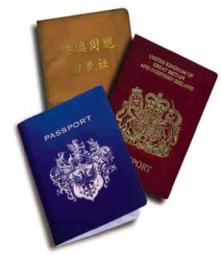
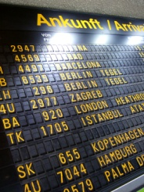
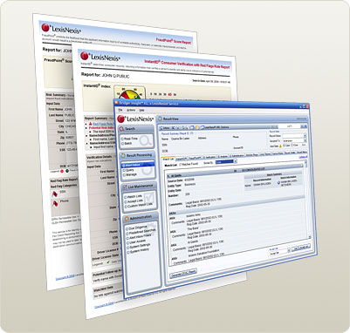


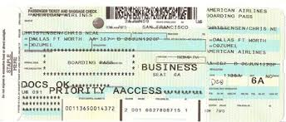
Passenger Data available from Airlines
Passenger Data
APIS, Advance Passenger Information Batch data (flight + passenger MRZ manifests) received after departure | APP, Advance Passenger Processing or iAPI (interactive API or AQQ) Interactive, real-time check-in, pre-departure (flight + passenger MRZ) | PNR, Passenger Name Record complete set of reservation and check-in data captured by the airlines

Slide 48
Passport and Travel Document Data
Data Type | Description | Carriers
APP | Advance Passenger Processing IATA endorsed standard for flight and document data declaration in real-time. Interactive process that allows governments to review and approve boarding of each passenger in real-time. | Sent by all types of carriers as part of check-in process
APIS | Advanced Passenger Information System Batch flight manifests received after departure. Legacy data format. | Used by carriers unable to send APP – sent after departure
AQQ | Advanced Quick Query. A form of interactive, real-time APIS defined by the US Customs and Border Protection agency which is similar in concept to APP. | Sent by certain airlines during check-in instead of APP

Slide 49
Booking and Check-in Data
Data Type | Description | Carriers
PNR | Passenger Name Record A booking or reservation (for air travel and possibly other services) on an ARS or GDS. In government parlance, the term PNR also includes check-in information as well as the booking itself. Note, however, such check-in data usually comes from a separate system (the DCS) and not the ARS. | Sent by airlines at pre-configured intervals
DCS | Departure Control System The system used to check passengers on to flights. In some cases, the DCS and ARS are the same system. More often, they are distinct systems (the ARS hands data over to DCS; after flight closure the DCS hands data back to the ARS). Note that Airlines sometimes provide check-in services (using their own DCS) on behalf of other Airlines. | Sent by airlines after departure

Slide 50
Data Comparison
Data Type | APIS | DCS | PNR
Name | Yes | Yes | Yes
Date of Birth | Yes | Yes | Yes
Gender | Yes | Yes | Yes
Travel Document Details | Yes | Yes | Yes
Flight details | Yes | Yes | Yes
Check-in status | Yes | Yes
Seat number |  | Yes
Seat preferences |  |  | Yes
Baggage information |  | Yes
PNR locator | Some | Yes | Yes
Booking details (date, travel agent) |  |  | Yes
Data Type | APIS | DCS | PNR
Itinerary details |  | Current Leg | All
Ticket information |  |  | Yes
Form of payment |  |  | Yes
Contact Details |  |  | Yes
Special Service Requests |  | Some | Yes
Other Service Information |  |  | Yes
Remarks |  |  | Yes
Frequent Traveller Details |  |  | Yes
Booking History |  |  | Yes

