Slide 1


Atlas Software House
Engineering the Future with AI
Intelligent Systems for a Complex World
Atlas Company | Confidential & Proprietary

Slide 2







The Atlas AI Advantage
Redefining Software Development
Beyond Traditional Code
We don't just write static scripts; we engineer intelligent systems that evolve. Our software is built on dynamic models, not just fixed rules.
Raw Data
Adaptive Ecosystems
Our solutions learn from user interactions and data patterns, continuously optimizing performance and user experience without manual intervention.
AI Engine
Predictive Intelligence
Shifting operations from reactive to proactive. We embed predictive analytics into the core of every application, from finance to healthcare.
Smart Solution

Slide 3




Our Core AI Technologies
The Pillars of Intelligent Software
Machine Learning
Deep Learning
RAG Technology
Algorithms that parse data, learn from it, and make informed decisions. We use ML for predictive analytics and trend forecasting across all platforms.
Neural networks capable of learning unsupervised from unstructured data. Essential for our computer vision and advanced pattern recognition systems.
Retrieval-Augmented Generation combines LLMs with your proprietary data. It delivers accurate, context-aware answers without hallucinations.
Regression
Classification
Neural Networks
Computer Vision
Context Awareness
Knowledge Base
Clustering
NLP
LLM Integration

Slide 4


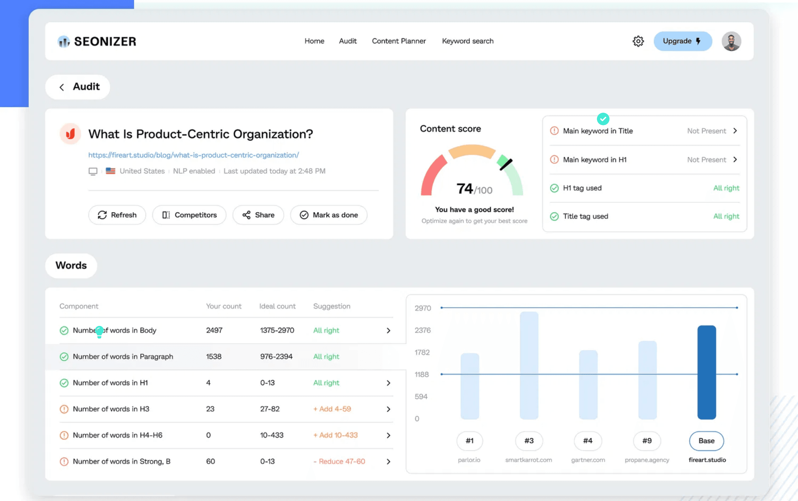




Intelligent Education: The AI-LMS
Personalized Learning at Scale
Adaptive Learning Paths
ML algorithms analyze student performance in real-time to dynamically adjust content difficulty and pacing, ensuring optimal engagement.
MASTERY: 92%
RAG-Powered Tutor
An intelligent assistant that answers student queries instantly by retrieving context-aware information directly from course materials.
NEXT TOPIC RECOMMENDED
Predictive Analytics
Early warning systems that identify at-risk students based on behavioral patterns, enabling timely intervention by educators.

Slide 5





Predictive Healthcare: The AI-HMS
Intelligent Hospital Management Systems
Predictive Analytics
Utilizing ML models to forecast patient admission rates, optimize resource allocation, and predict potential disease outbreaks before they escalate.
AI Analysis Active
PATIENT_ID: 8944-X
VITALS: STABLE
SPO2: 98%
Clinical Decision Support
AI-driven diagnostic tools that analyze patient data to suggest potential diagnoses and personalized treatment plans, reducing human error.
RAG Knowledge Integration
AI_DIAGNOSIS: PENDING
CONFIDENCE: 94.2%
Retrieval-Augmented Generation allows clinicians to instantly query vast medical databases and journals for the latest research and protocols.

Slide 6


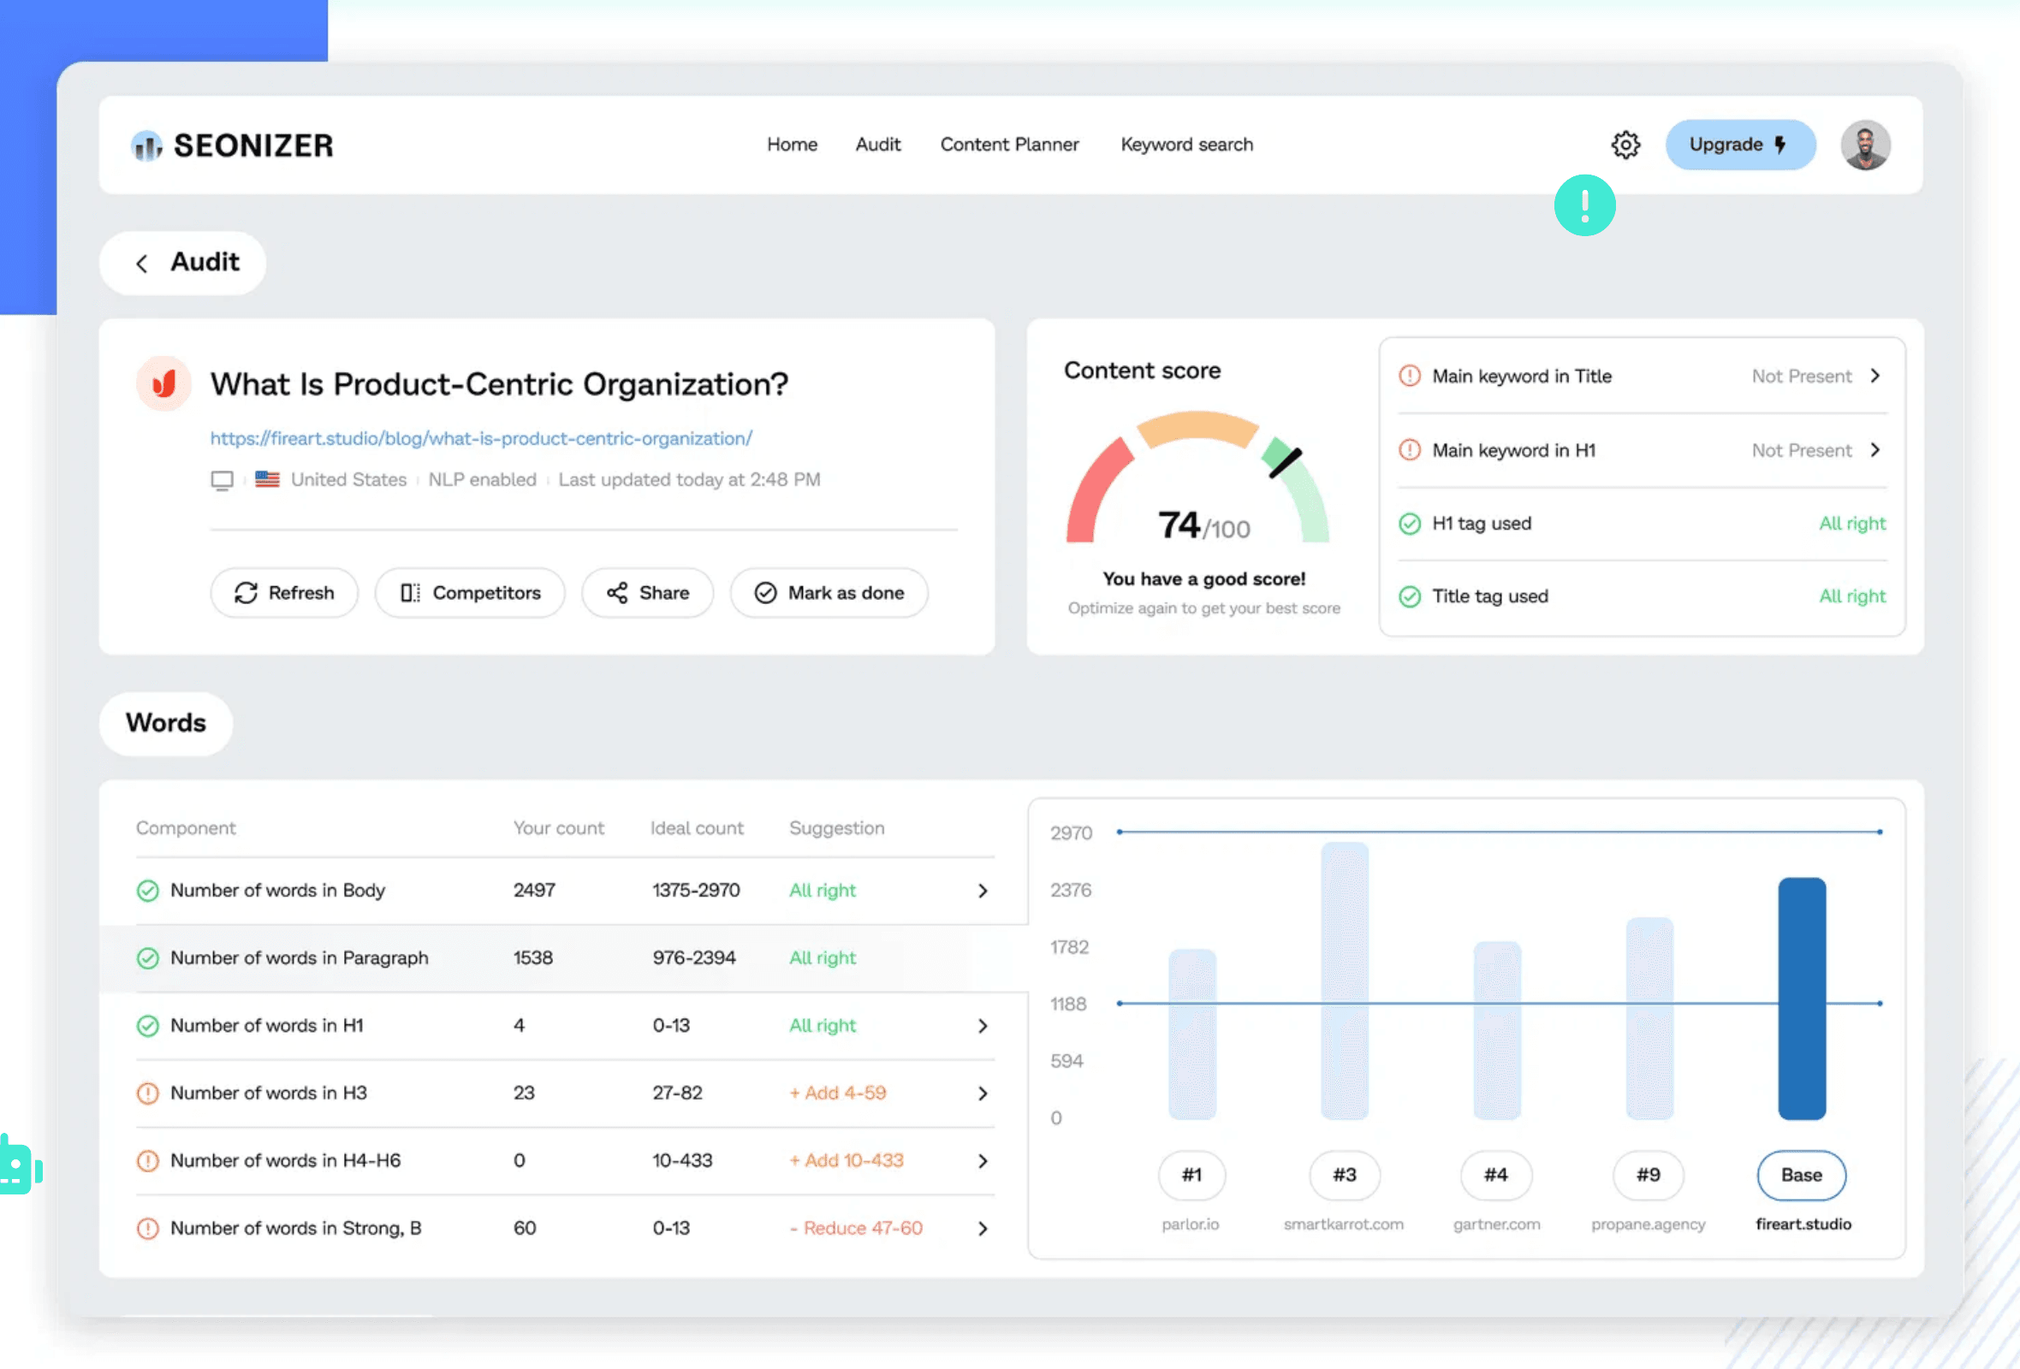




Proactive Finance: The AI-IFMIS
Integrated Financial Management Information System
AI Fraud Detection
Real-time anomaly detection algorithms monitor transactions to identify and flag suspicious activities instantly, preventing revenue leakage.
Fraud Alert Blocked
Confidence: 99.8%
Predictive Budgeting
Machine learning models analyze historical data to forecast revenue and expenditure trends, enabling more accurate and strategic budget planning.
RAG Compliance Assistant
Budget Forecast
Optimization Complete
A conversational AI interface that allows finance officers to query complex financial regulations and get instant, context-aware answers.

Slide 7






Autonomous Security
AI-Powered Threat Detection & Response
FEED: AERIAL_01 // LIVE
Computer Vision
OBJ: DRONE | CONF: 98%
Deep learning models analyze video feeds in real-time to detect unauthorized access, identify objects, and track potential threats with superhuman accuracy.
Network Anomaly Detection
ML algorithms continuously monitor network traffic patterns to identify and isolate cyber threats or unusual data spikes before they cause damage.
FEED: GROUND_CAM_04 // ANALYZING
Automated Response
> ANOMALY CHECK: CLEAR
> PERIMETER: SECURE
Integrated AI systems can instantly trigger security protocols, lock down sensitive areas, and alert personnel the moment a threat is confirmed.

Slide 8


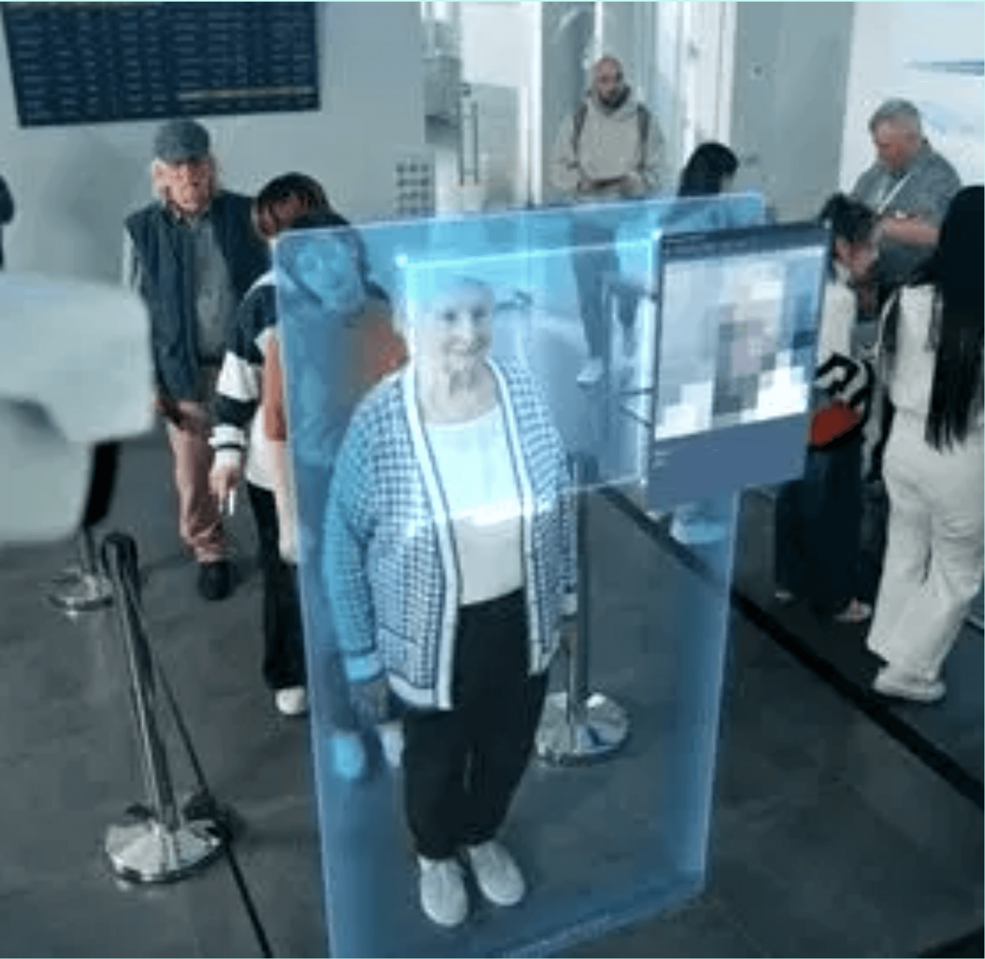


Optimized Operations: The AI-OMS
Efficiency Through Intelligence
System Status: Optimal
AI Agents: Active
Demand Forecasting
LIVE: ZONE A
Efficiency Rating
AI models analyze historical data and market trends to predict resource needs with 95% accuracy, minimizing waste.
98.4%
Supply Chain Optimization
Real-time ML algorithms route logistics and manage inventory levels dynamically to ensure operational continuity.
Predicted Load
Predictive Maintenance
Low
IoT sensor integration allows the system to predict equipment failures before they occur, reducing downtime.

