Slide 1
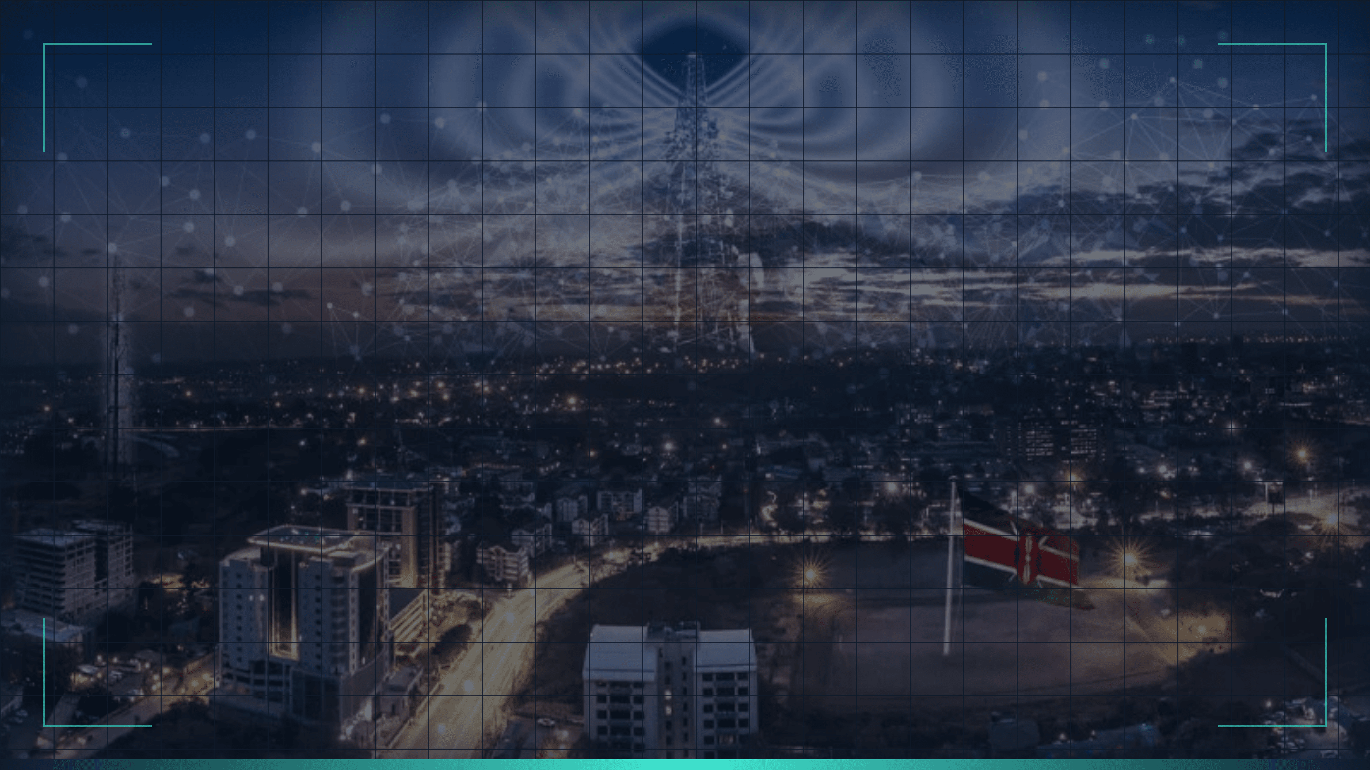

Atlas R&D Center
Africa’s Innovation Engine

Slide 2


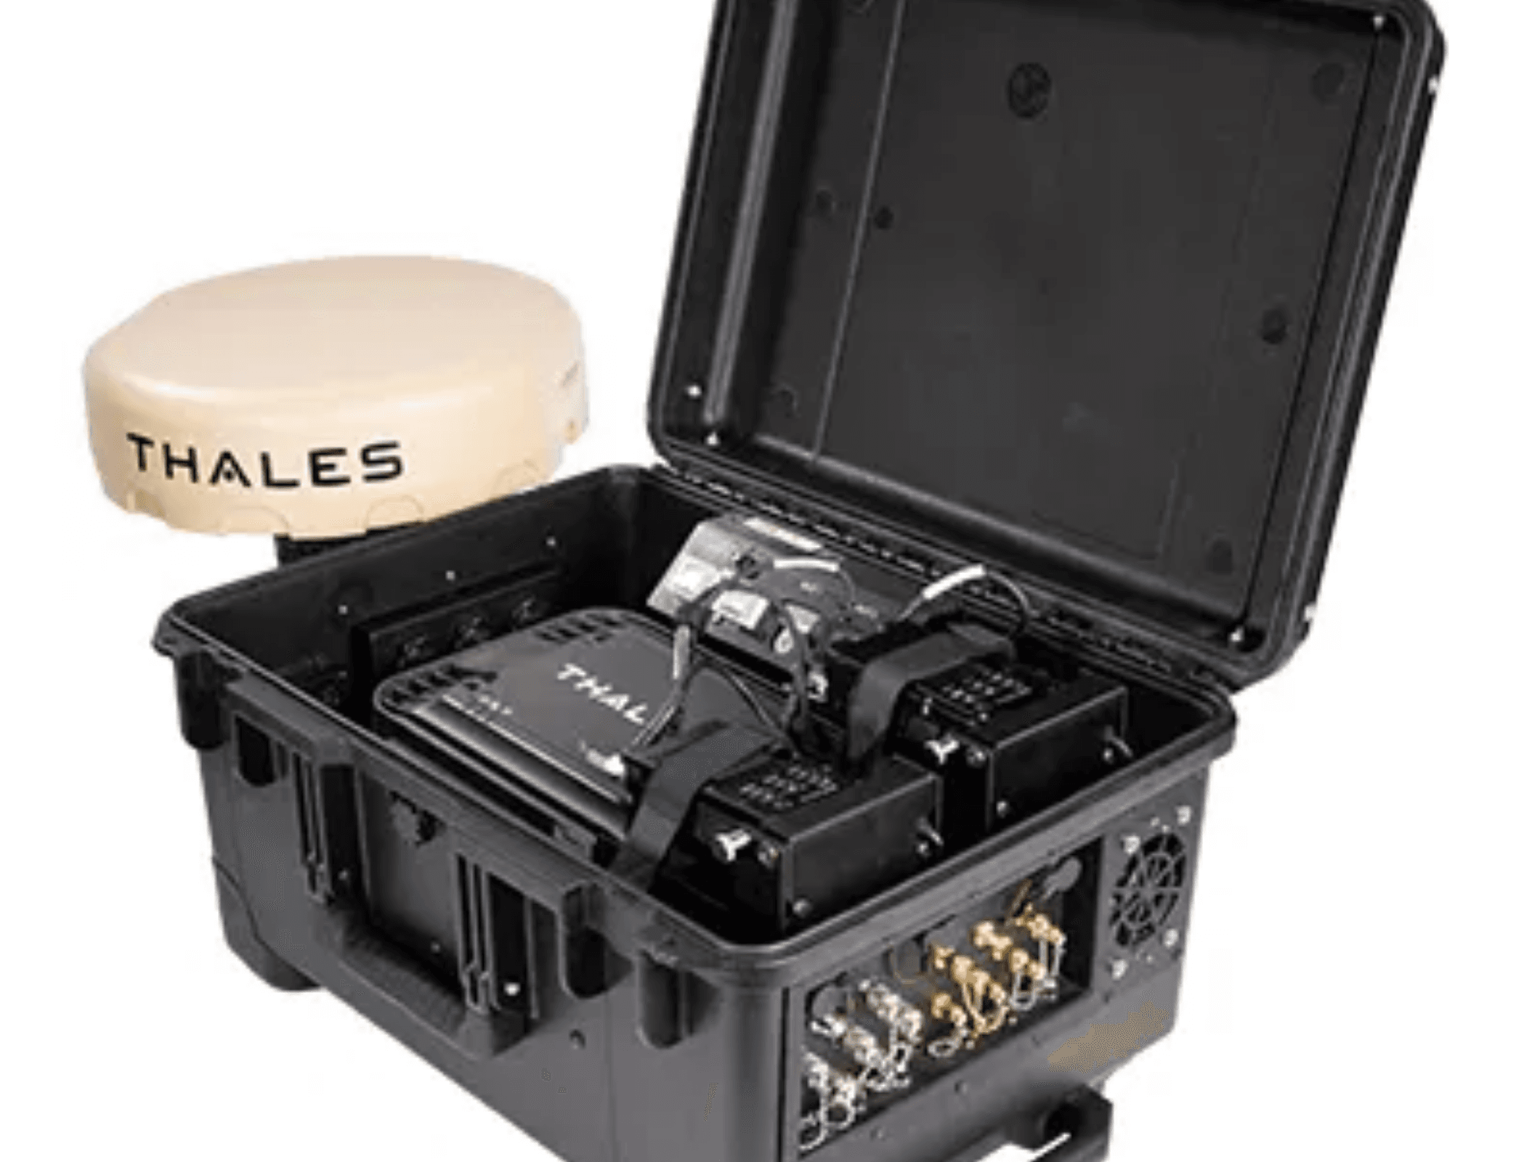

Vision & Mission
Accelerating Digital Transformation in Africa
Our Vision
"To be the premier catalyst for African technological sovereignty, driving self-reliance through innovation and world-class engineering."
Our Mission
"Pioneering tailored AI and security solutions that address regional challenges, empowering governments and enterprises with secure, scalable technology."

Slide 3






The Partner Ecosystem
Strategic Collaboration for World-Class Solutions
Salesforce
Thales
AI Core, Predictive Analytics, CRM Integration
Zero Trust Security, Data Encryption, Identity Mgmt
ATLAS R&D
Rapiscan
Oracle
Physical Screening, Threat Detection Hardware
Sovereign Cloud, OCI, Scalable Infrastructure

Slide 4

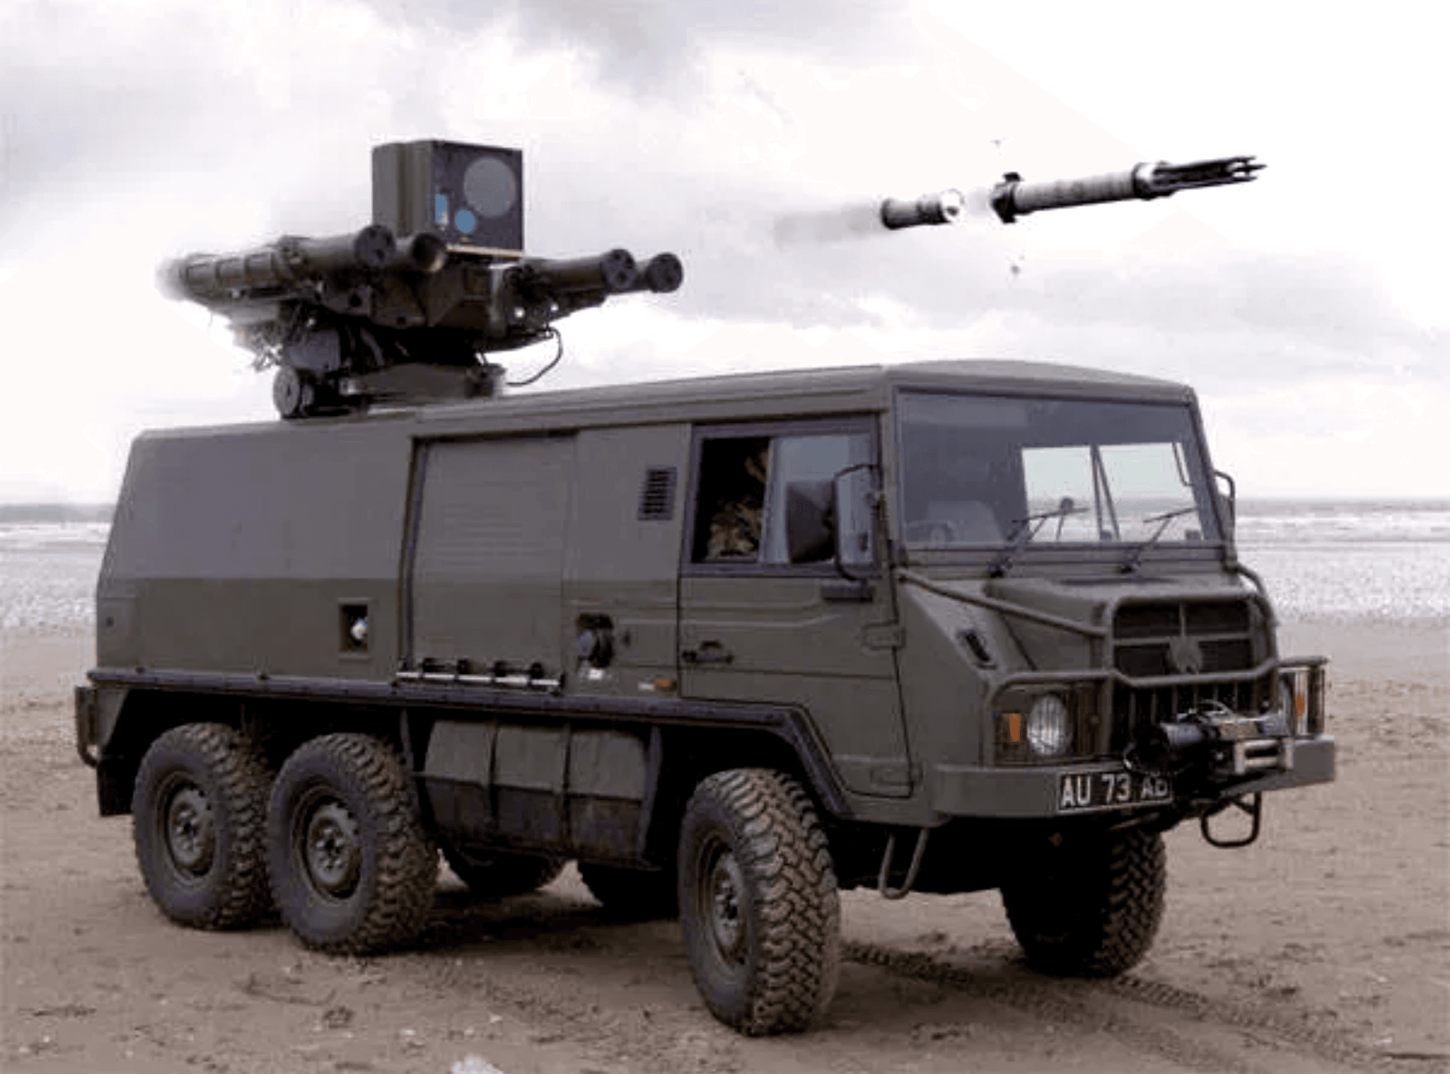




Pillar 1: AI & Predictive Analytics
Powered by Salesforce Einstein & Data Cloud
Salesforce Einstein
Predictive Modeling
Anticipating needs in public sector and enterprise operations before they arise, shifting from reactive to proactive management.
Data Unification
Aggregating data from diverse sources—including field assets and legacy systems—into a single, secure source of truth via Data Cloud.
Automated Insights
Delivering real-time "Next Best Action" recommendations to operators, enhancing decision speed and accuracy in critical scenarios.
DATA SOURCE: MISSION CRITICAL ASSETS

Slide 5


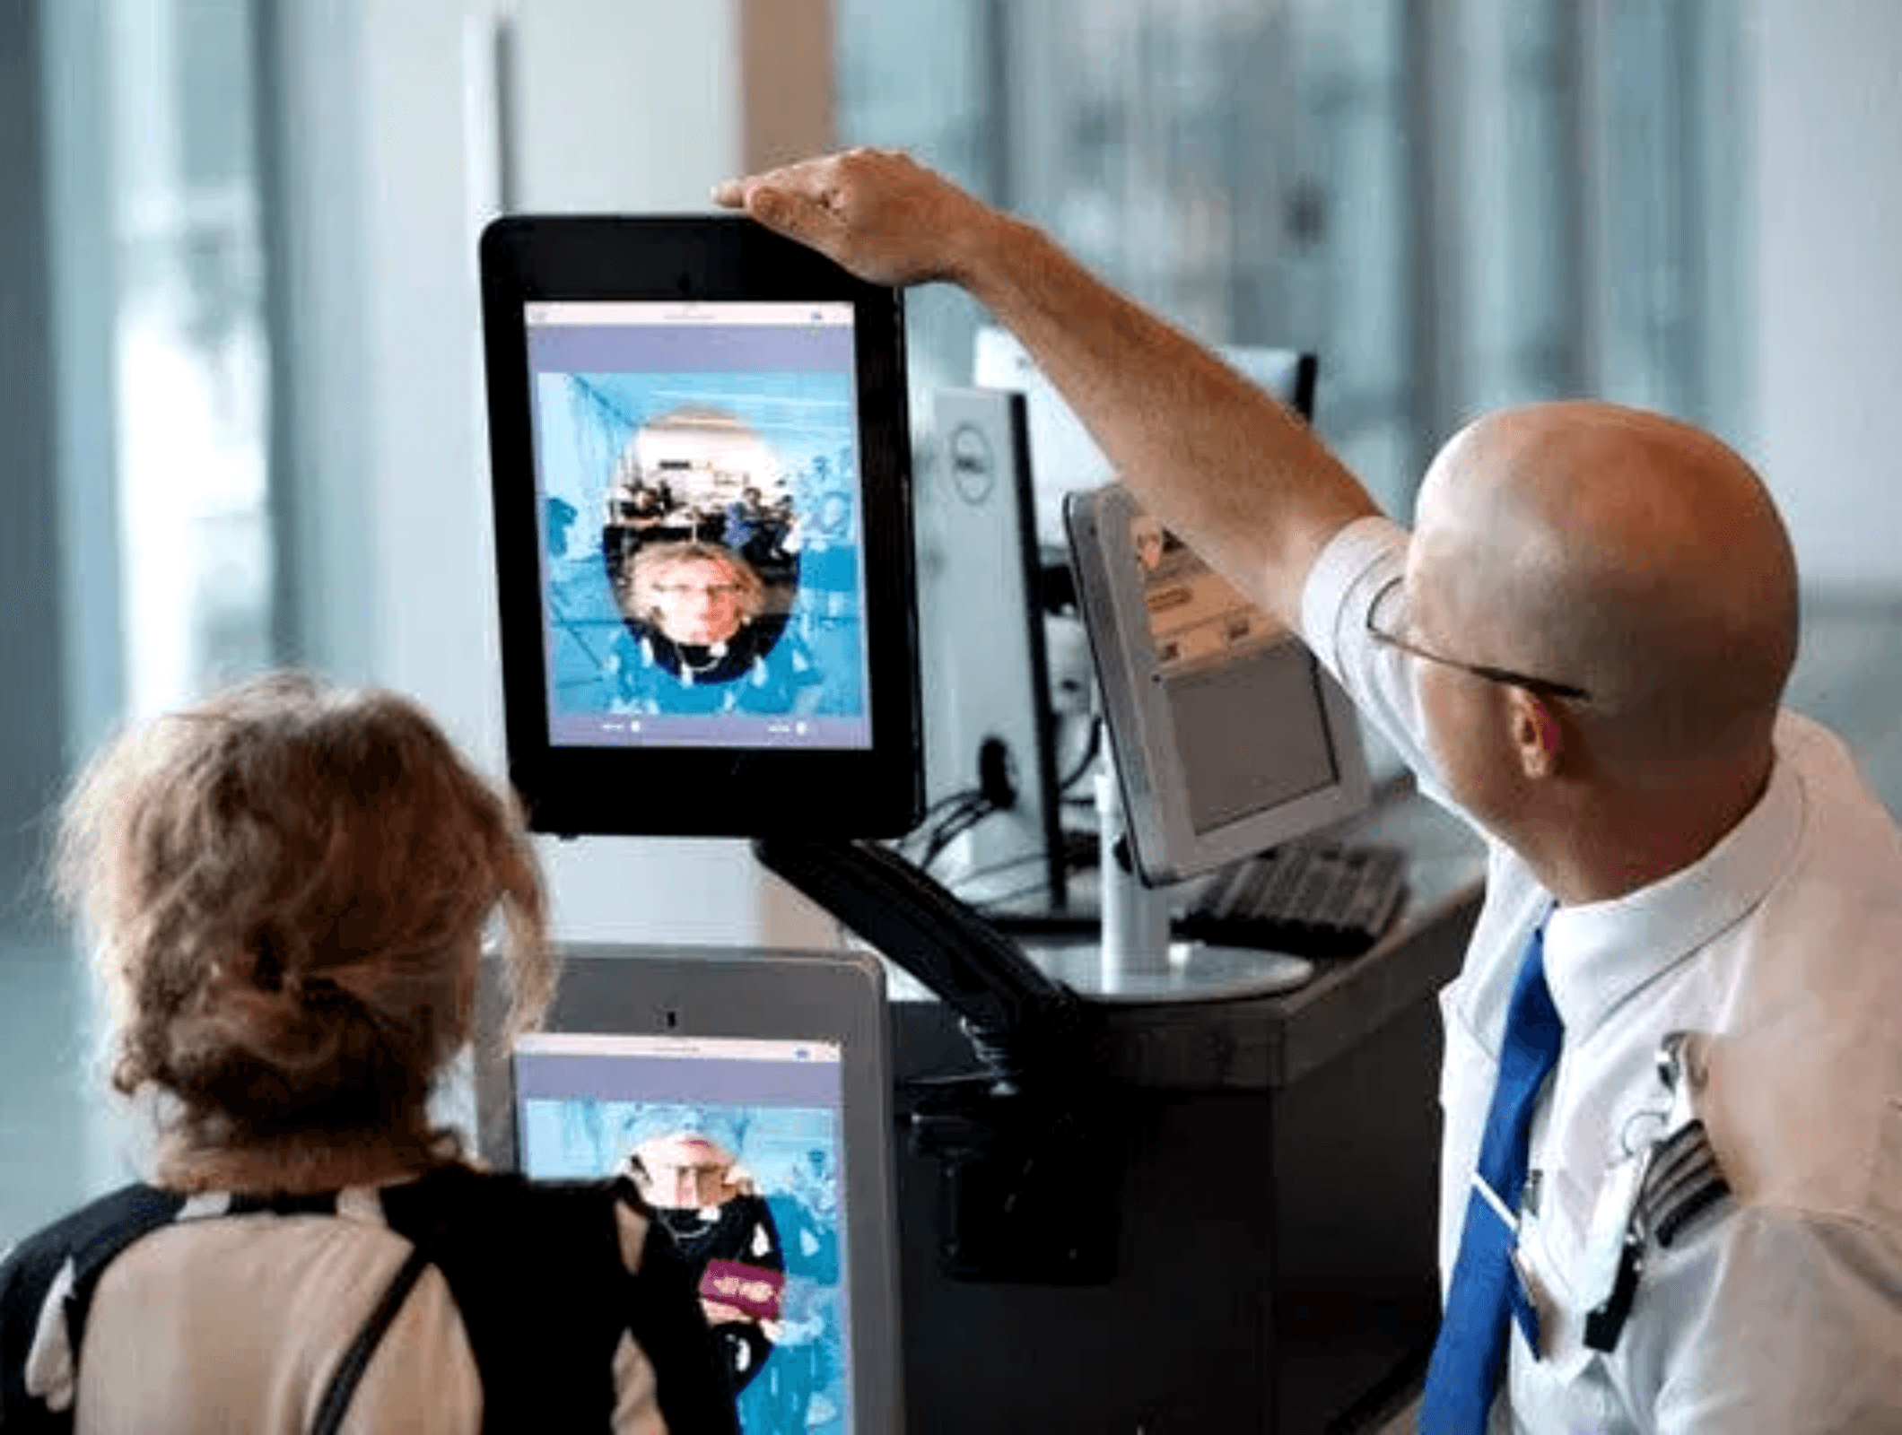



Pillar 2: Zero Trust Security
Never Trust, Always Verify
Identity First Security
Shifting from perimeter-based defense to identity-based verification. Every user and device is authenticated before access is granted.
Thales CipherTrust
Data-centric security providing granular encryption, key management, and access controls for data at rest and in motion.
Continuous Monitoring
Real-time threat assessment and dynamic policy enforcement to protect critical infrastructure from evolving cyber threats.
Powered by Thales

Slide 6

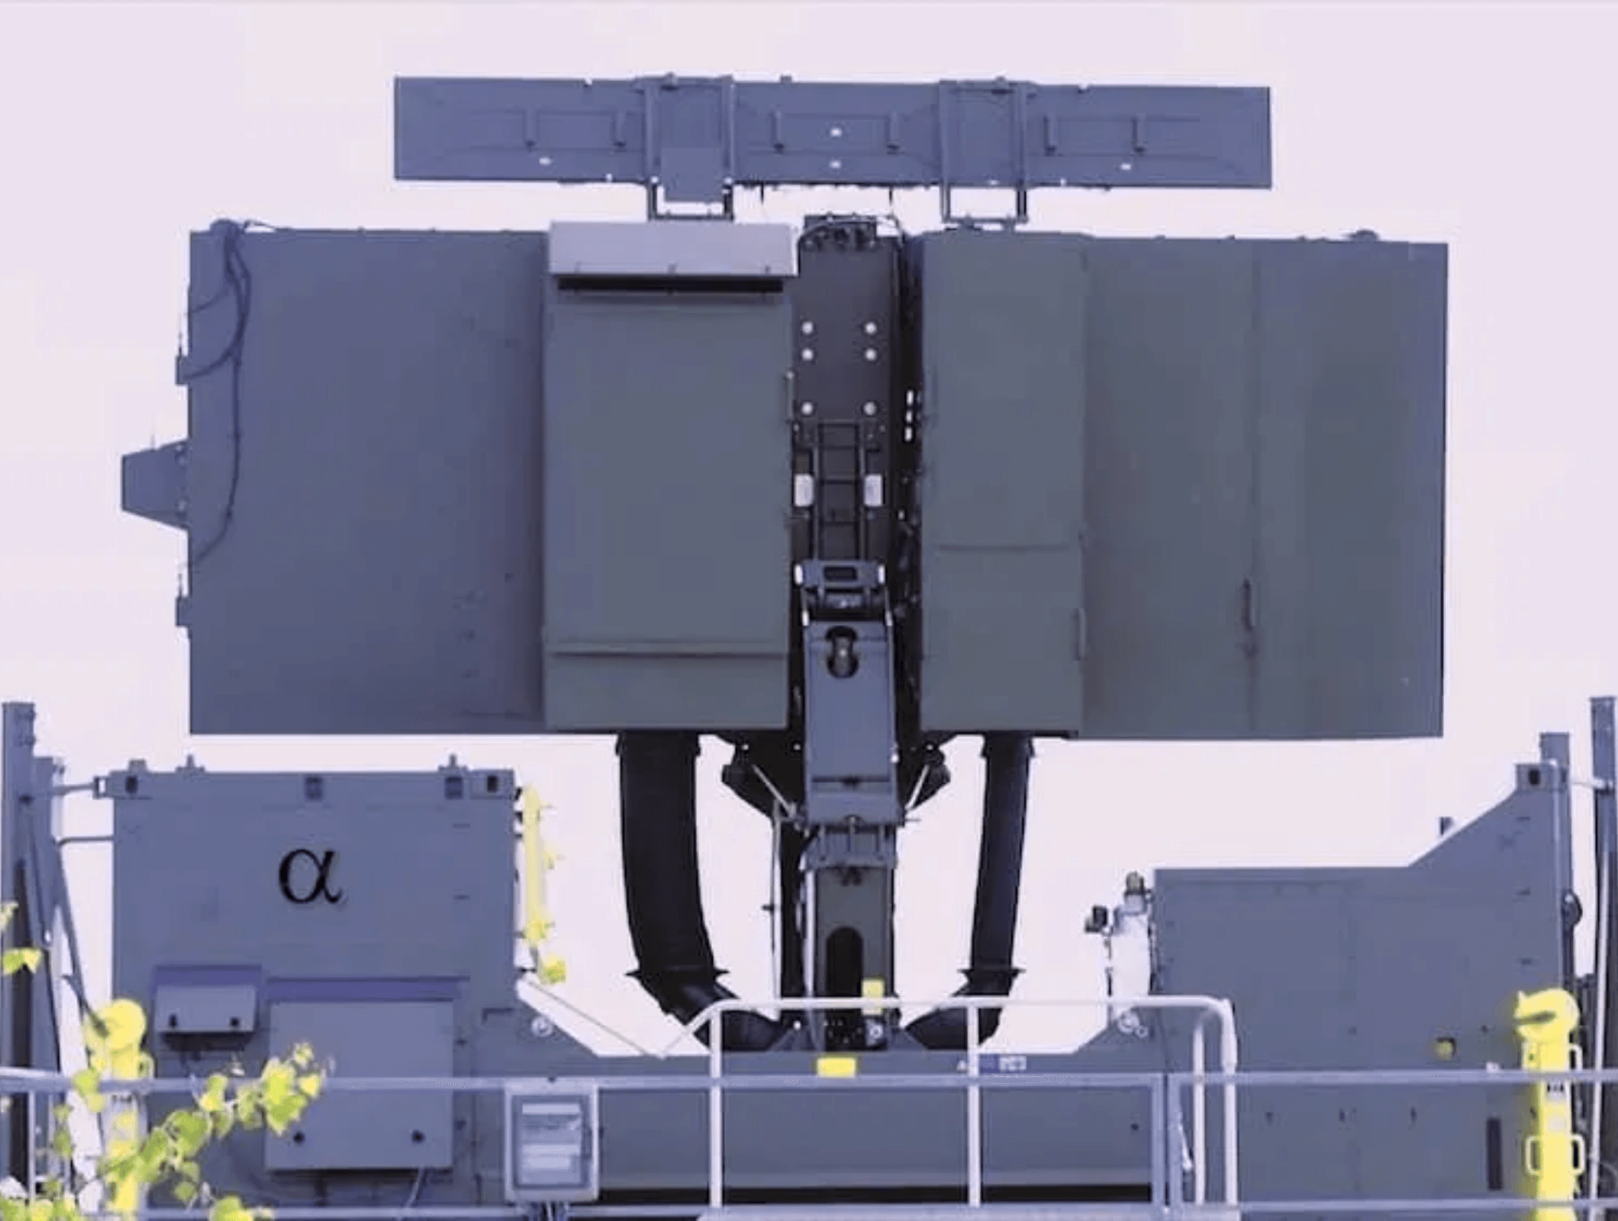


Pillar 3: Advanced Threat Intelligence
Holistic Detection: From Physical Screening to AI Analysis
Rapiscan Integration
Ingesting high-resolution physical screening data from checkpoints directly into the central intelligence core. We digitize the physical security layer for real-time analysis.
AI Correlation Engine
Cross-referencing physical scan data with broader surveillance inputs (like Thales Radar systems). Our AI detects patterns that isolated systems miss.
Predictive Alerting
Sensor Input Layer
Moving beyond reaction. The system identifies anomalies and potential threats before they escalate, enabling proactive neutralization of risks.

Slide 7


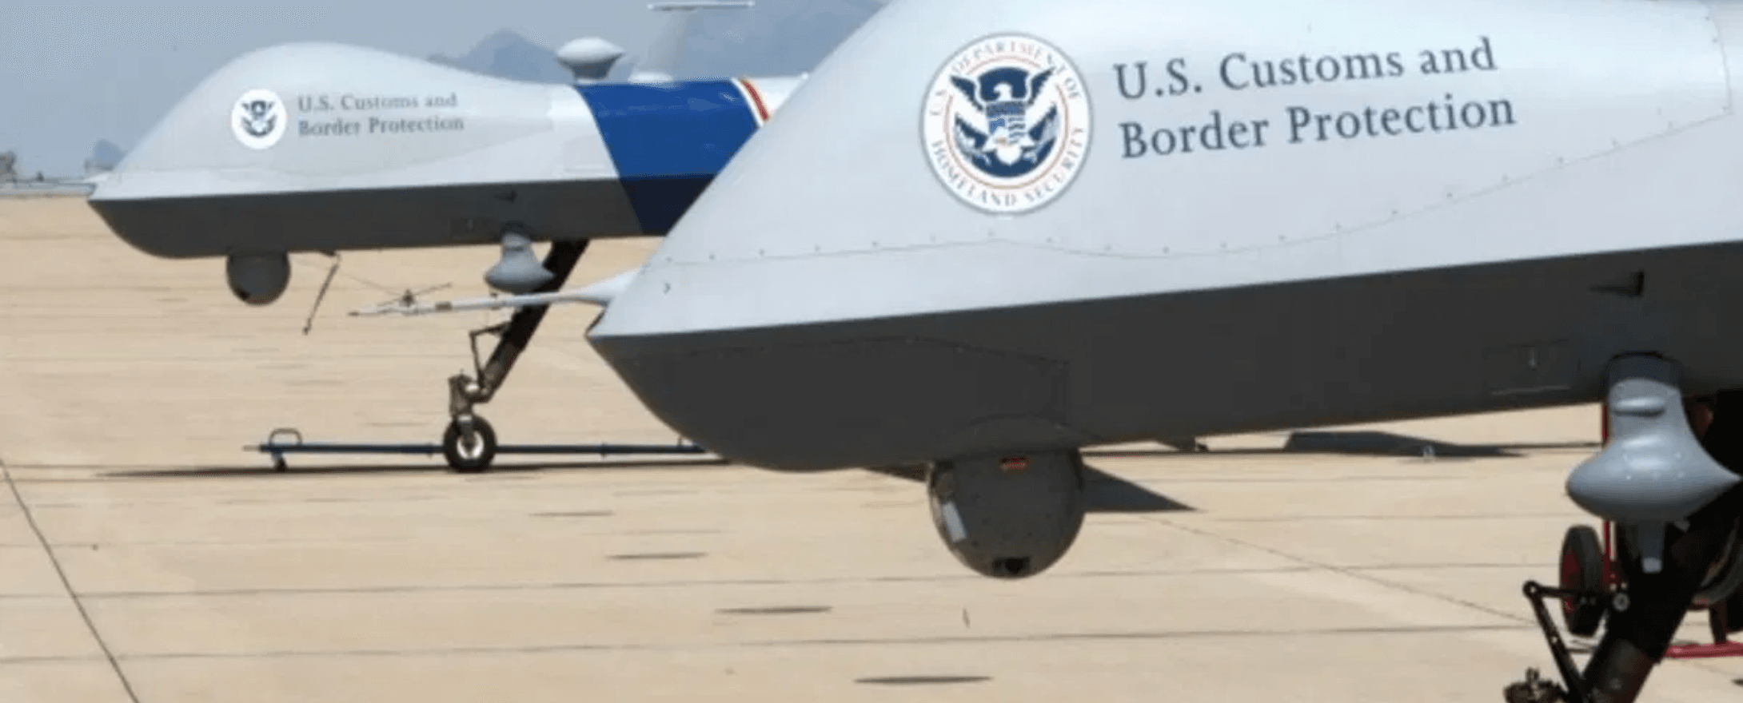

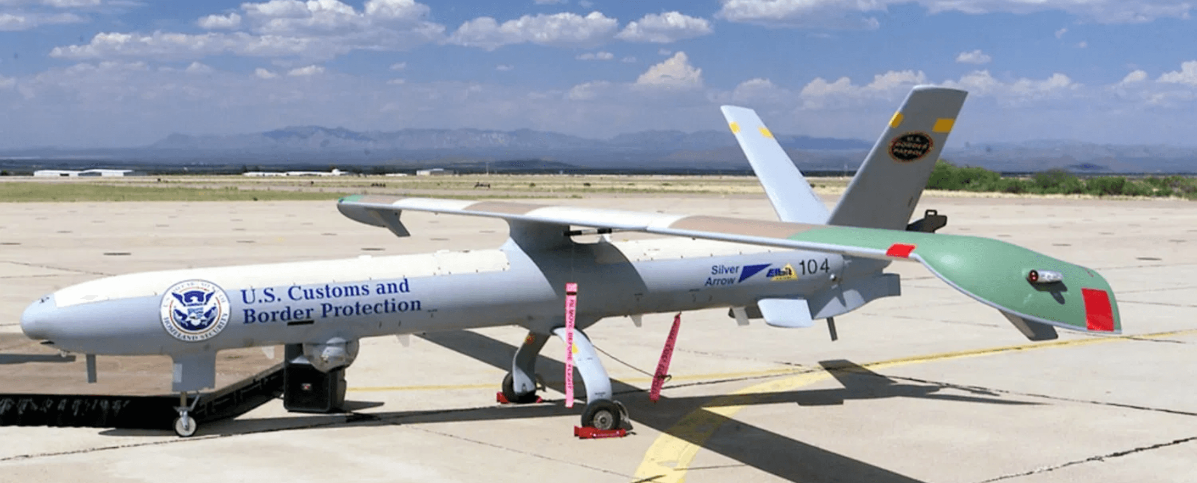

Pillar 4: Sovereign Cloud
Secure Infrastructure & Edge Computing
Sovereign Infrastructure
Built on the AIS Hub & Oracle OCI model, we provide a secure, scalable cloud environment that ensures critical national data remains within borders (Data Residency).
Powered by Oracle & AIS
Edge Node: Autonomous Surveillance
Edge Intelligence
Processing data at the source. Our architecture supports low-latency decision-making for critical assets like UAS and surveillance grids, reducing bandwidth load and increasing response speed.
Secure Data Exchange
Implementing military-grade encryption and Zero Trust protocols to secure communications between edge devices and the central cloud core.
Real-time Data Ingestion

Slide 8

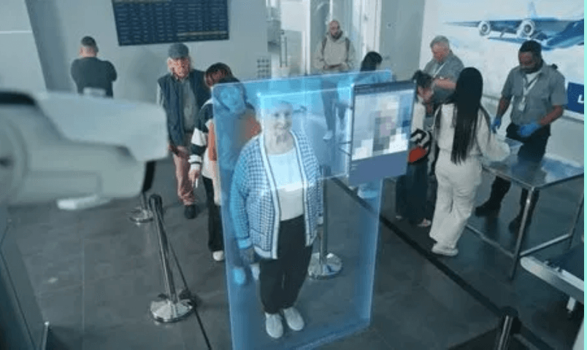



Innovation Lifecycle
From Concept to Regional Impact
01
02
03
04
Ideation
Co-Creation
Prototyping
Identifying specific regional challenges and defining strategic requirements.
Collaborating with Salesforce & Thales labs to design tailored solutions.
Agile development, security testing, and iteration in the R&D Center.
Deployment
Rollout to critical infrastructure in Ethiopia, Kenya, and Nigeria.

Slide 9

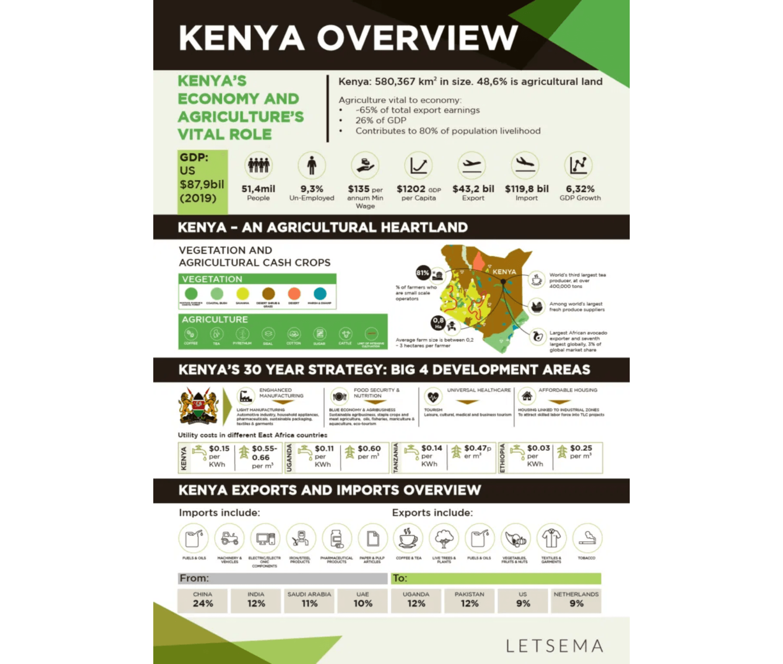



Strategic Impact
Driving Growth, Security, and Independence
Economic Data Analysis
Economic Growth
Facilitating legitimate trade and protecting national revenue streams through intelligent, data-driven border management and oversight.
National Security
Enhancing the safety of citizens and critical infrastructure by proactively identifying and neutralizing threats before they materialize.
Tech Sovereignty
Reducing reliance on foreign "black-box" systems by building local IP and expertise, ensuring long-term control over critical national assets.

Slide 10






Future Roadmap & Contact
Charting the Course for African Innovation
Research Horizons
Q3 2025
Q4 2025
2026
Quantum-Safe Cryptography
Autonomous Defense Grid
Pan-African AI Hub
Developing post-quantum encryption standards to future-proof critical national data against next-gen threats.
Launching the pilot for a fully autonomous, AI-driven border surveillance grid integrated with UAS swarms.
Expanding the R&D Center to serve as the central AI excellence hub for the entire East African Community.
Partner with the Future
Email Us
Headquarters
partners@atlas-rd.africa
Addis Ababa, Ethiopia
Join us in building sovereign technological capability.

