Slide 1



Atlas
AI &
CyberSecurity
Academy
Forging Africa’s Tech Leadership

Slide 2


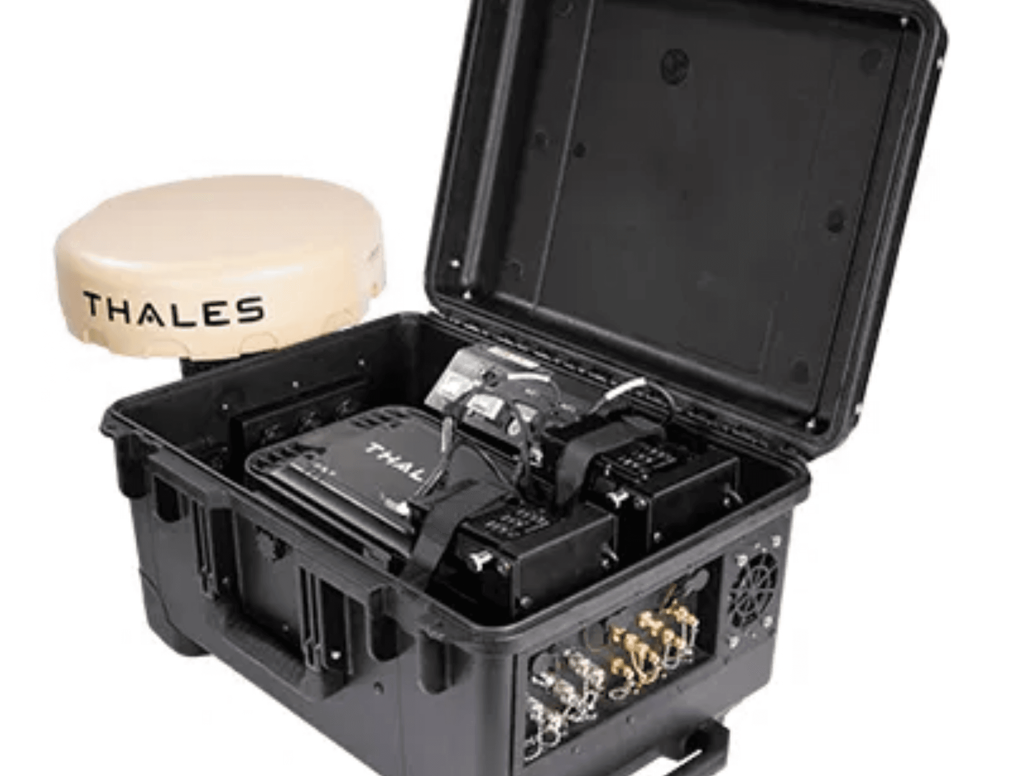

Mission & Vision
Empowering the Next Generation of Innovators
Our Mission
To bridge the digital skills gap in Ethiopia, Kenya, and Nigeria by providing world-class, practical training in AI and Cybersecurity.
Our Vision
To be the premier talent foundry for Africa, cultivating a sovereign workforce capable of building and defending the continent's digital future.

Slide 3



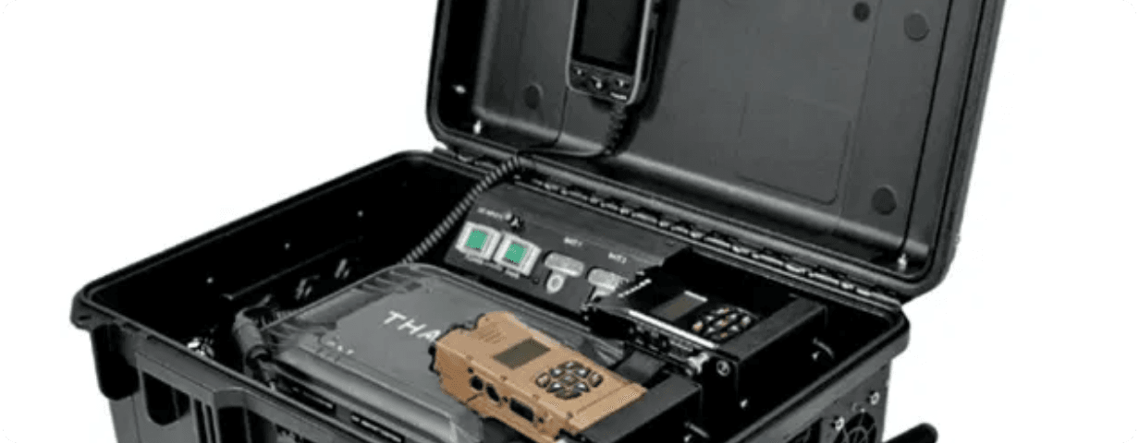
The Academy Model
A Holistic Approach: Learn, Do, Apply
01
02
03
Rigorous Theory
Hands-on Labs
Real-World Projects
Building a strong foundation in computer science, mathematics, and security principles. Our curriculum is aligned with global academic standards.
Practical training with real equipment. Students work directly with advanced sensor systems and security hardware.
Applying skills to solve actual regional challenges. Capstone projects involve deploying solutions for local industry partners.

Slide 4
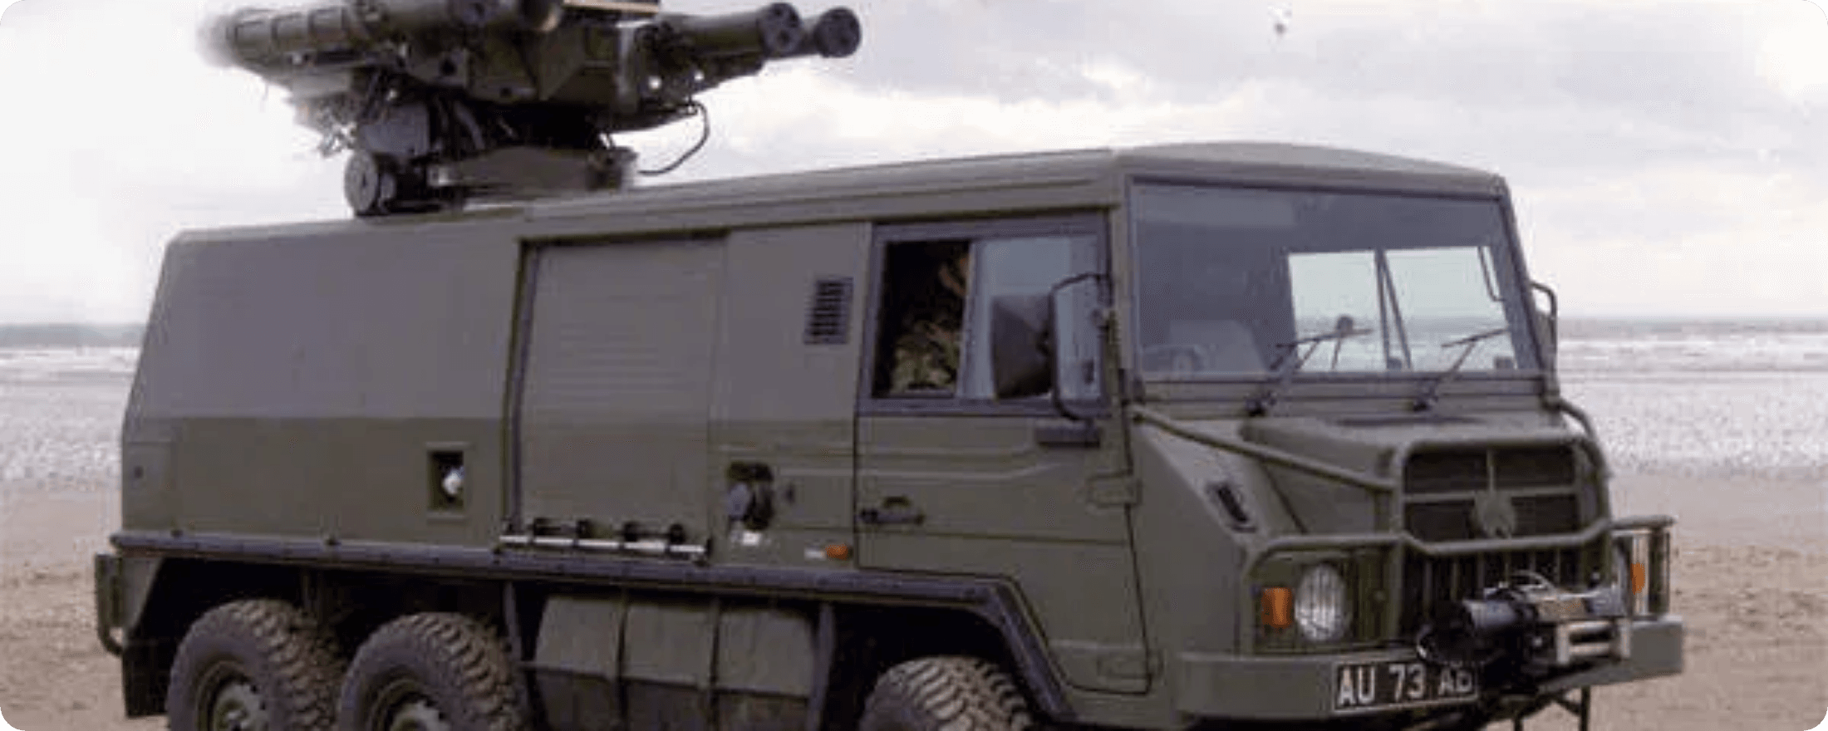


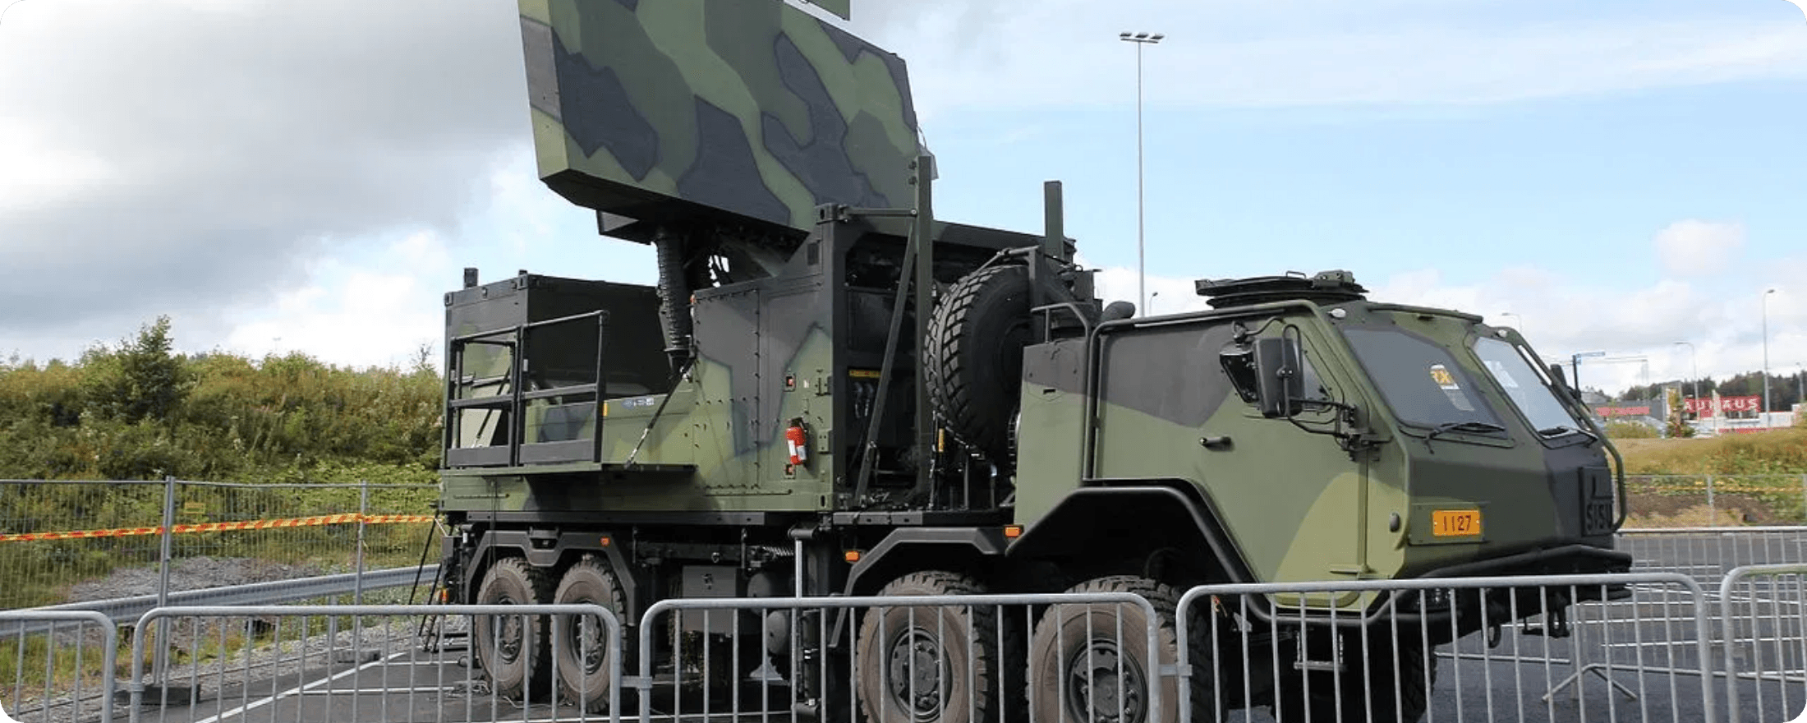


School of AI & Data Science
Mastering Intelligence with Salesforce Einstein
Applied AI: Defense Systems
Machine Learning Foundations
Comprehensive training in algorithms, neural networks, and predictive modeling. Students learn to build and deploy scalable ML models.
Generative AI & RAG
Specialized track on Retrieval-Augmented Generation (RAG). Building context-aware AI systems that leverage proprietary data for accurate outputs.
Case Study: Autonomous Threat Detection
Data Analytics
Turning raw data into actionable insights. Advanced visualization techniques and data storytelling for decision support.
Case Study: Sensor Data Fusion
Curriculum Powered By
Salesforce Einstein & Data Cloud

Slide 5

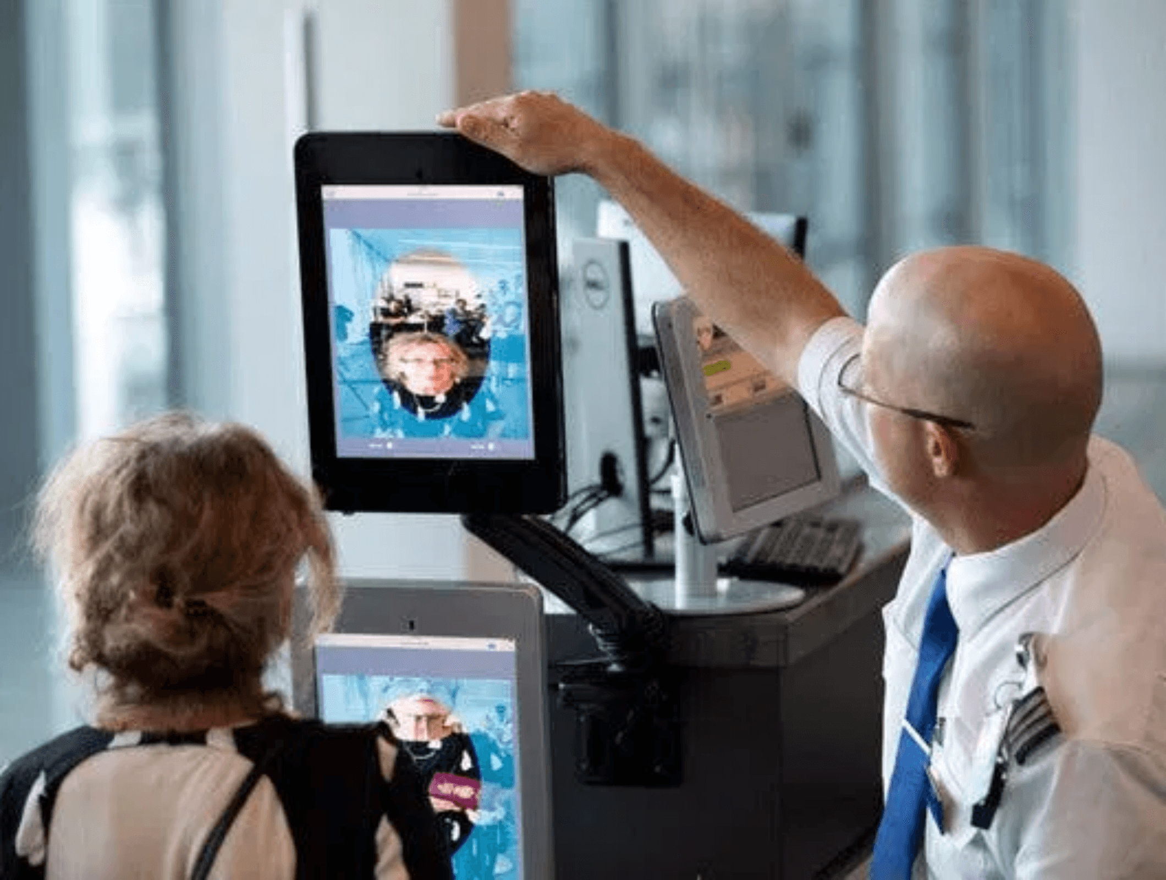



School of Cybersecurity
Mastering the Zero Trust Framework
Curriculum Powered by Thales
Zero Trust Architecture
Deep dive into the "Never Trust, Always Verify" principle. Designing network architectures that assume breach and verify every request.
Data Security (CipherTrust)
Hands-on training with Thales CipherTrust platform for enterprise-grade encryption, key management, and tokenization.
Identity Management Lab
Identity & Access Mgmt (IAM)
Implementing robust IAM solutions using biometrics and multi-factor authentication to secure digital identities.

Slide 6
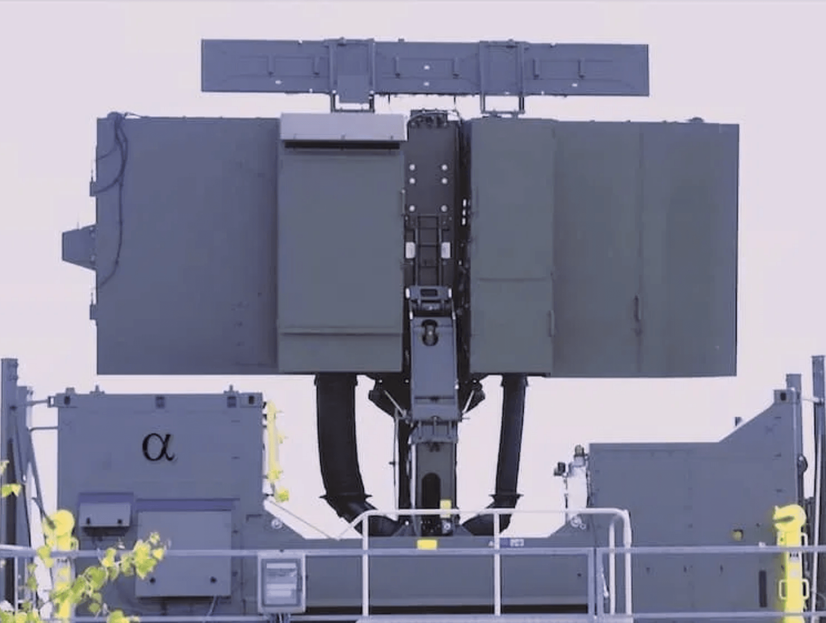



School of Critical Infrastructure
Converging Physical & Digital Defense
Physical Screening Tech
Mastering the operation and maintenance of advanced screening systems for borders and checkpoints.
Rapiscan Systems
OT & IoT Security
Securing Operational Technology (OT) and connected sensors. Learning to protect industrial control systems from cyber threats.
Thales
OT Security Lab
Integrated Command
Managing unified Security Operations Centers (SOCs) that correlate physical alerts with digital threat intelligence.

Slide 7

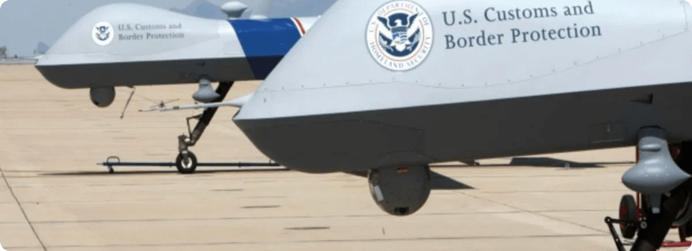

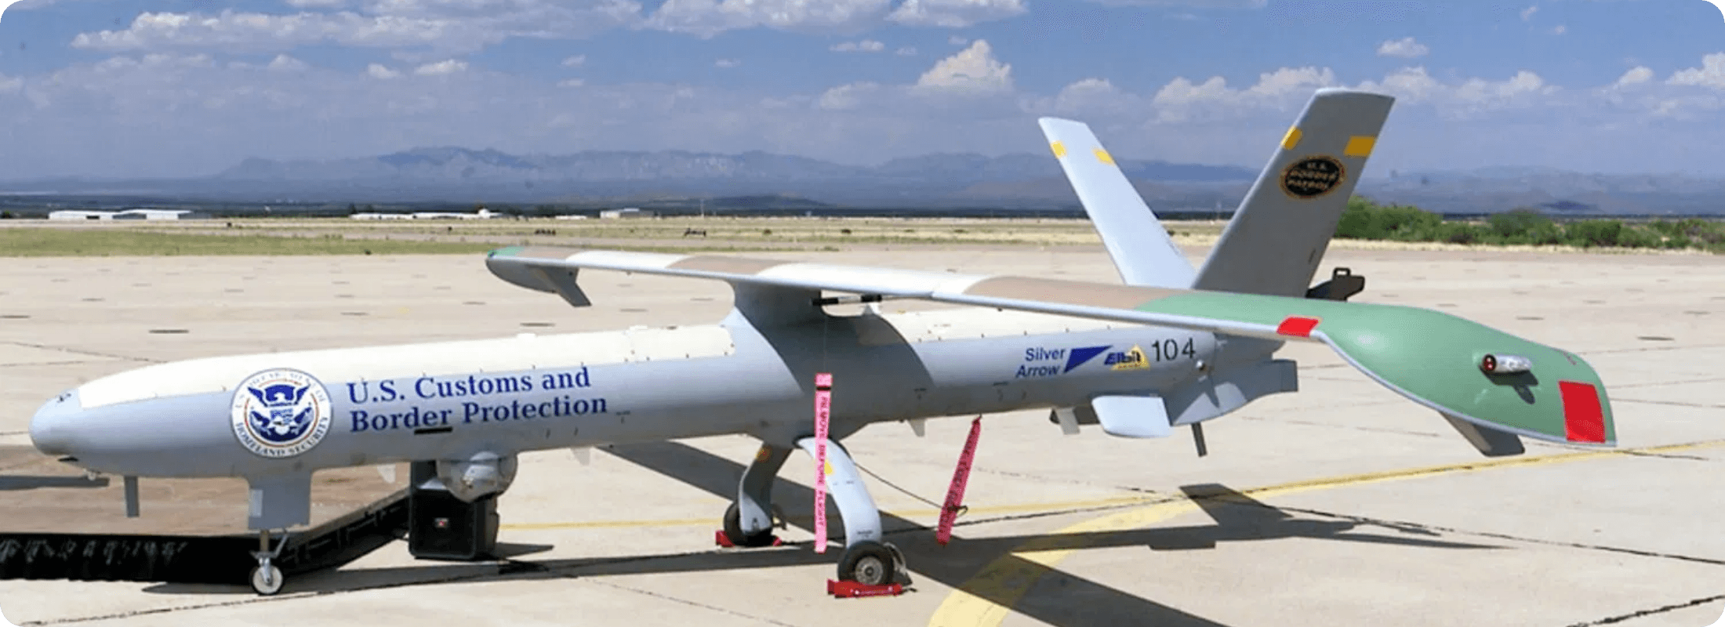


School of Cloud Engineering
Architecting Sovereign Infrastructure & Edge Systems
OCI Architecture
Mastering Oracle Cloud Infrastructure. Designing secure, scalable, and high-availability environments for national data sovereignty.
Edge Computing & IoT
Deploying cloud logic to the tactical edge. Managing low-latency data processing for autonomous systems like UAS and sensor grids.
Application: Edge Intelligence (UAS)
DevSecOps Pipeline
Integrating security into the CI/CD pipeline. Automating compliance and secure code deployment for critical applications.
Application: Real-time Data Ingestion
Oracle Certified Architect Track

Slide 8
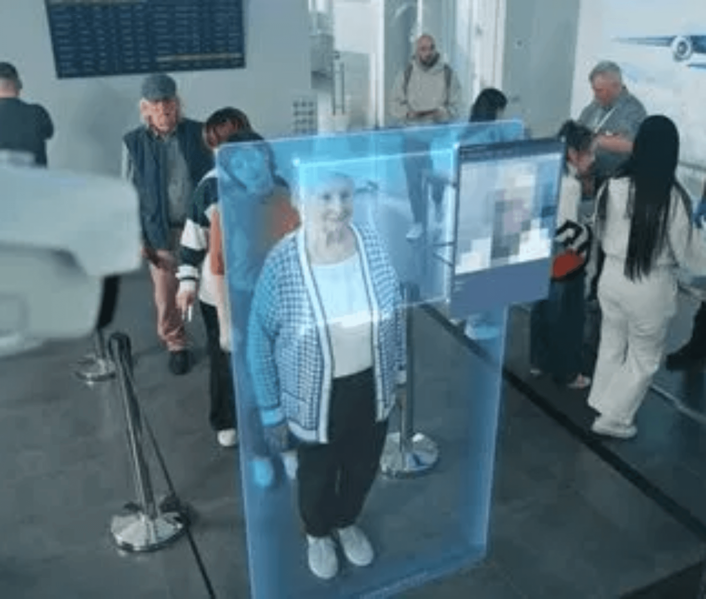



World-Class Certification
Global Recognition for Local Talent
Thales Certified Professional
Zero Trust Architecture, Data Protection, and Identity Management.
Salesforce Credentials
Certified Administrator, AI Associate, and Data Cloud Specialist.
Oracle Cloud Architect
OCI Architect Associate and Cloud Operations Professional.
Global Mobility
Industry Ready
Our graduates earn internationally recognized credentials, ensuring their skills are validated and transferable across the global tech landscape.

Slide 9

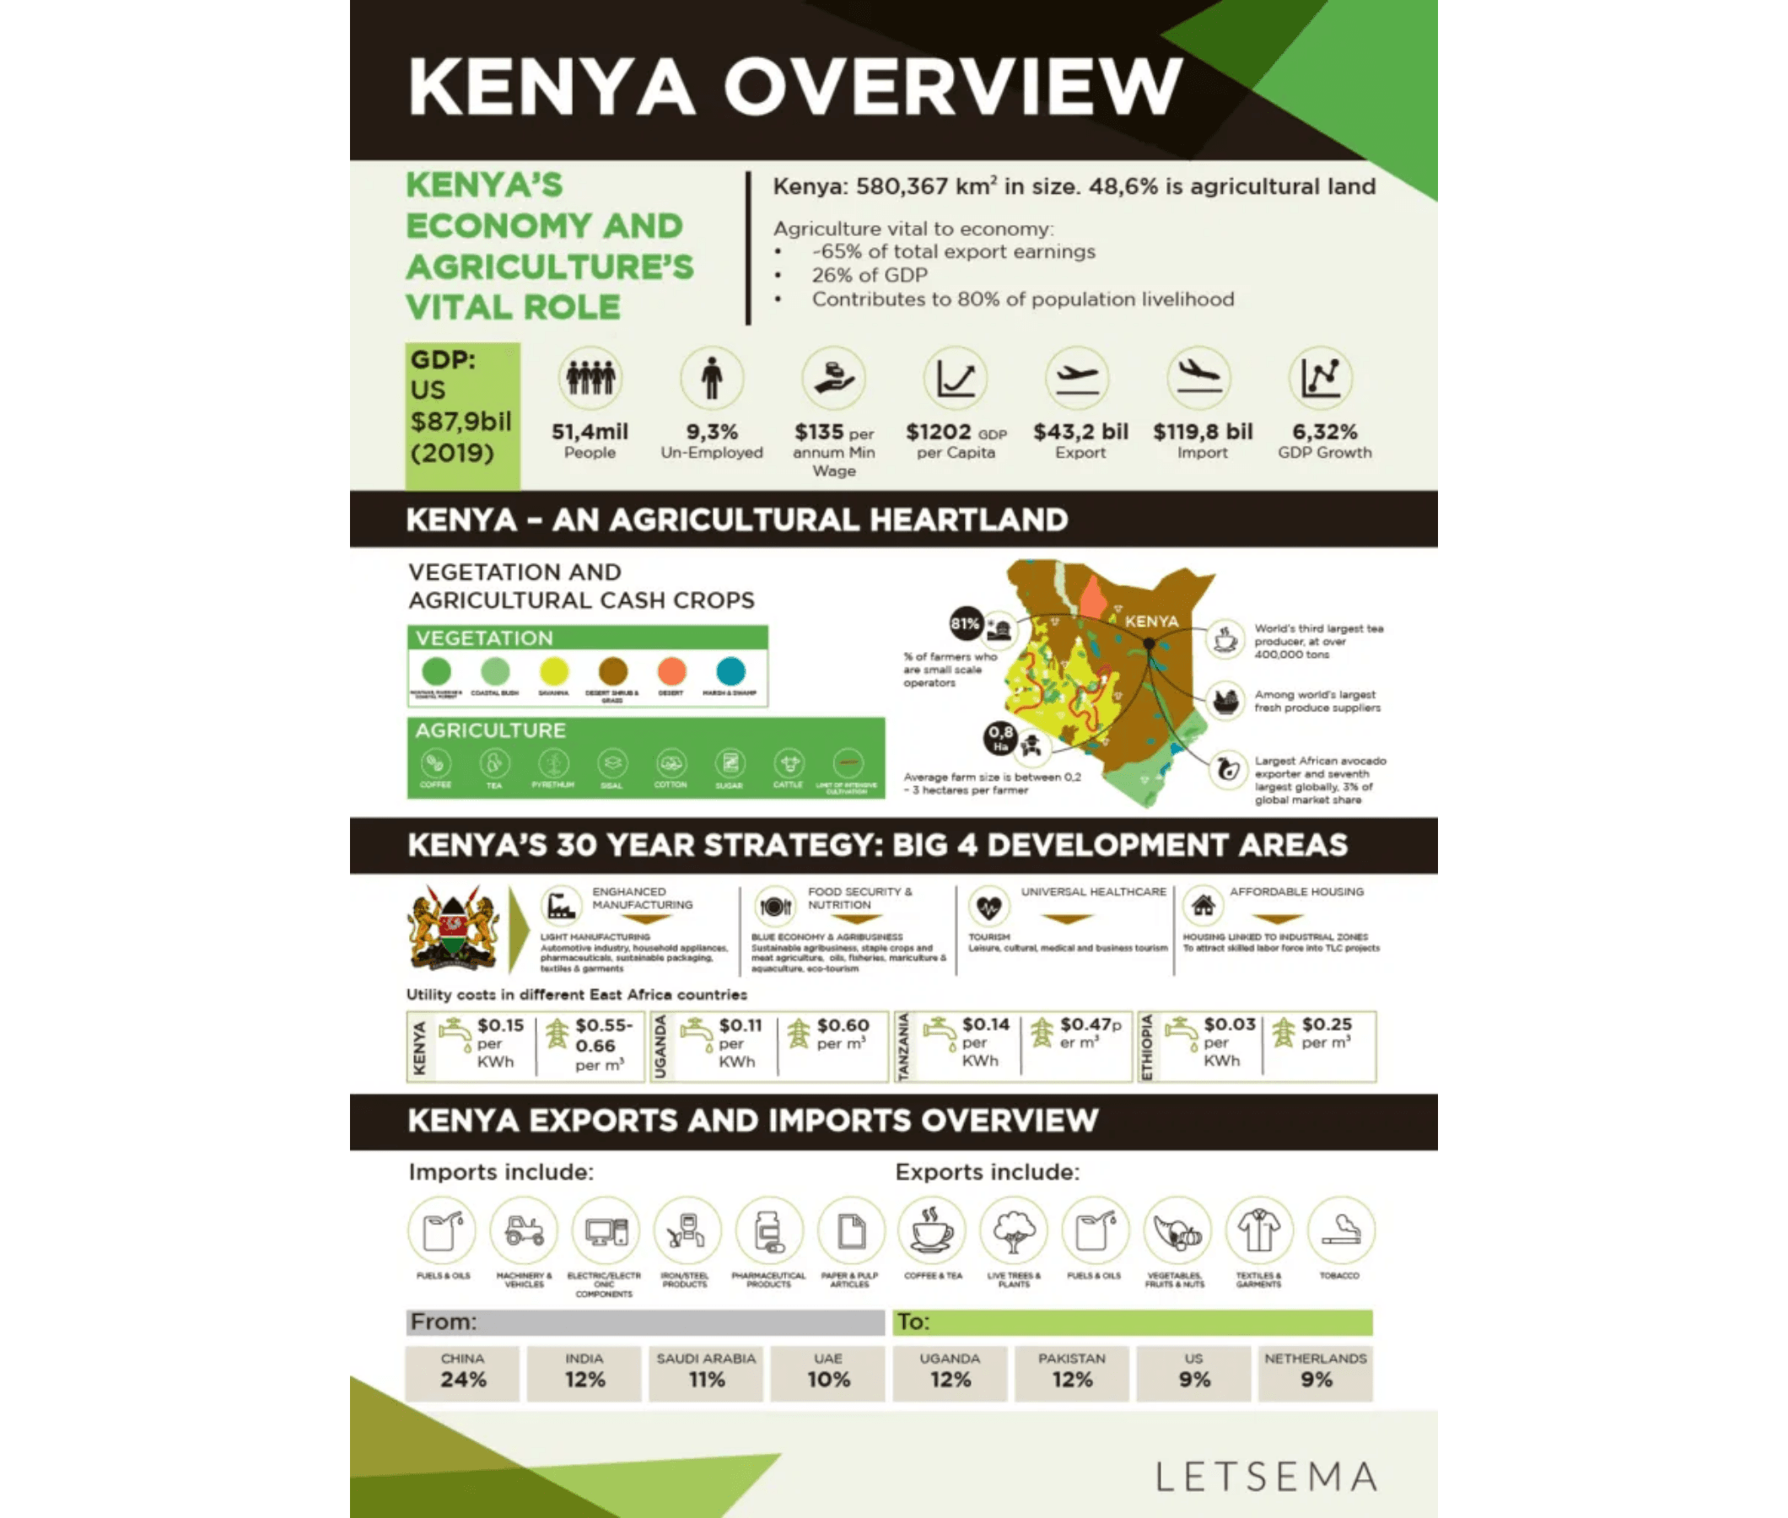



Building Sovereign Capability
From Classroom to National Impact
Talent Independence
Reducing reliance on foreign consultants by cultivating a homegrown workforce capable of managing critical national infrastructure.
Economic Impact Analysis
Economic Multiplier
Tech-enabled sectors drive GDP growth. Our graduates fuel innovation in agriculture, finance, and logistics.
Future Readiness
Preparing the nation for the 4th Industrial Revolution with skills in AI, Robotics, and Advanced Cybersecurity.
100%
3 Key
Local Talent
Sectors Transformed

Slide 10










Admissions & Partnerships
Join the Ecosystem of Excellence
For Students
For Partners
Target Audience
Talent Pipeline
STEM graduates, early-career IT professionals, and software engineers seeking specialization.
Priority access to hire top-tier graduates certified in Thales, Salesforce, and Oracle technologies.
Requirements
Corporate Upskilling
Bachelor's degree in related field, passing score on the Atlas Technical Aptitude Test.
Customized training programs to upgrade the skills of your existing technical workforce.
Next Intake
R&D Collaboration
Applications open for the September 2025 Cohort.
Partner with the Academy on capstone projects to solve your specific business challenges.
Apply or Partner Today
www.atlas-academy.africa
admissions@atlas-academy.africa
Secure your place in Africa's digital future.

